Slide 1
Ch. 1 – Introduction
Supplemental slides for CSE 327
Prof. Jeff Heflin

Slide 2
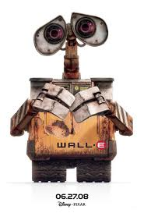
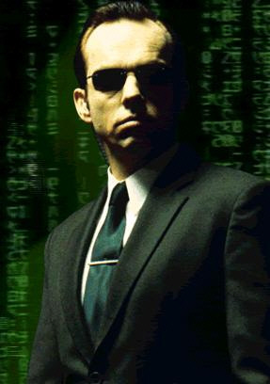
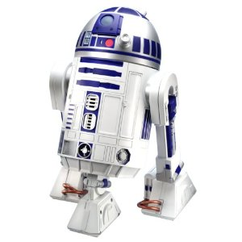
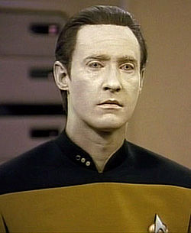
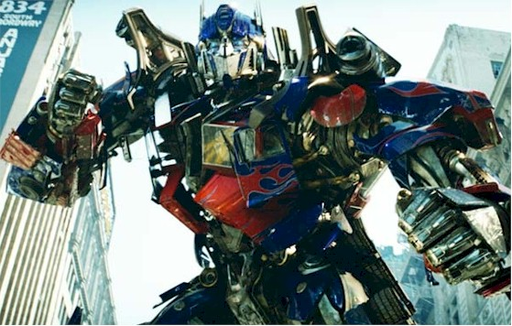
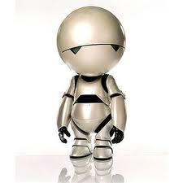
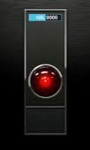
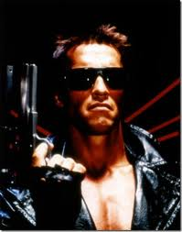
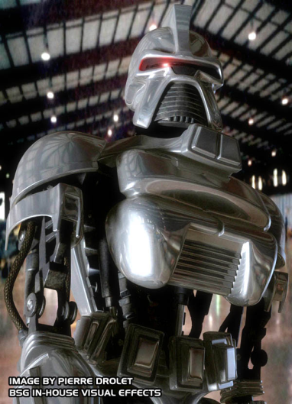
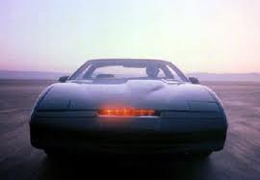
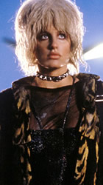
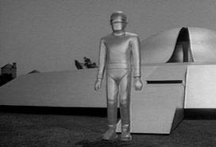
Test Your SciFi IQ
Optimus Prime – Transformers (2007)
WALL-E – WALL-E (2008)
Agent Smith – The Matrix (1999)
R2D2 – Star Wars (1977)
Commander Data – Star Trek TNG (1987)
Marvin – The Hitchhiker’s Guide to the Galaxy (2005)
HAL900 – 2001:A Space Odyssey (1968)
K.I.T.T. – Knight Rider (1982)
T-800 – The Terminator (1984)
Cylon – Battle Star Galactica (1978/2004)
Priss – Blade Runner (1982)
Joshua – WarGames (1983)
Gort – The Day the Earth Stood Still (1951)
Notes:
R2D2, Optimus Prime, Commander Data, Agent Smith, Terminator, Cylon, K.I.T.T., War Games, HAL, Marvin, Gort, Priss

Slide 3
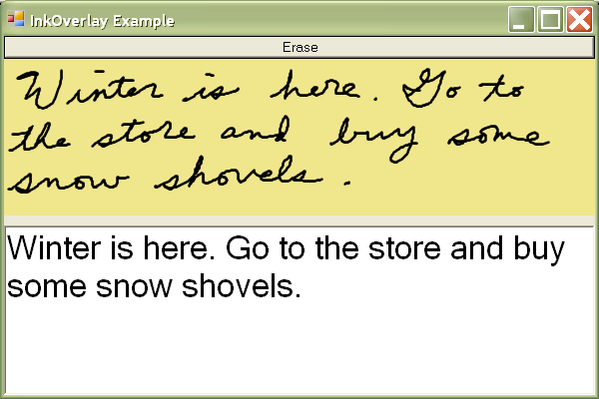
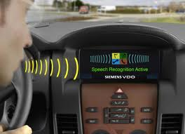
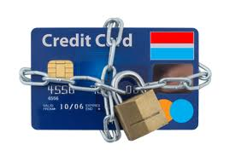
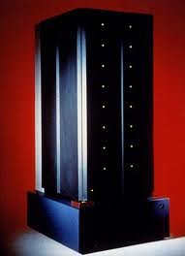
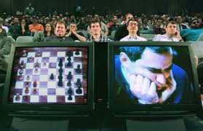
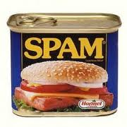
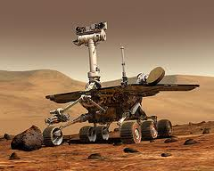
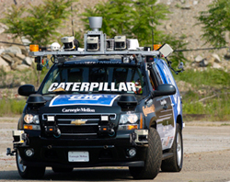
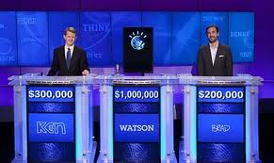
Test Your Real AI IQ
GRAIL (1969): handwriting recognition
HELP (1975): hospital decision support system
DRAGON (1975): speech recognition
Falcon (1995): Credit card fraud monitoring
Deep Blue (1997): beat world chess champion
SpamAssassin (2001): kills spam
MAPGEN (2004): handled routine plans for Mars Rover missions
BOSS (2007): won DARPA Urban Challenge
Watson (2011): beat human Jeopardy! champions
Notes:
GRAIL (1969): Handwriting recognition
Medical Expert Systems (1975-present):
- HELP (1975): Hospital decision support system
- PUFF (1979): interprets lung disease test results
- APACHE (1981): predicts risk of patient death
DRAGON (1975): speech recognition
Deep Blue (1997): beat world chess champion
Falcon (1998): Credit Card Fraud monitoring by HNC software, uses neural networks and expert rules, latest version now used by many banks
SpamAssassin (2001): Uses Bayseian rules to classify Spam
MAPGEN (2004): handled routine plans for Mars Rover missions [mixed initiative planer]
BOSS (2007): won DARPA Urban Challenge
Watson (2011): beat human Jeopardy! champions
Other:
Remote Agent - Deep Space 1 probe
RoboCup
Logistics Planning (Desert Storm)

Slide 4
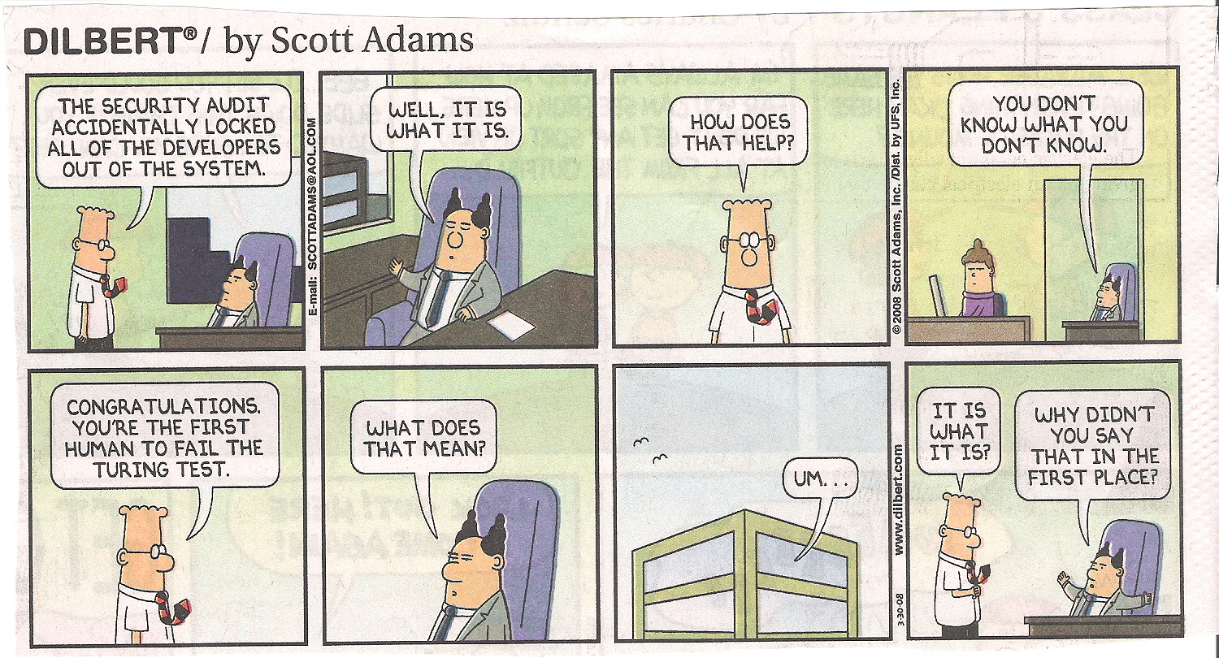
The Turing Test

