Slide 1
CSE 428 Semantic Web Topics Introduction
Jeff Heflin
Lehigh University

Slide 2
The Semantic Web
“Semantic” + “Web”
Semantic: "of or relating to meaning in language" (Def. Webster’s)
Web: The World Wide Web
Official Definition
The Semantic Web is not a separate Web but an extension of the current one, in which information is given well-defined meaning, better enabling computers and people to work in cooperation. (Berners-Lee et al., Scientific American, May 2001)
Knowledge Graph
A model that describes object of interest and connections between them
A practical outcome of Semantic Web research

Slide 3
Knowledge Graphs in Industry
Technology companies¹
Google, Amazon, Facebook, eBay, Airbnb, IBM Research, Microsoft
Financial companies
Goldman Sachs, Capital One, Wells Fargo
Others
Thomson-Reuters, Astrazeneca, etc.
¹ Noy et al., Industry-Scale Knowledge Graphs: Lessons and Challenges, Comm. of the ACM, 62(8) , August 2019.
Notes:
From ISWC 2018 panel “Enterprise Knowledge Graphs” and Columbia May 2019 Knowledge Graph Conference (http://sps.columbia.edu/executive-education/knowledge-graph-conference)

Slide 4
Ontologies
Often used in conjunction with knowledge graphs
Like schemas, but “turbo-charged”
Structure data but also help machines to interpret it
Ontologies define the semantics of the terms used in knowledge graphs
identify context, provide shared definitions
has a formal syntax and unambiguous semantics
usually includes a taxonomy, but typically much more
Inference algorithms can compute what logically follows

Slide 5
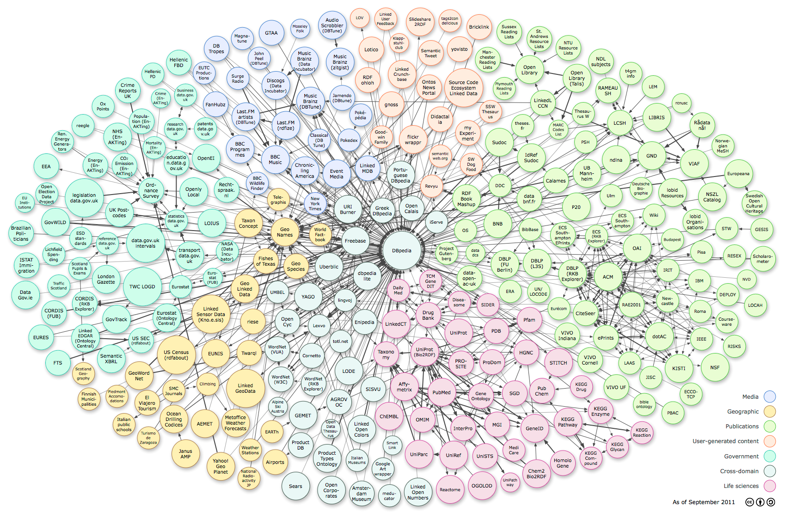
Linked Data
> 150 billion public facts from over >3000 data sets
Notes:
Stats taken from stats.lod2.eu on 6/27/17

Slide 6
Semantic Web Standards
World Wide Web Consortium (W3C) Recommendations
RDF(S) (1999, revised 2004)
essentially semantic networks with URIs
XML serialization syntax
OWL (2004)
Web Ontology Language
extends RDF with more semantic primitives
based on description logics (DLs)
has a model theoretic semantics
rdfs:Class
rdf:Property
<owl:Class rdf:ID=”Band”> <rdfs:subClassOf> <owl:Restriction> <owl:onProperty rdf:resource=”#hasMember” /> <owl:allValuesFrom rdf:resource=”#Musician” /> </owl:Restriction> </rdfs:subClassOf> </owl:Class>
A Band is a subset of the groups which only have Musicians as members
rdf:type
rdf:type
rdf:type
g:Person
rdfs:domain
rdfs:subclassOf
u:Chair
g:name
rdf:type
g:name
John Smith

Slide 7
A Web of Ontologies
S₁
S₂
commits to
Dublin Core
alignment
Foaf
Region
alignment
alignment
alignment
Citeseer
DBLP
alignment
Congress
commits to
commits to
AIGP
NSF Awards
commits to
S₃
S₄
commits to
S₇
commits to
Low barrier to sharing data
Anyone can propose and share an alignment
Semantics emerge as ontologies are aligned
S₅
S₆

Slide 8
The End

Slide 9
URIs and Namespaces
URI
Uniform Resource Identifier
includes URLs
but also anything that you can design an identification scheme for
helps to prevent collision of names
all the “symbols” in RDF are either URIs or Literals
Namespace
a mechanism for abbreviating URIs
by assigning a prefix for a URI fragment
Notes:
URIs help prevent the same name from being used to denote two different things

Slide 10
Semantic Web Challenges
The Web is distributed
many sources, varying authority
inconsistency
The Web is dynamic
representational needs may change
The Web is enormous
systems must scale well
The Web is an open-world

Slide 11
Semantic Web Layer Cake
From W3C
(March 2007)

Slide 12
Why Study Semantic Web?
Open source Semantic Web tools
from IBM, Hewlett-Packard, Nokia, etc.
Commercial software vendors
Oracle 11g RDBMS supports RDF and much of OWL
Adobe’s products use RDF to provide metadata for documents, photos
Semantic Web specific companies: TopQuadrant, Aduna Software, etc.
>400 million Semantic Web documents (as of October 2011)
Yahoo SearchMonkey uses RDF to present richer search results
Google now indexes RDFa (a means for embedding RDF in web pages)
Semantic Web enabled sites
Data.gov: much of U.S. government’s open data is available in RDF
Newsweek: annotates articles with RDFa
BBC Music: exports RDF playlists, RDF for all artists
Harper’s Magazine: connects articles to events on a timeline
DBPedia: a Semantic Web version of Wikipedia
BestBuy publishes product and store information in RDF
Notes:
65 million figure comes from Sindice – includes microformats
Oct. 2009: Google finds 463,000 RDF, 30,000 OWL, 51,000 XML with RDF keyword
System Integration costs source: Semantic Technology Conference materials
Other companies:
Boeing: integrate work of partners involved in airplane design
Chevron: manage the life cycle of power plants and oil refineries
British Telecom: online service to help vendors work together
Harper’s Magazine: web site that connects articles to events on a timeline

