Slide 1
Peter Arquin

Slide 2
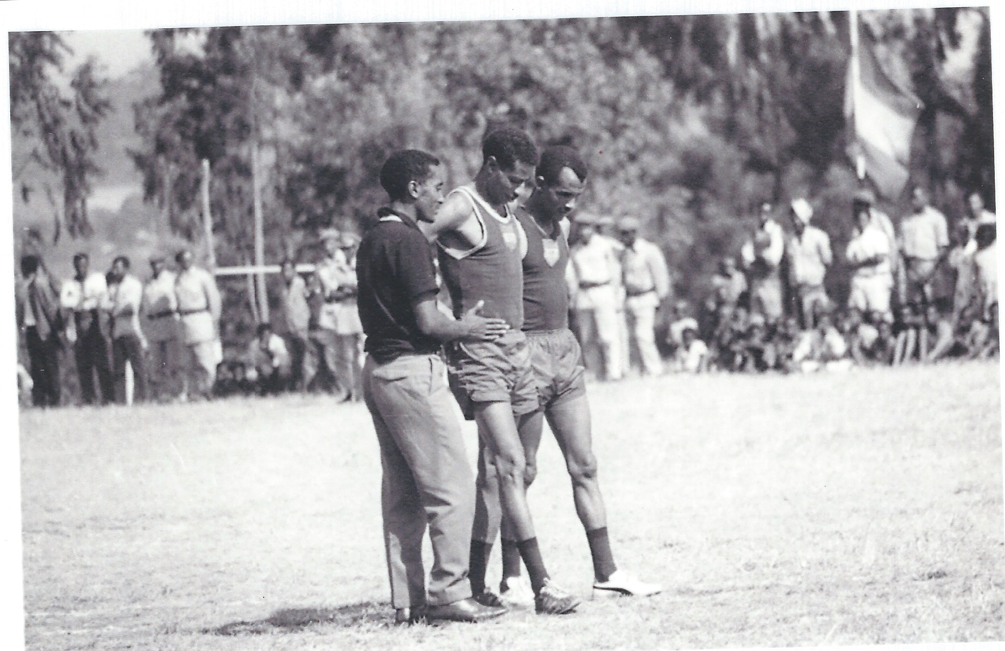

Slide 4
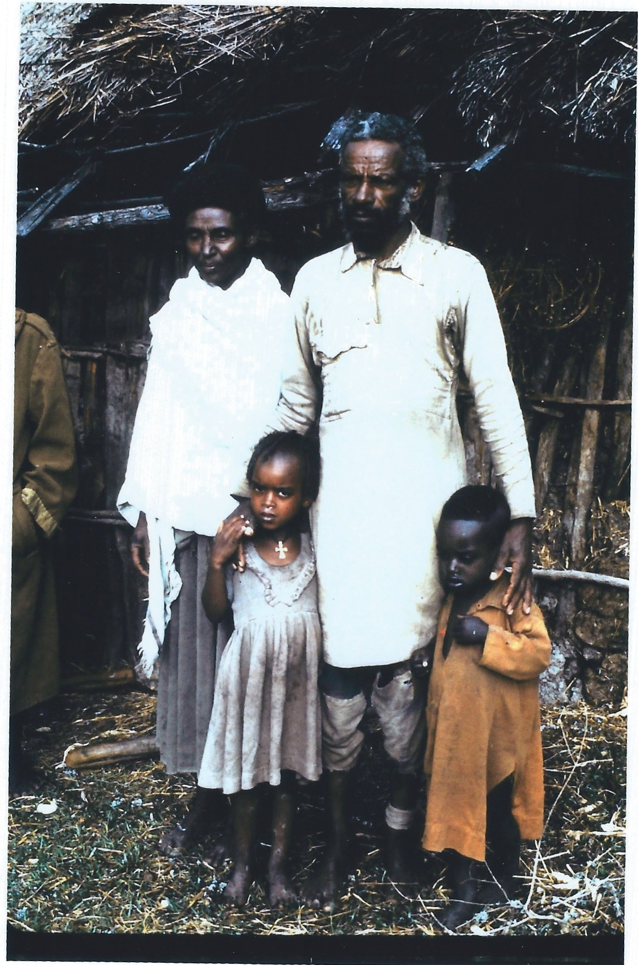

Slide 5
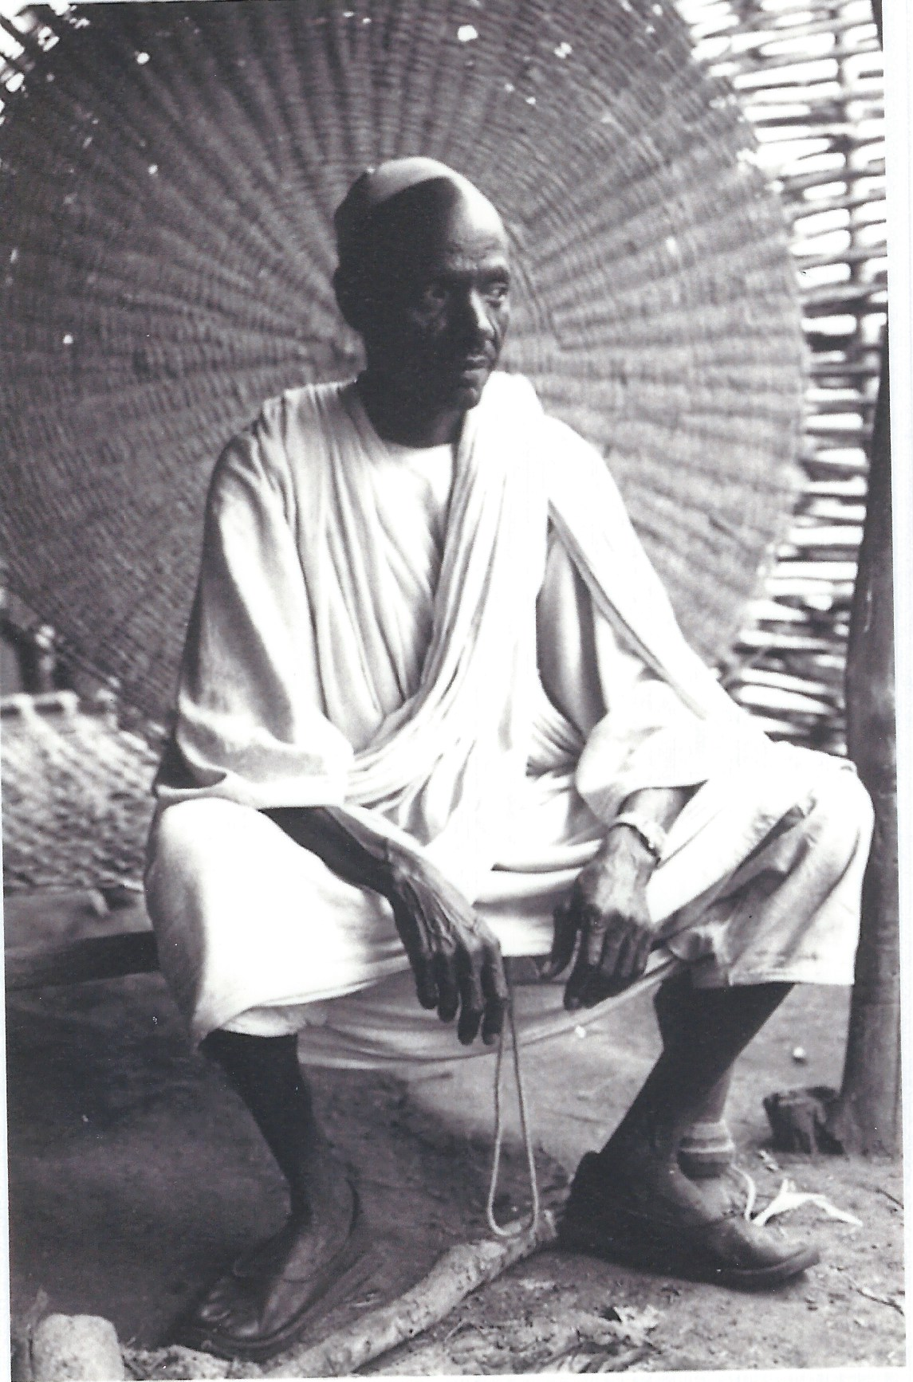

Slide 6
Diane Dilendik

Slide 7
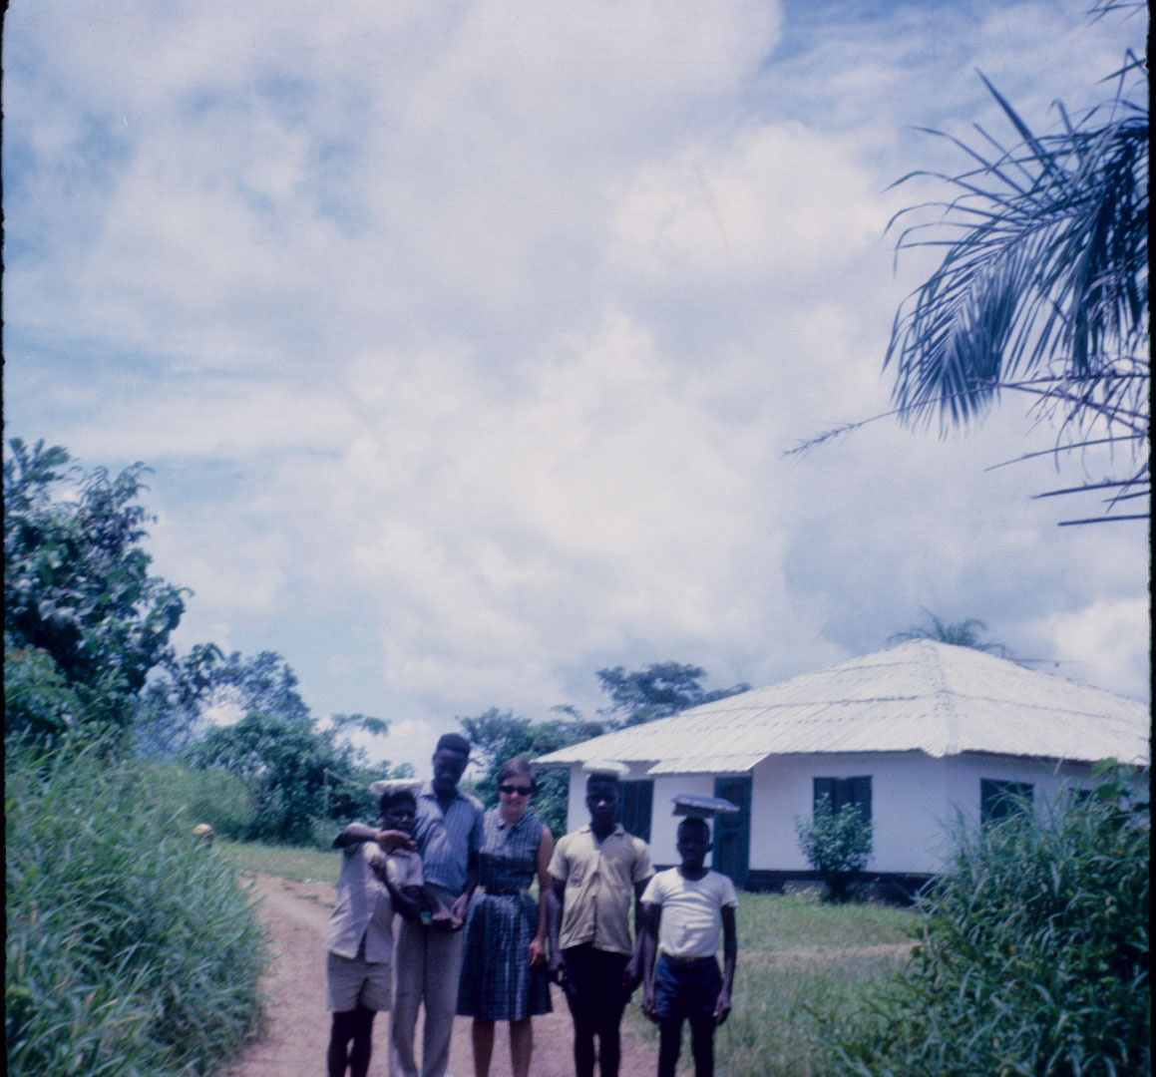

Slide 8
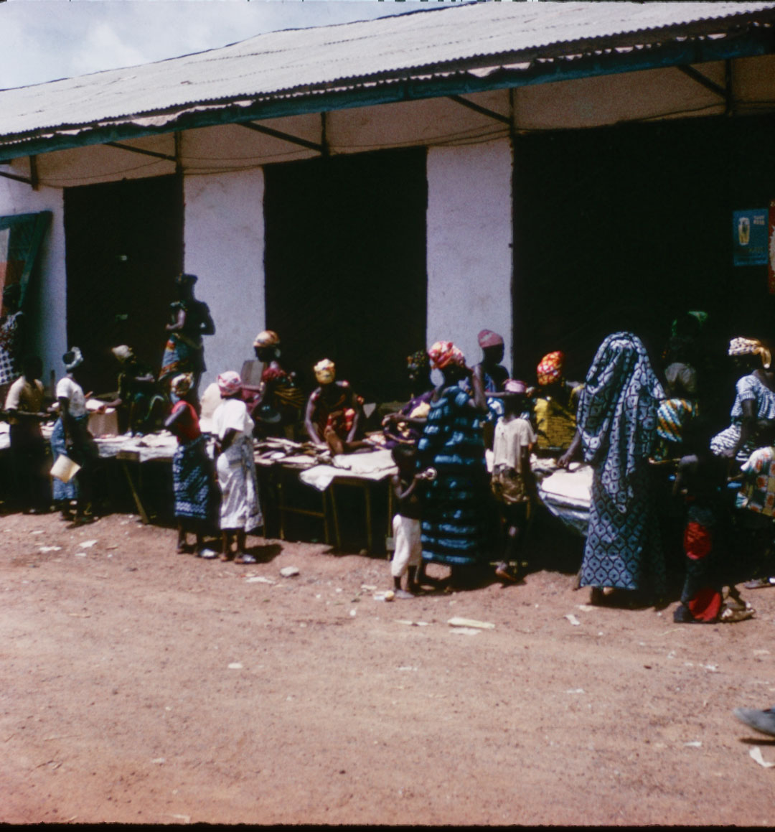

Slide 9
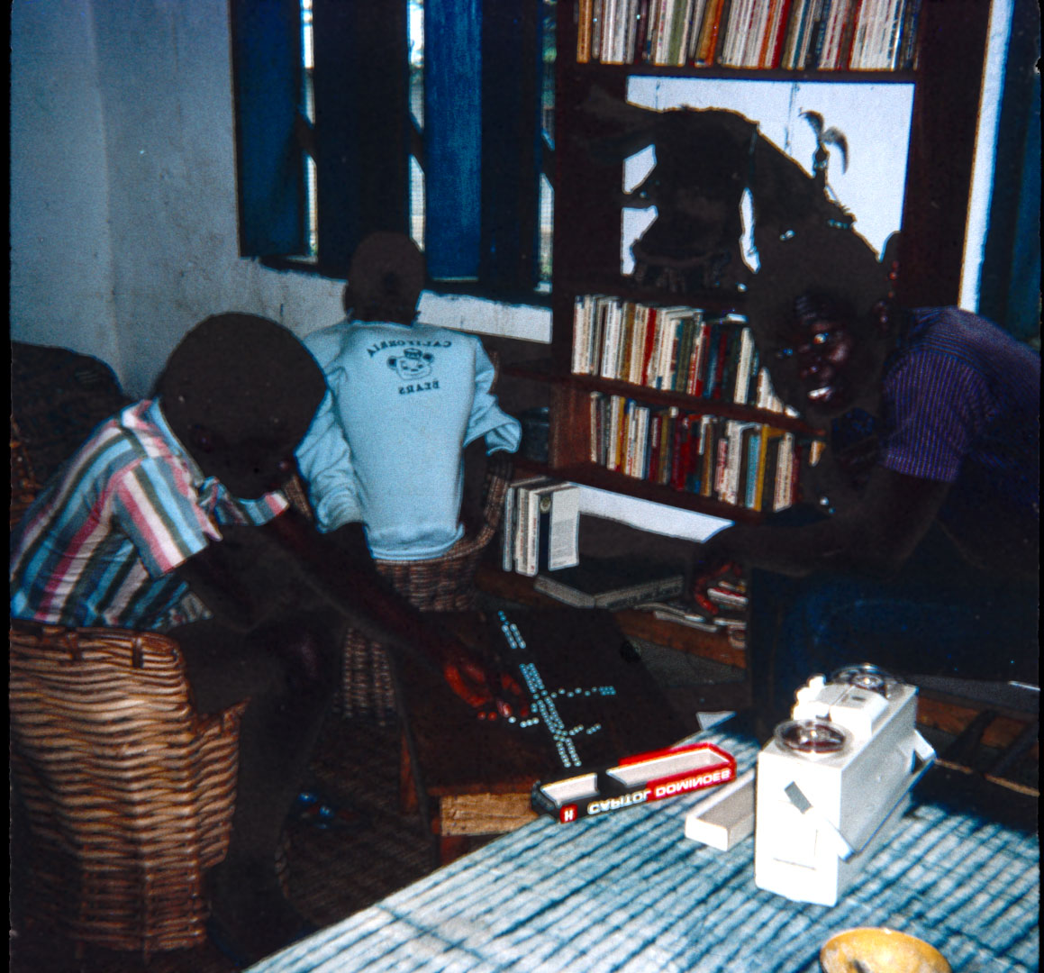

Slide 10
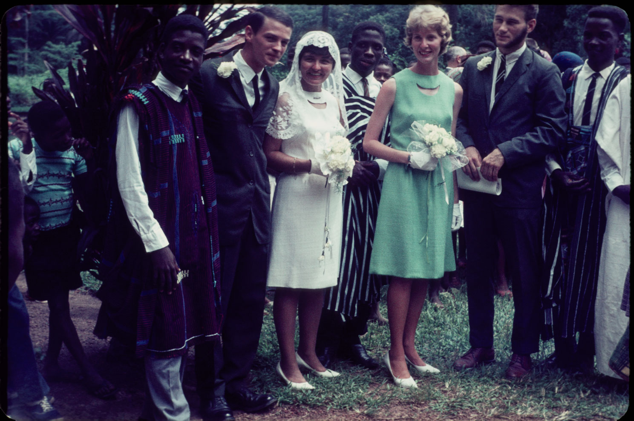

Slide 11
Christine Musa

Slide 12
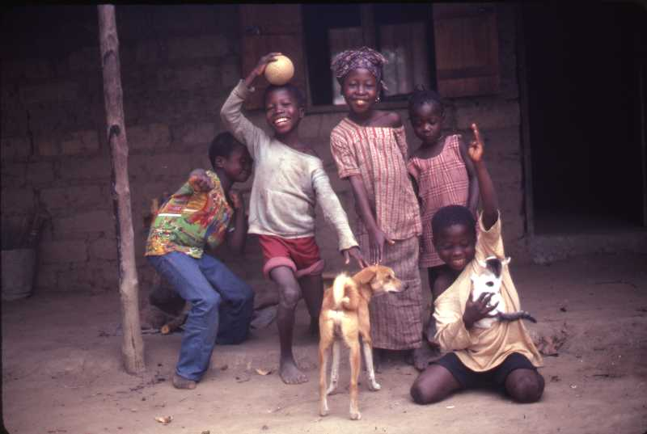
KIDS FROM THE NEIGHBORHOOD AT THE BACK OF MY HOUSE IN YARYA, SIERRA LEONE
(USED IN 2011 RPCV CALENDAR)

Slide 13
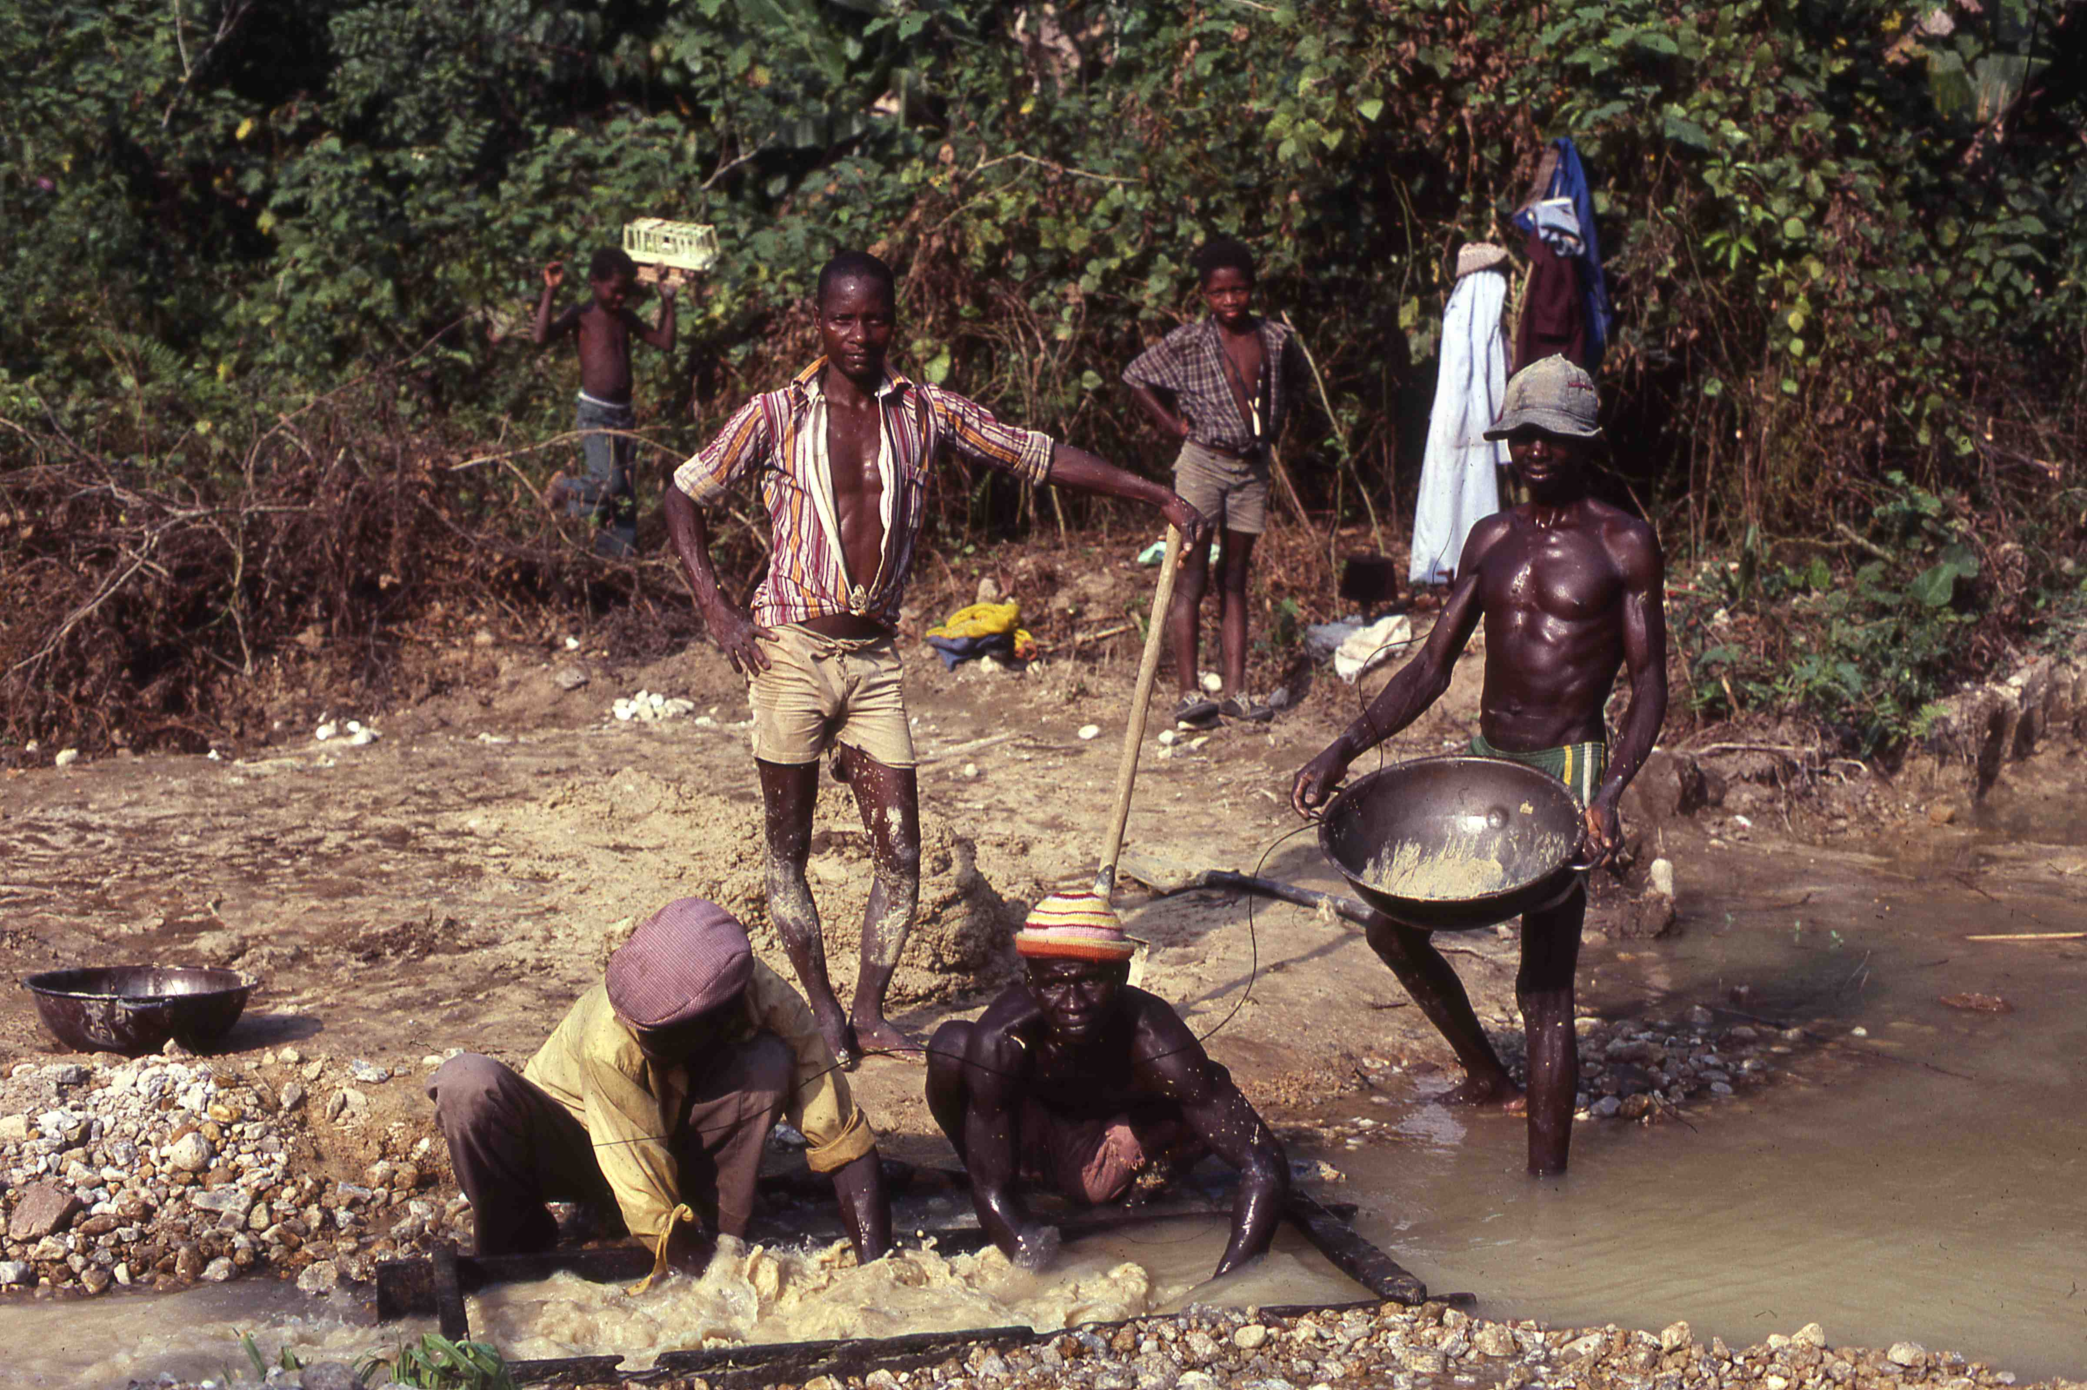
FRIENDS WASHING FOR DIAMONDS IN KONO DISTRICT

Slide 14
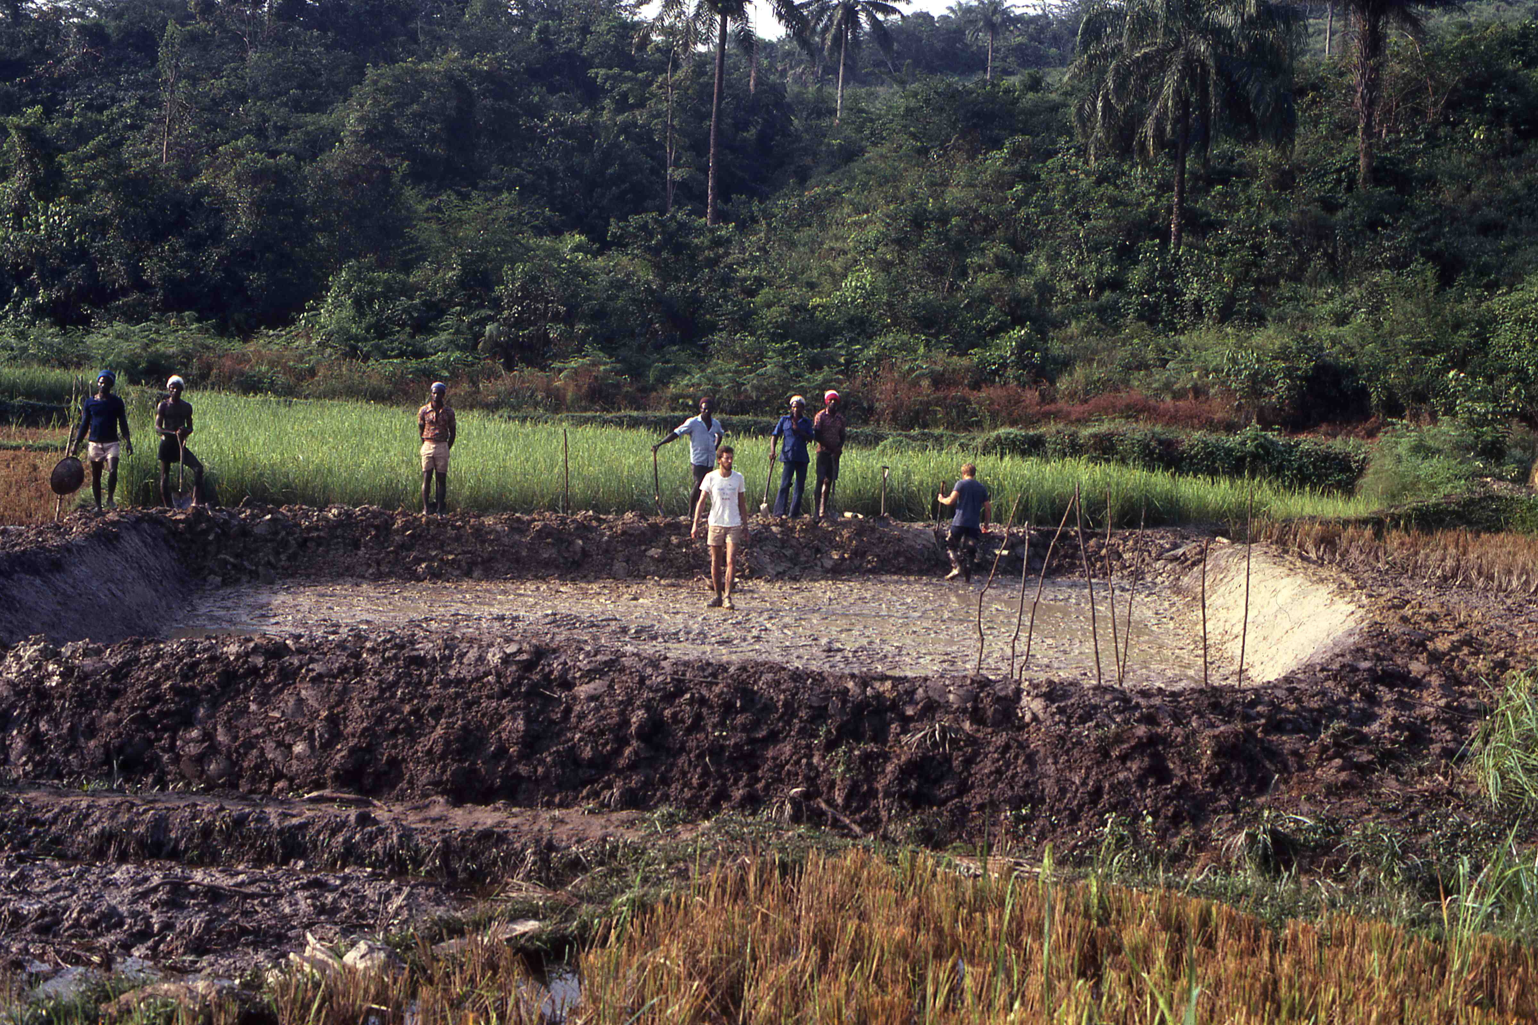
FISHPOND CONSTRUCTION FOR TILAPIA CULTURE

Slide 15
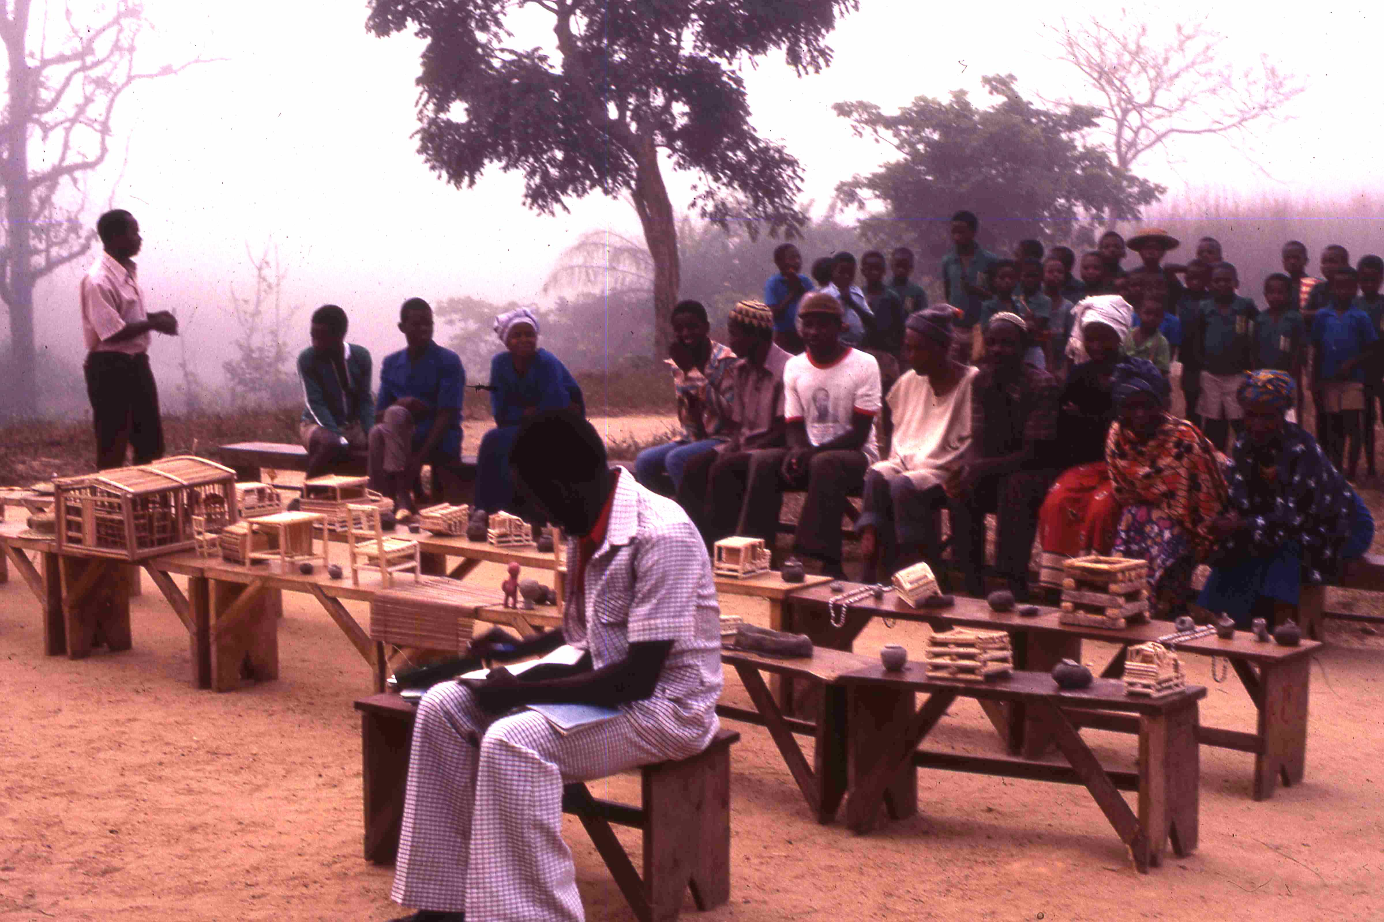
SEE NEXT SLIDE

Slide 16
Students presenting crafts (in presence of their families) which I asked for in exchange for books for the school. I sent crafts home & sold them after I got back to pay for those books. Essentially the students/families paid for their own books, which was the whole idea. I was opposed to handouts.

Slide 17
Mimi Stanford

Slide 18
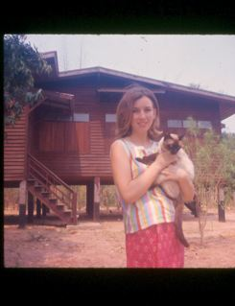

Slide 19
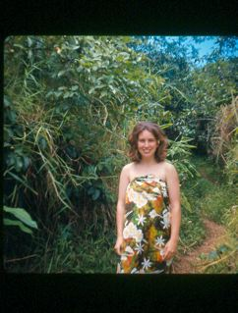

Slide 20
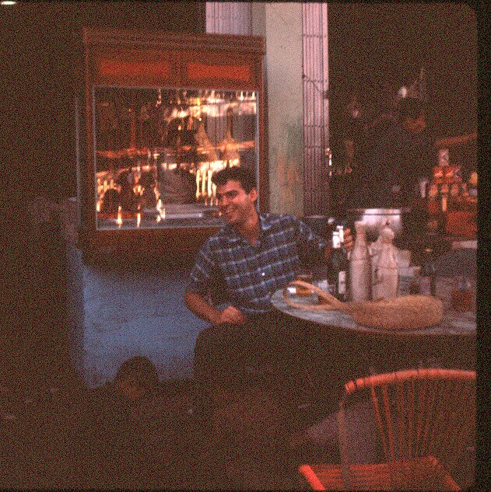

Slide 21
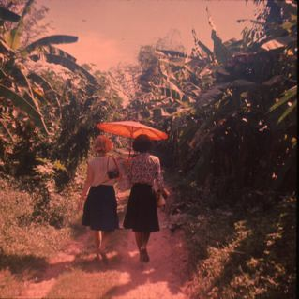

Slide 22
BRUCE WHITEHOUSE

Slide 23
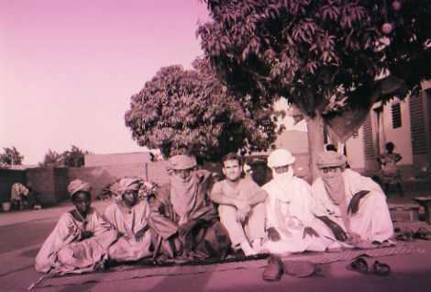

Slide 24
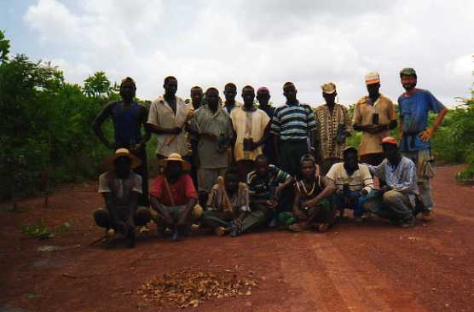

Slide 25
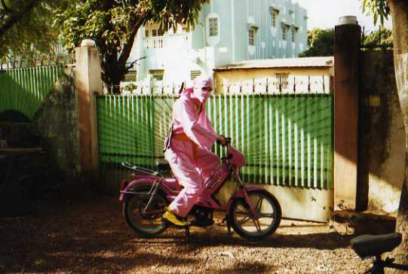

Slide 26
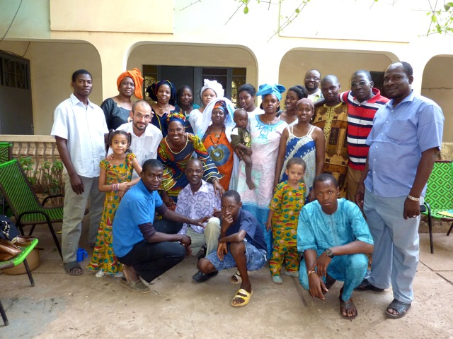

Slide 27
Susan Norling

Slide 28
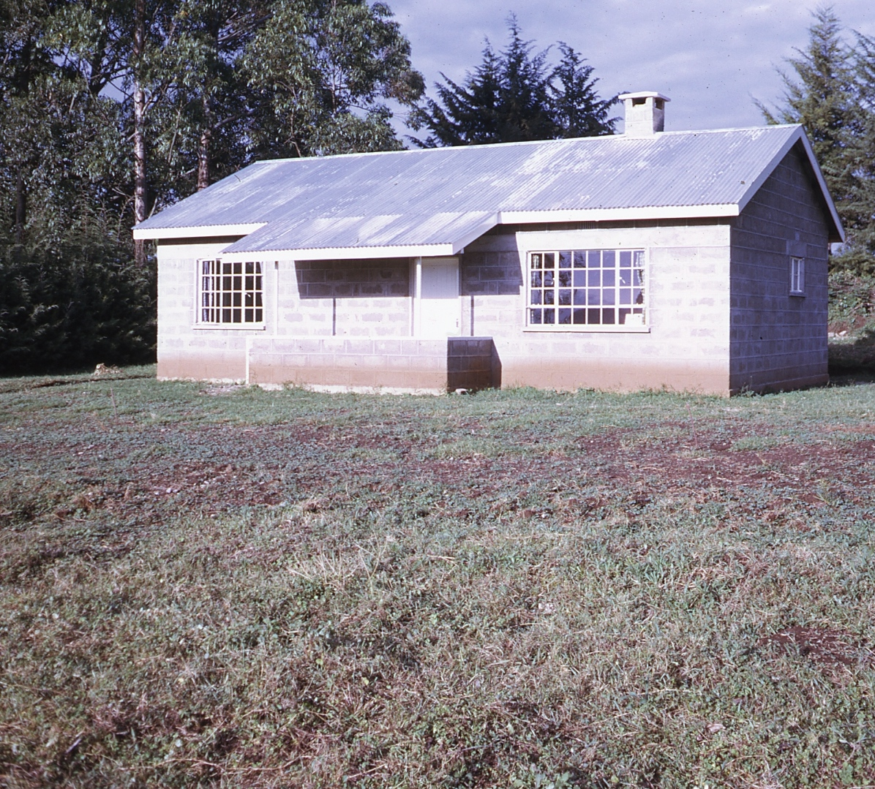

Slide 29
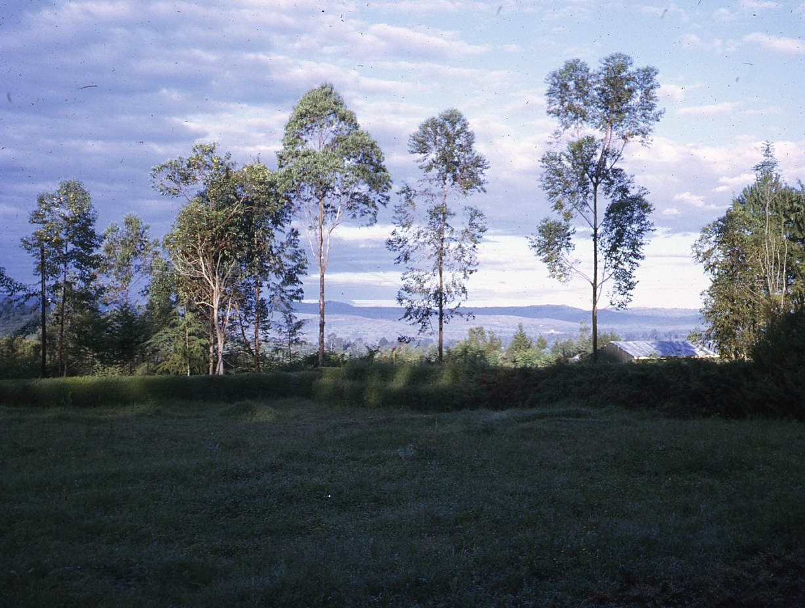

Slide 30
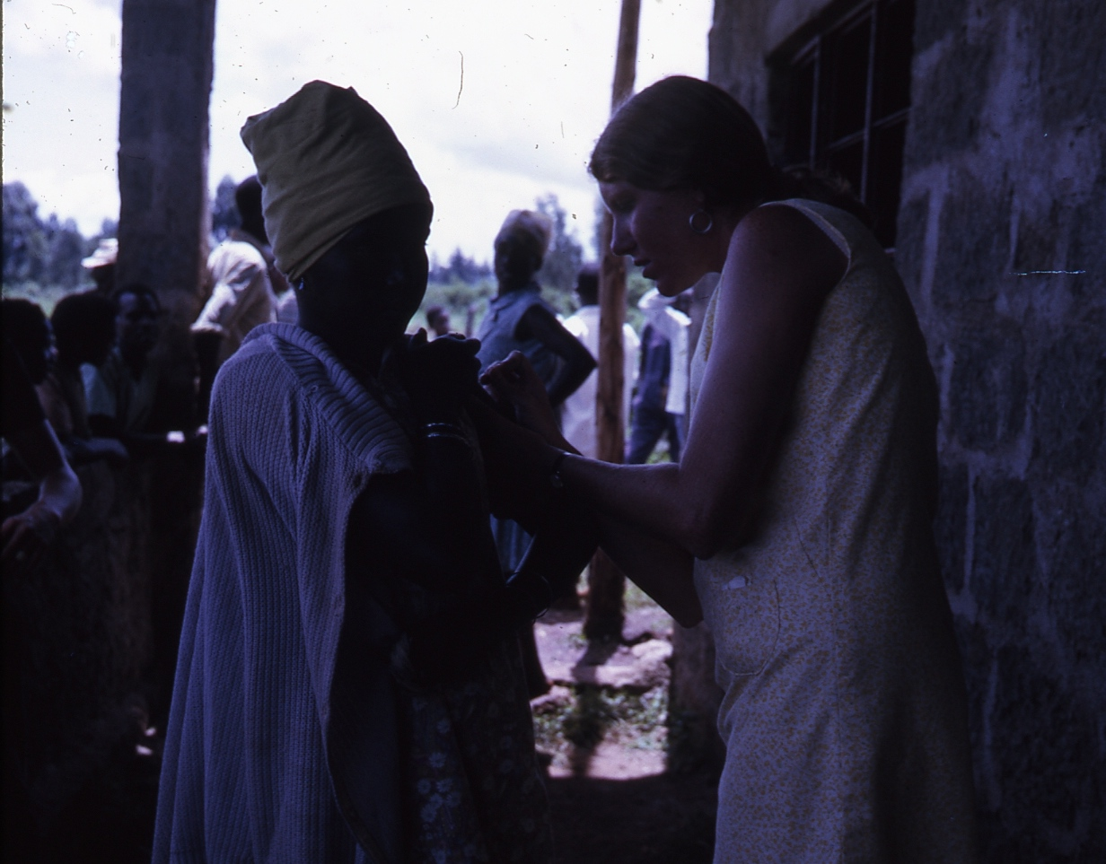

Slide 31
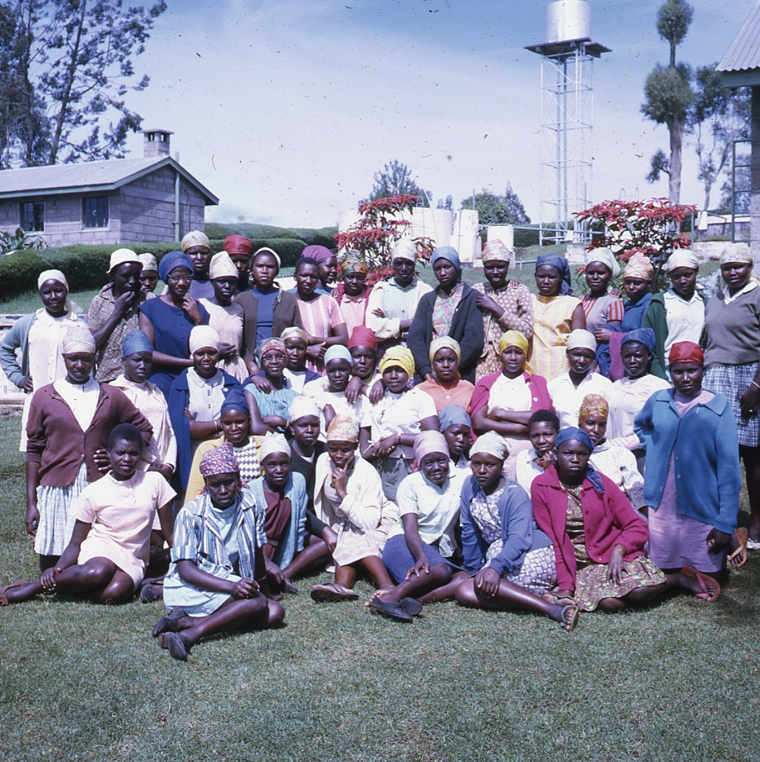

Slide 32
JANNIE & EDWIN KAY

Slide 33
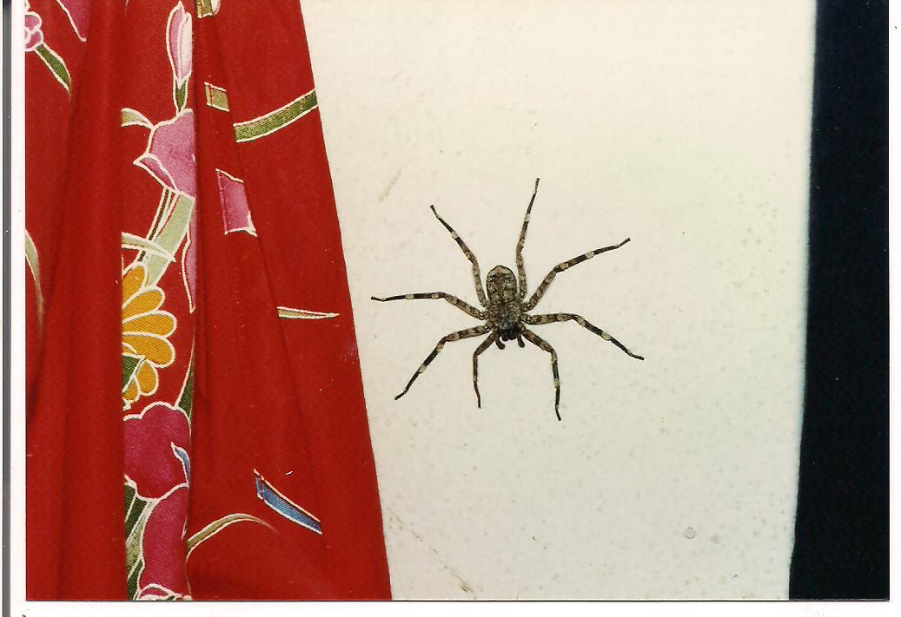

Slide 34
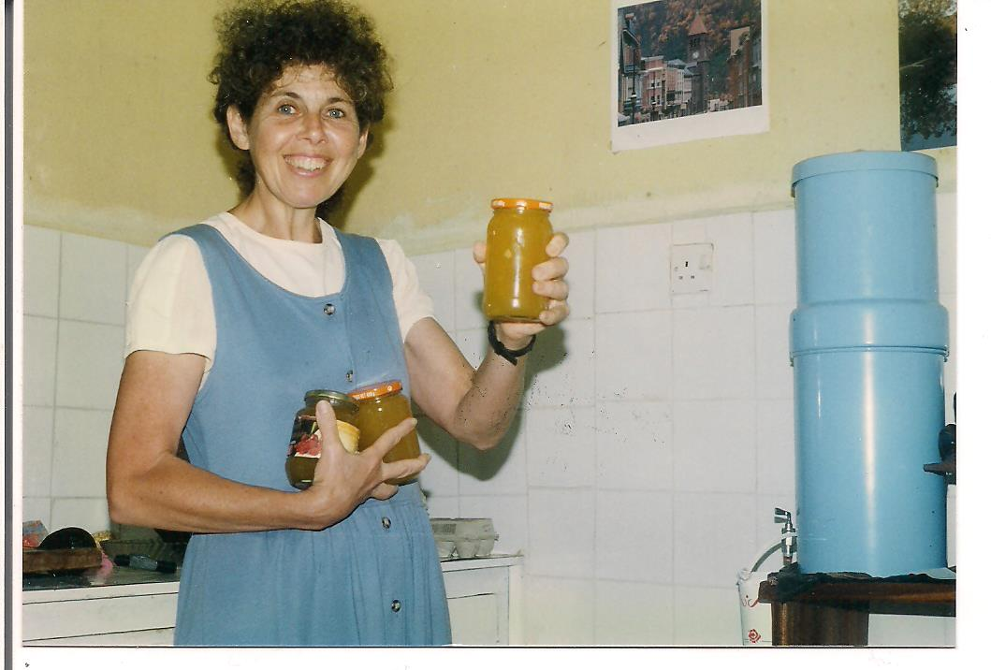

Slide 35
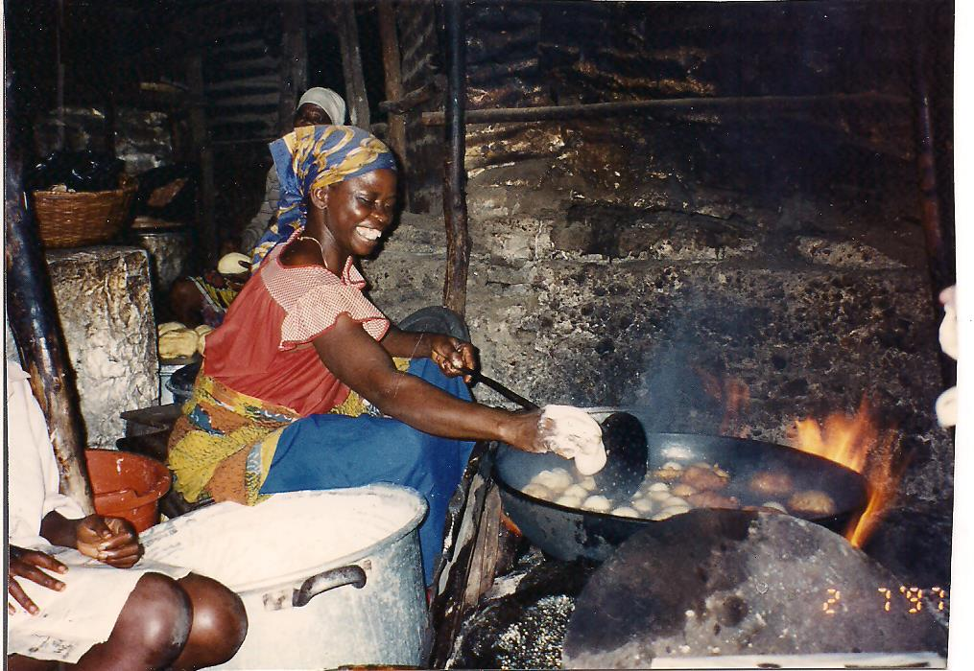

Slide 36
