Slide 1
Ch. 1 – Introduction
Supplemental slides for CSE 327
Prof. Jeff Heflin

Slide 2
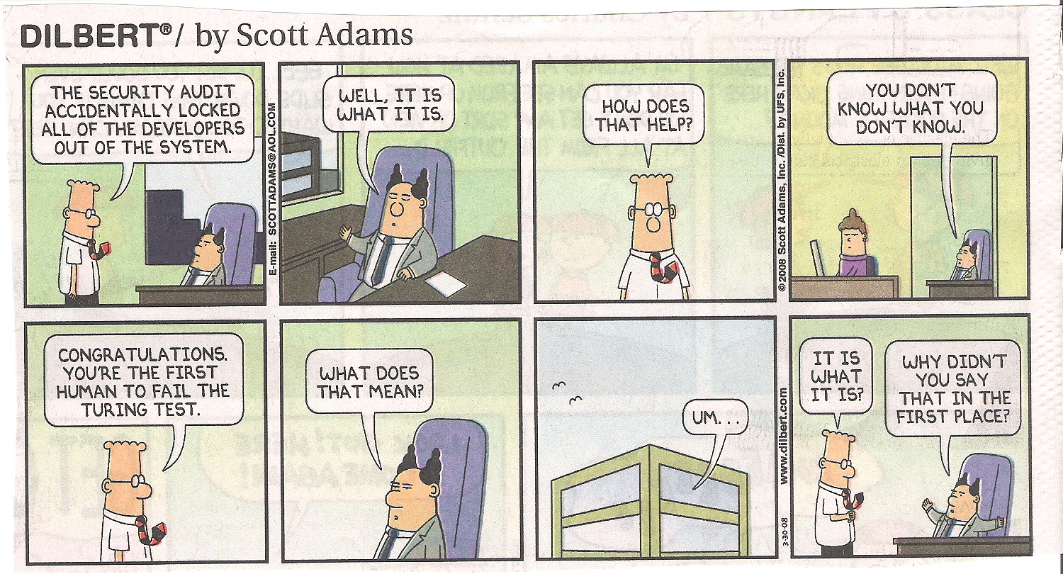
The Turing Test

