Slide 1
Introduction to the Semantic Web
Jeff Heflin
Lehigh University

Slide 2
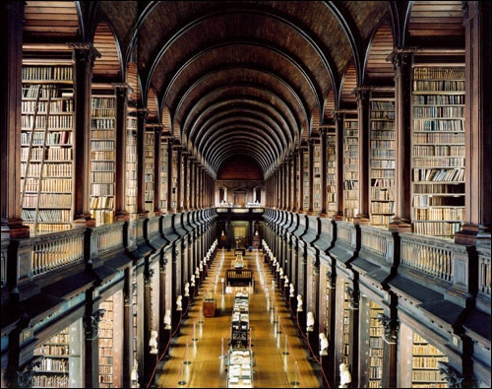

What should the Web be?
A giant library?
or
A giant brain?

Slide 3
The Semantic Web
Definition
  The Semantic Web is not a separate Web but an extension of the current one, in which information is given well-defined meaning, better enabling computers and people to work in cooperation. (Berners-Lee et al., Scientific American, May 2001)
Ontology
  a key component of the Semantic Web
  ontologies define the semantics of the terms used in semi-structured web pages
    identify context, provide shared definitions
    has a formal syntax and unambiguous semantics
    usually includes a taxonomy, but typically much more
  inference algorithms can compute what logically follows

Slide 4
Semantic Web Standards
World Wide Web Consortium (W3C) Recommendations
RDF(S) (1999, revised 2004)
  essentially semantic networks with URIs
  XML serialization syntax
OWL (2004)
  extends RDF with more semantic primitives
  based on description logics (DLs)
  has a model theoretic semantics
rdfs:Class
rdf:Property
<owl:Class rdf:ID=”Band”>
<rdfs:subClassOf>
<owl:Restriction>
<owl:onProperty rdf:resource=”#hasMember” />
<owl:allValuesFrom rdf:resource=”#Musician” />
</owl:Restriction>
</rdfs:subClassOf>
</owl:Class>
A Band is a subset of the groups which only have Musicians as members
rdf:type
rdf:type
rdf:type
g:Person
rdfs:domain
rdfs:subclassOf
u:Chair
g:name
rdf:type
g:name
John Smith

Slide 5
A Web of Ontologies
S₁
S₂
commits to
Dublin Core
alignment
Foaf
Region
alignment
alignment
alignment
Citeseer
DBLP
alignment
Congress
commits to
commits to
AIGP
NSF Awards
commits to
S₃
S₄
commits to
S₇
commits to
Low barrier to sharing data
Anyone can propose and share an alignment
Semantics emerge as ontologies are aligned
S₅
S₆

Slide 6
Why Study the Semantic Web?
Open source Semantic Web tools
  from IBM, Hewlett-Packard, Nokia, etc.
Commercial software vendors
  Oracle 11g RDBMS supports RDF and much of OWL
  Adobe’s products use RDF to provide metadata for documents, photos
  Semantic Web specific companies: TopQuadrant, Aduna Software, etc.
>400 million Semantic Web documents (as of October 2011)
  Yahoo SearchMonkey uses RDF to present richer search results
  Google now indexes RDFa (a means for embedding RDF in web pages)
Semantic Web enabled sites
  Data.gov: much of U.S. government’s open data is available in RDF
  Newsweek: annotates articles with RDFa
  BBC Music: exports RDF playlists, RDF for all artists
  Harper’s Magazine: connects articles to events on a timeline
  DBPedia: a Semantic Web version of Wikipedia
Notes:
Other companies:
Boeing: integrate work of partners involved in airplane design
Chevron: manage the life cycle of power plants and oil refineries
British Telecom: online service to help vendors work together

Slide 7
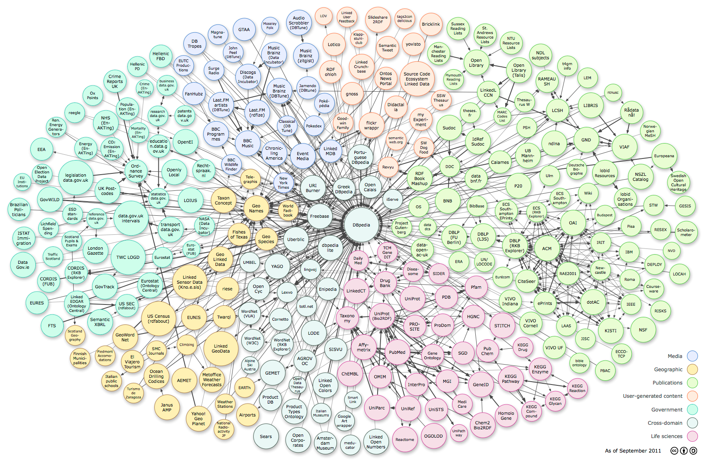
Linked Data
> 25 billion triples of data in over >250 data sets

Slide 8
The End

Slide 9
Integration Architecture
GUI
4) Retrieves sources and ontologies from the Web and uses a reasoner to answer the query
GUI
1) Query entered by the user is translated into SPARQL (the standard Semantic Web query language)
SPARQL Query
Results
OBII-IR
Loader
Reasoner
Reformulator
Selector
3) Selects relevant sources
2) Reformulates queries into Boolean index queries
Indexer
Index
Relevant Data Source
S₁
M₁
O₁
Mapping ontologies
Domain ontologies
0) Is run periodically to create an inverted index of source content
S_{n}
M_{n}
O_{n}

Slide 10
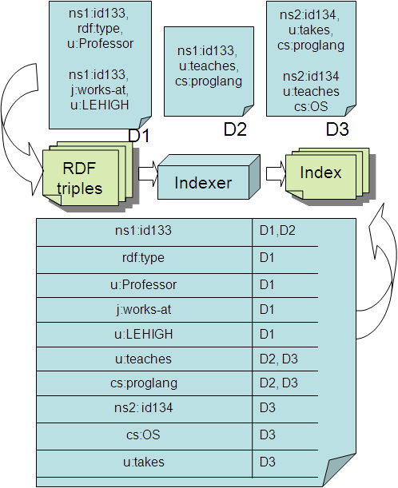
Basic Source Selection
Indexing the sources
Given, a query looking up sources in the index
Q: u:Professor(x) ∧ u:teaches(x, cs:proglang) ∧ j:works-at(x,y)
u:Professor AND rdf:type
j:works-at
u:teaches AND cs:proglang
subgoals | sources
u:Professor AND rdf:type | D1
u:teaches AND cs:proglang | D2,D3
j:works-at | D1
Note: D3 will not actually contribute to an answer for this query but must be loaded anyway to make sure!
This “inverted index” is based on ideas used in modern search engines

Slide 11
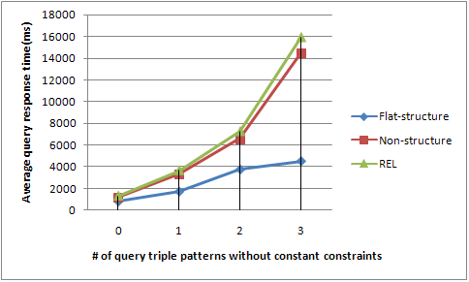
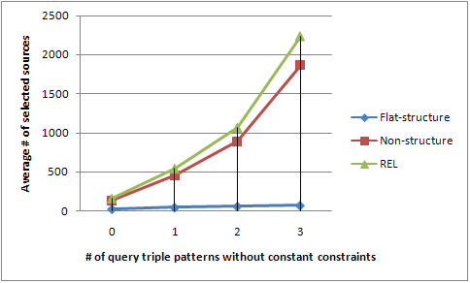
Evaluation Results
Average query response time
Average number of selected sources
  Analysis: flat-structure scales best as we increase the number of unconstrained qtps because it has better source selectivity.
  Analysis: flat-structure has best source selectivity:
  linear vs exponential

Slide 12
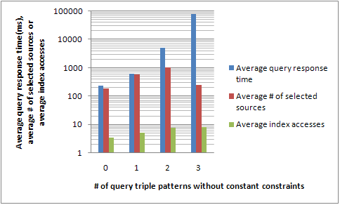
Scalability Evaluation
Structure algorithm over subset of BTC data
  23 million sources, 73 million triples
  Indexing time: ~58 hours
  Index size: 18GB

Slide 13
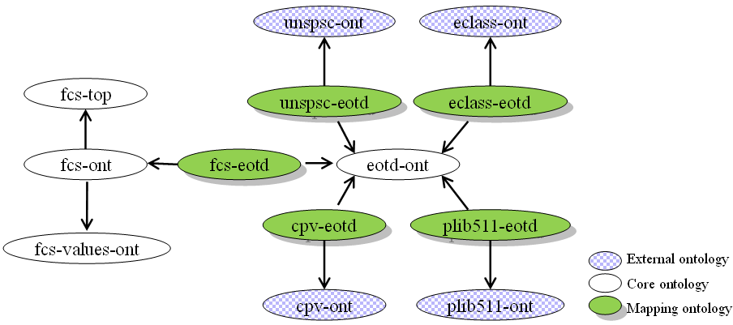
Example: E-Commerce Integration
Mappings constitute “mediator” ontologies

Slide 14
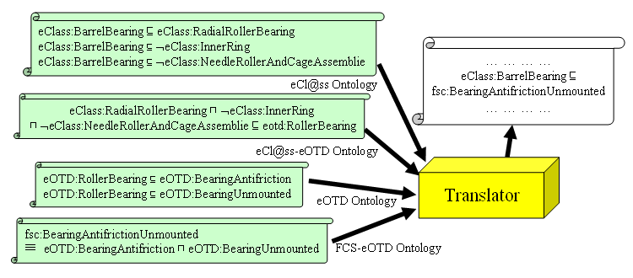
Semantic Web Benefits
An example of translation
10/27/2009

Slide 15
Ontology Mapping
Many types of heterogeneity in the source ontologies
  Union (A ≡ B ⊔ C)
    “fsc:KnobsAndPointers ≡ eOTD:Knob ⊔ eOTD:Pointer”
  Intersection (A ≡ B ⊓ C)
    “fsc:BearingAntifrictionUnmounted
    ≡ eOTD:Bearing-Antifriction ⊓ eOTD:Bearing-Unmounted”
  Exclusion (A ≡ B ⊓ ¬ C)
    “eOTD:BearingPlain
    ≡ eCl@ss:PlainBearing ⊓ ¬ eCl@ss:PlainBearingParts”
  Class vs. property distinction (A ⊑ ∃P.{a, b, c})
    “PLIB:HexagonHeadTappingScrewWithAFlatEnd
    ⊑ ∃eOTD:head-Style.{eOTD:Hexagon}”
    “PLIB:HexagonHeadTappingScrewWithAFlatEnd
    ⊑ ∃eOTD:pointStyle.{eOTD:Flat, eOTD:Flat2, eOTD:Flat3}”
  When all else fails, most specific subsumer and subsumee
    “cpv:PrimaryBatteries ⊑ eOTD:BatteryAssemblyAll”
    “eOTD:BatteryThermal ⊑ cpv:PrimaryBatteries”

Slide 16
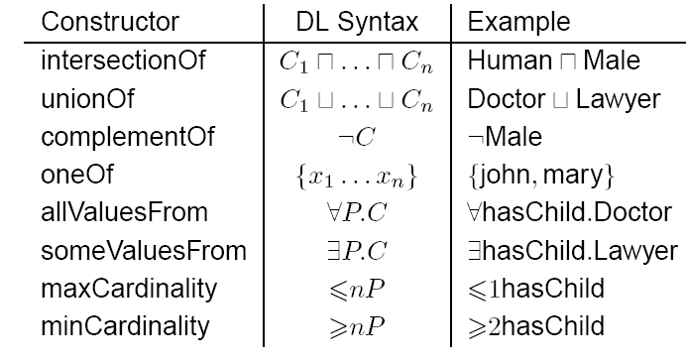
OWL Class Constructors
example taken from Ian Horrocks

Slide 17
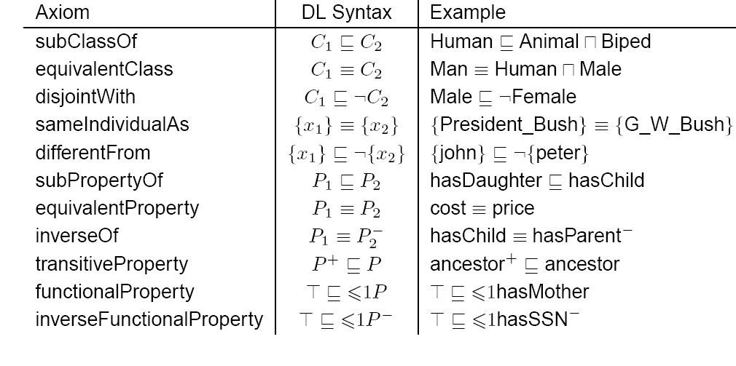
OWL Axioms
example taken from Ian Horrocks

