Slide 1
Ch. 12 – Knowledge Representation
Supplemental slides for CSE 327
Prof. Jeff Heflin

Slide 2
Categories in FOL
unary predicate representation
Laptop(DellD600)
x Laptop(x) ⇒ Computer(x)
x Computer(x) ⇒ Electronic(x)
reified category representation
Member(DellD600, Laptop)
Subset(Laptop, Computer)
Subset(Computer, Electronic)
∀ x,y,z Subset(x,y) ∧ Subset(y,z) ⇒ Subset(x,z)
∀ x,y,z Member(x,y) ∧ Subset(y,z) ⇒ Member(x,z)

Slide 3
Semantic Networks
a kind of logic that uses a graphical notation
graph with labeled nodes and arcs
nodes represent categories and individual objects
arcs represent relations between objects
Granny
cage12
owner
livesIn
Tweety

Slide 4
Inheritance in Semantic Nets
The properties of a category can be inherited by their members
Drawn with a single box
canFly
Bird
True
MemberOf
Implies that canFly for Tweety is true
Tweety

Slide 5
Overriding Inheritance
canFly
Values of class relations are defaults
e.g. some birds cannot fly
Nonmonotonic
New information can cause you to revoke prior conclusions
If we only know Opus is a Bird, but then later learn that he is a Penguin
Bird
True
SubsetOf
canFly
Penguin
False
MemberOf
Implies that canFly for Opus is false
Opus

Slide 6
Events in Semantic Networks
FlyEvent
Member
Fly₁₇
Agent
During
Shankar
Yesterday
Origin
Destination
NewYork
NewDelhi
From Fig. 10.10, p. 352

Slide 7
Description Logic
DL Axiom | Description
Father ≡ And(Male,Parent) | a father is a male parent
Parent ≡ AtLeast(1, hasChild) | a parent has at least one child
Trio ≡ And(Band, All(members, Musician), Exactly(3, members)) | a trio is a band with three members, all of whom are musicians

Slide 8
DL Inference Tasks
classification
does an object belong to a category?
example
bob∈Male, bob∈Parent
is bob∈Father?
subsumption
is one category a subset of another?
given
Herbivore ≡ And(Animal, All(eats, Plant))
a herbivore is an animal that only eats plants
Giraffe ⊆ And(Animal, All(eats, Leaves))
a giraffe is an animal that only eats leafs
Leaves ⊆ Plant
leaves are plants
is Giraffe ⊆ Herbivore true?

Slide 9
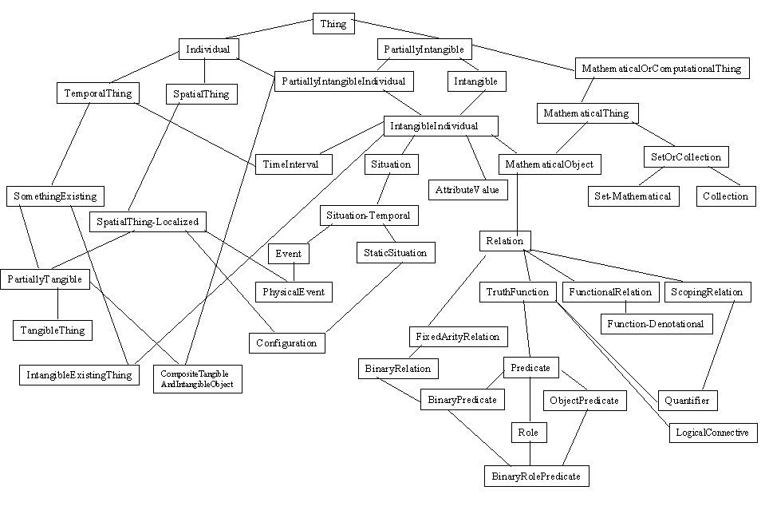
Cyc Upper Ontology
From http://www.cyc.com/cycdoc/vocab/upperont-diagram.html

