Slide 1
Ch. 1 – Introduction
Supplemental slides for CSE 327
Prof. Jeff Heflin

Slide 2
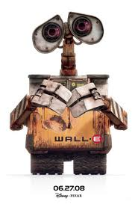
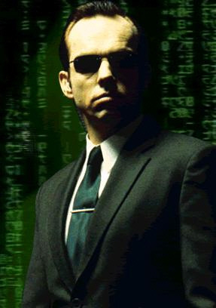
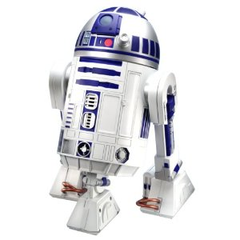
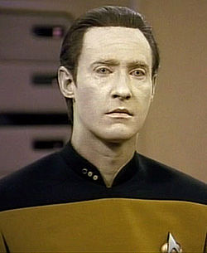
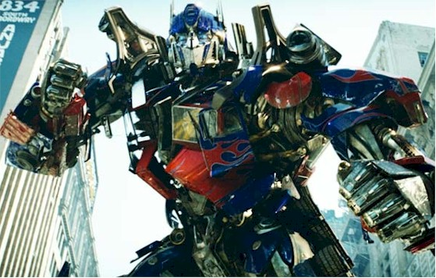
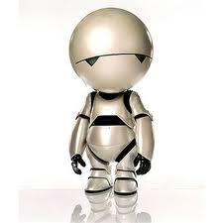
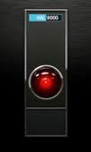
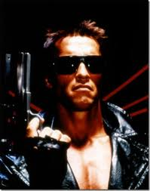
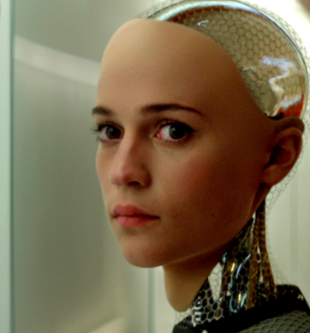
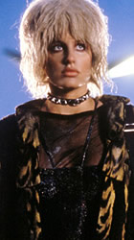
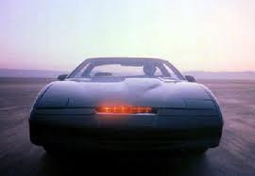
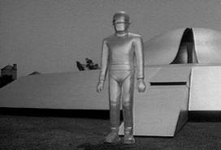
Test Your SciFi IQ
Optimus Prime – Transformers (2007)
WALL-E – WALL-E (2008)
Agent Smith – The Matrix (1999)
R2D2 – Star Wars (1977)
Commander Data – Star Trek TNG (1987)
Marvin – The Hitchhiker’s Guide to the Galaxy (2005)
HAL900 – 2001:A Space Odyssey (1968)
K.I.T.T. – Knight Rider (1982)
T-800 – The Terminator (1984)
Ava – Ex Machina (2015)
Priss – Blade Runner (1982)
Joshua – WarGames (1983)
Gort – The Day the Earth Stood Still (1951)
Notes:
R2D2, Optimus Prime, Commander Data, Agent Smith, Terminator, Cylon, K.I.T.T., War Games, HAL, Marvin, Gort, Priss

Slide 3
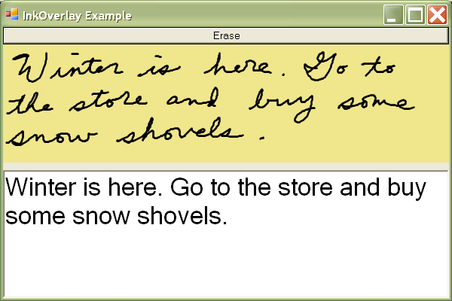
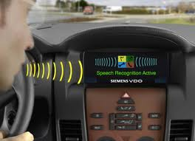
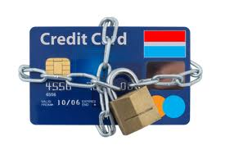
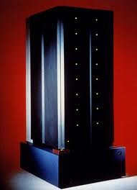
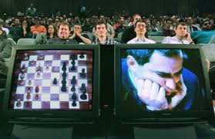
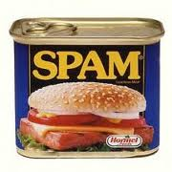
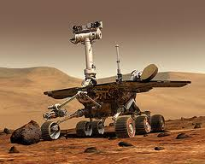
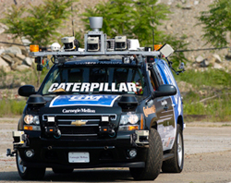
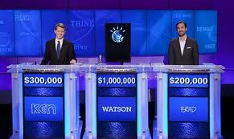
Test Your Real AI IQ
GRAIL (1969): handwriting recognition
HELP (1975): hospital decision support system
DRAGON (1975): speech recognition
Falcon (1995): Credit card fraud monitoring
Deep Blue (1997): beat world chess champion
SpamAssassin (2001): kills spam
MAPGEN (2004): handled routine plans for Mars Rover missions
BOSS (2007): won DARPA Urban Challenge
Watson (2011): beat human Jeopardy! champions
Notes:
GRAIL (1969): Handwriting recognition
Medical Expert Systems (1975-present):
- HELP (1975): Hospital decision support system
- PUFF (1979): interprets lung disease test results
- APACHE (1981): predicts risk of patient death
DRAGON (1975): speech recognition
Deep Blue (1997): beat world chess champion
Falcon (1995): Credit Card Fraud monitoring by HNC software, uses neural networks and expert rules, latest version now used by many banks
SpamAssassin (2001): Uses Bayseian rules to classify Spam
MAPGEN (2004): handled routine plans for Mars Rover missions [mixed initiative planer]
BOSS (2007): won DARPA Urban Challenge
Watson (2011): beat human Jeopardy! champions
Other:
Remote Agent - Deep Space 1 probe
RoboCup
Logistics Planning (Desert Storm)

Slide 4
Possible AI Definitions
 | Compared to humans | Compared to ideal (rationality)
Thought process | Systems that think like humans | Systems that think rationally
Behavior | Systems that act like humans | Systems that act rationally

Slide 5
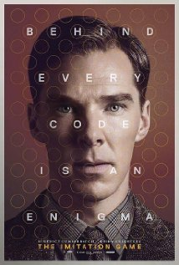
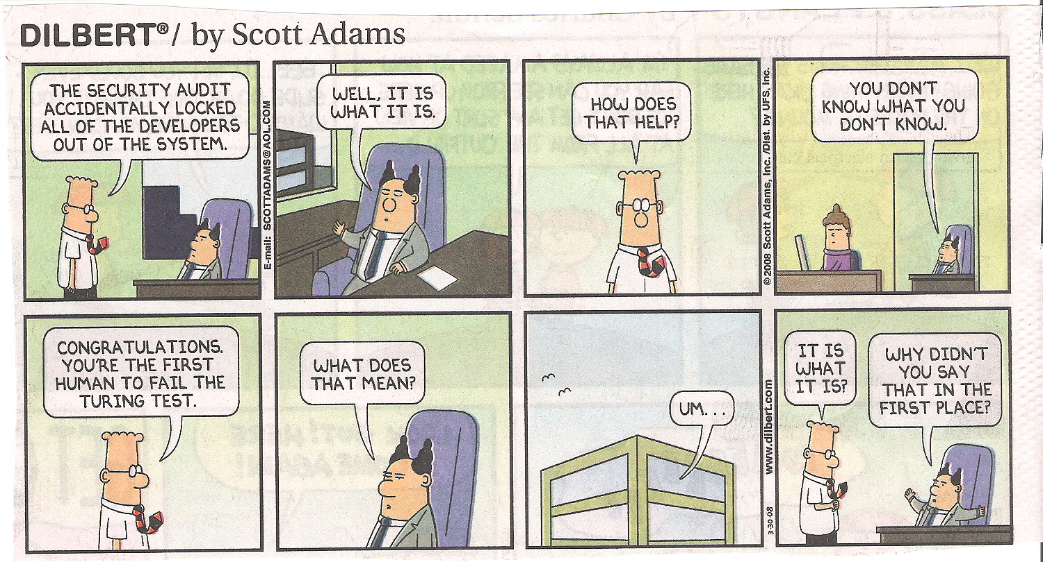
The Turing Test

Slide 6
Fields that AI Draws From
Philosophy
rules of thought, nature of mind, source of knowledge
Mathematics
formal logic, probability, linear algebra
Economics
how to make decision that lead to preferred outcomes
Psychology
study of human mind and its functions
especially Cognitive Science
Physics
how does the world really work?

Slide 7
A Brief History Lesson
~350 BC: Aristotle’s syllogisms
17th century: mathematical logic
Leibniz, Boole, Frege
1950: Alan Turing proposes intelligent computers
1956: Dartmouth conference
Coined term “artificial intelligence”
John McCarthy, Marvin Minsky, Allen Newell and Herbert Simon
Logic Theorist
1958: General Problem Solver (Newell and Simon)
1958: Lisp (McCarthy)

