Slide 1
Solution Diversity in Planning and Case-Based Reasoning
Alexandra Coman Dr. Héctor Muñoz-Avila
Department of Computer Science & Engineering
Lehigh University

Slide 2
Outline
Solution Diversity in Case-Based Reasoning
Solution Diversity in Planning
Quantitative and Qualitative Diversity
Diverse Case-Based Planning and Diverse Generative Planning
Character Diversity Application
Current and Future Work
Solution Diversity in Nondeterministic Planning
2

Slide 3
Diversity in Case-Based Reasoning

Slide 4
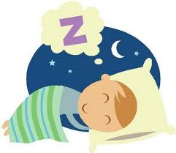
Inspiration: Recommender Systems
Problem: user’s need
Solution: match between user’s need and an available product/service
4

Slide 5
Recommender Systems: Similarity-Based Retrieval
Query: green, triangular
Query: early twentieth-century novel by British author
Author:
Evelyn Waugh
5

Slide 6
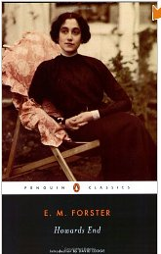
Diversity-Conscious Retrieval
Smyth and McClave (2001),
Shimazu (2001),
McSherry (2002),
McGinty and Smyth
(2003),
Bridge and Kelly
(2006),
…
Query: green, triangular
Query: early twentieth-century novel by British author
Authors:
Evelyn Waugh
E.M. Forster
Virginia Woolf
Robert Graves
6

Slide 7
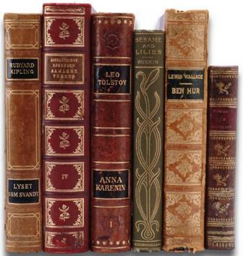
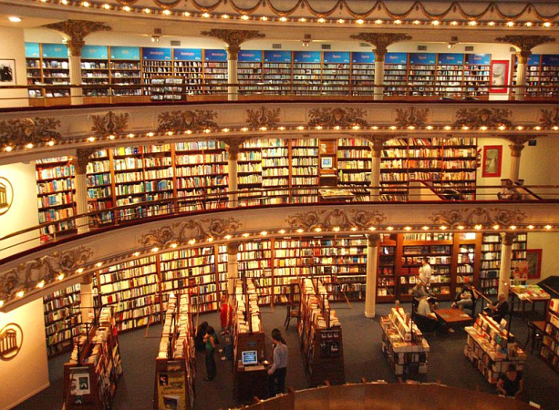
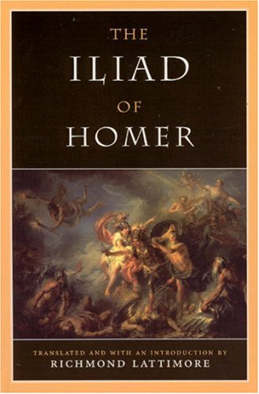
When Necessary?
Large, difficult-to-navigate search spaces, complex products
Planning search spaces are like that!
7

Slide 8
Traditional Retrieval Approach
Similarity-Based Retrieval
Select the k most similar items to the current query.
Problem
Vague queries.
Limited coverage of search space in every cycle of the dialogue.
Query
Available case
C2
C3
C1
Similar case
Q

Slide 9
Diversity Enhancement
Diversity-Enhanced Retrieval
Select k items such that they are all similar to the current query but different from each other.
Providing a wider choice allows for broader coverage of the product space.
Allows many less relevant items to be eliminated.
Query
Available case
C1
Q
Retrieved case
C2
C3

Slide 10
Dangers of Diversity Enhancement
Leap-Frogging the Target
Problems occur when the target product is rejected as a retrieval candidate on diversity grounds.
⇒ Protracted dialogs.
Diversity is problematic in the region of the target product.
Use similarity for fine-grained search.
Similarity is problematic when far from the target product.
Use diversity to speed-up the search.
T
C1
Q
C2
C3

Slide 11
Sources
cbrwiki.fdi.ucm.es/
www.iiia.csic.es/People/enric/AICom.html
www.cse.lehigh.edu/~munoz/CSE335/
www.aic.nrl.navy.mil/~aha/slides/
http://www.csi.ucd.ie/users/barry-smyth
http://www.csi.ucd.ie/users/lorraine-mcginty

Slide 12
Solution Diversity in Planning

Slide 13
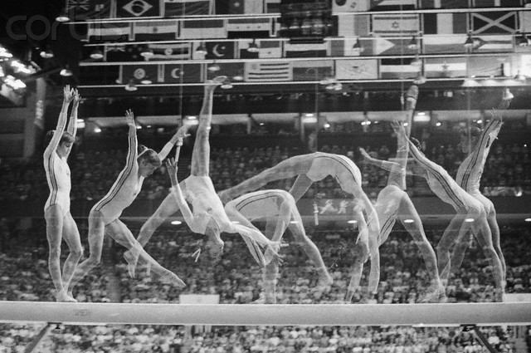
AI Planning
Generating proposed courses of action for reaching given goals
In deterministic planning, solutions are plans: sequences of actions
We use case-based planning and first-principles heuristic search planning (generative planning)
13

Slide 14
AI Planning
Generating proposed courses of action for reaching given goals
In deterministic planning, solutions are plans: sequences of actions
We use case-based planning and first-principles heuristic search planning (generative planning)
Remember:
planning tasks are synthesis tasks!
recommender systems solve analysis tasks!
14

Slide 15
Short Review of Planning Topics

Slide 16
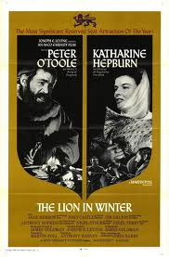
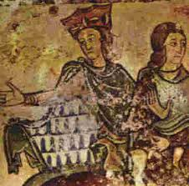
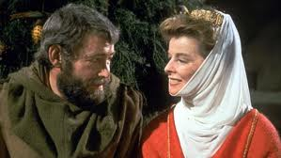
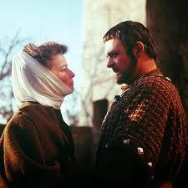
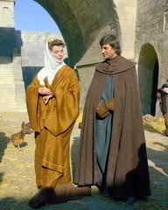
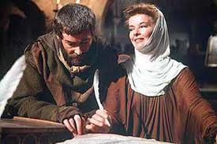
Deterministic Planning
Initial State: captive(Eleanor), heir(John), distrusts(Richard,Eleanor), distrusts(Henry,Eleanor), discontented(Geoffrey), …
Goal: free(Eleanor), heir (Richard), trusts(Richard,Eleanor), …
Operators: flirt(Char1,Char2), plead(C1,C2), plot (…),threaten(…), ...
Actions (with preconditions and effects):
bluff(Eleanor,Henry)
pre:trusts(Henry,Eleanor),
together(Eleanor, Henry)
eff: free(Eleanor)
flirt(Eleanor,Henry)
pre: together(Eleanor, Henry)
eff: trusts(Henry,
Eleanor)
plead(Eleanor,Richard)
pre: together(Eleanor,Richard)
eff: trusts(Richard,Eleanor)
plot(Eleanor,Geoffrey)
pre: together(Eleanor, Geoffrey)
eff: heir(Richard), not heir (John)
16

Slide 17
Nondeterministic Planning
Eliminates determinism assumption
An action may have multiple possible outcomes
Solutions are policies:
sets of state-action pairs
indicate which action should be taken in each state assumed possible
plot(Eleanor,Geoffrey)
pre: together(Eleanor, Geoffrey,)
eff1: heir(Richard), not heir (…), …
eff2: heir(Geoffrey ), not heir (…), …
eff3: heir(John), not heir (…), …
eff4: heir(None), …
Policy:
state: heir(Richard): done!
state: heir(Geoffrey): plot(Eleanor,Richard)
state: heir(John): threaten(Eleanor,John)
state: heir(None): threaten(Eleanor,Henry)
17

Slide 18
First-Principles Planning
}
h(st1)
Candidate State 1
…
Initial State
State n
plead
GOAL
flirt
Candidate State 2
}
plot
h: estimated goal distance (length of π_{h}, solution plan to a relaxed problem); pick candidate state with lowest h value
h(st2)
Applicable Actions
FF (Hoffmann and Nebel, 2001)
18

Slide 19
Case-Based Planning (simplified)
New Problem: Endear self to Henry
19

Slide 20
Case-Based Planning (simplified)
New Problem: Endear self to Henry
1.RETRIEVE
Case Base
Prob. 1: Escape
Prob. 2: Revenge
Prob. 3: Endear self to Richard
…
Problem n: …
20

Slide 21
Case-Based Planning (simplified)
New Problem: Endear self to Henry
1.RETRIEVE
2. ADAPT
Case Base
Prob. 1: Escape
Prob. 2: Revenge
Prob. 3: Endear self to Richard
…
Problem n: …
Prob. 3: Endear self to Richard
Solution Plan:
Be charming
Flatter
Speak of shared memories: childhood music lessons
x
Henry
meeting at King Louis’ court
x
21

Slide 22
Case-Based Planning (simplified)
New Problem: Endear self to Henry
1.RETRIEVE
2. ADAPT
Case Base
Prob. 1: Escape
Prob. 2: Revenge
Prob. 3: Endear self to Richard
…
Problem n: …
Prob. 3: Endear self to Richard
Solution Plan:
Be charming
Flatter
Speak of shared memories: childhood music lessons
x
Henry
meeting at King Louis’ court
x
3. Store new problem/solution plan pair for future use
22

Slide 23
Solution Diversity in Planning

Slide 24
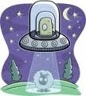
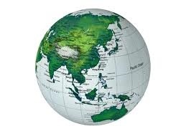
Solution Diversity
Diverse planning consists of generating solutions (plans or policies) which:
solve the same planning problem
are different from one another (ideally, meaningfully different)
24

Slide 25
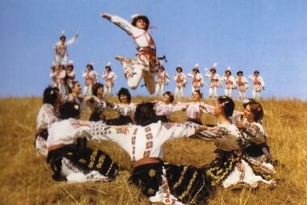
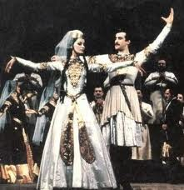
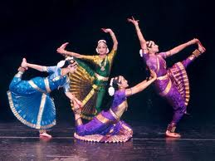
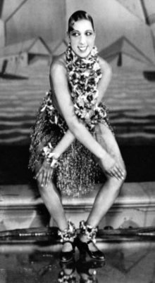
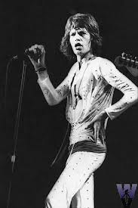
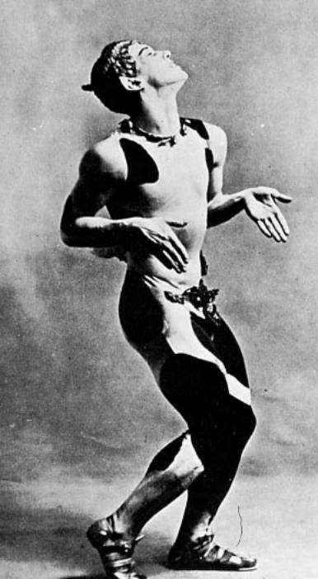
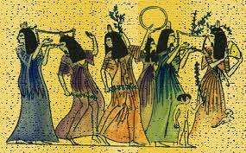
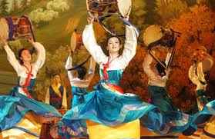
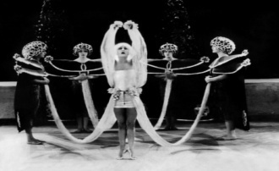
Diversity Motivation
assortment difference dissimilarity distinction distinctiveness
divergence
diverseness diversification heterogeneity medley
multeity multifariousness multiformity multiplicity range unlikeness variance variegation variety variousness
Alternatives sampling a larger area of the vast solution space
May cover varied circumstances, preferences, needs not encoded in the planning problem
Trade-offs, diverse tactical approaches
Application domains: route & travel planning, intrusion detection, computer games, …
Balanced with similarity (e.g. dance plans with diverse choreographies)
Diverse World, diverse needs, tastes, problems
and solutions: diverse plans
25

Slide 26
Quantitative and Qualitative Plan Diversity

Slide 27
Measuring Plan-Set Diversity
∏: a non-empty set of plans; π: a plan
Smyth and McClave (2001) in CBR diversity, Myers and Lee (1999) in Planning (as “dispersion”)

Slide 28
Plan Distance
!!!
!!!
∏: a non-empty set of plans; π: a plan
Smyth and McClave (2001) in CBR diversity, Myers and Lee (1999) in Planning (as “dispersion”)

Slide 29
Plan Distance
D( , )=?
29

Slide 30
Plan Distance
D( , )=?
D: plan distance metric
A measure of the dissimilarity between two plans
Non-trivial: plans are complex structures
Quantitative or Qualitative
30

Slide 31
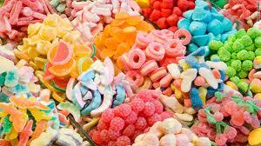
Quantitative Plan Distance
Any distinct plan elements (e.g. actions) are considered maximally distant from one another
Dist(Add Sugar, Add Vinegar) = Dist(Add Lemon_Juice, Add Vinegar)
No domain-specific degrees of distance
e.g. D_{Quant} = (# actions in Plan1 not in Plan2) + (# actions in Plan2 not in Plan1) (Fox et al., 2006)
Srivastava et al. (2007), Nguyen et al. (2012)
31

Slide 32
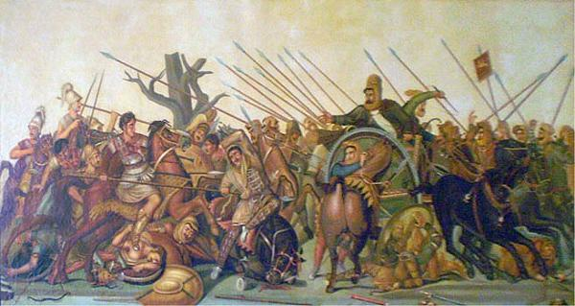
Quantitative Distance: Limitations
Very similar plans?
Approach Pinarus River
Attack with Unit1
Attack with Unit5
Approach Pinarus River
Attack with Unit2
Attack with Unit5
Attack with Unit3
Attack with Unit5
Approach Pinarus River
Approach Pinarus River
Attack with Unit4
Attack with Unit5
Battle of Issus, 333 BC

Slide 33
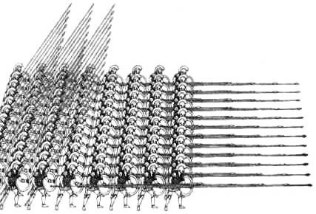
Quantitative Distance: Limitations Unit?
Unit1
Approach Pinarus River
Attack with Unit1
Attack with Unit5
Approach Pinarus River
Attack with Unit2
Attack with Unit5
Attack with Unit3
Attack with Unit5
Approach Pinarus River
Approach Pinarus River
Attack with Unit4
Attack with Unit5
Battle of Issus, 333 BC

Slide 34
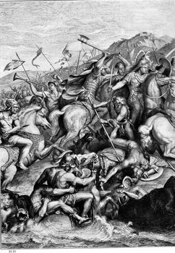
Quantitative Distance: Limitations Unit?
Unit1
Approach Pinarus River
Attack with Unit1
Attack with Unit5
Attack with Unit2
Attack with Unit5
Approach Pinarus River
Unit2
Attack with Unit3
Attack with Unit5
Approach Pinarus River
Approach Pinarus River
Attack with Unit4
Attack with Unit5
Battle of Issus, 333 BC

Slide 35
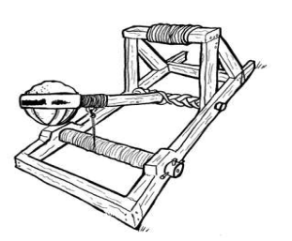
Quantitative Distance: Limitations Unit?
Unit1
Approach Pinarus River
Attack with Unit1
Attack with Unit5
Attack with Unit2
Attack with Unit5
Approach Pinarus River
Unit2
Attack with Unit3
Unit3
Attack with Unit5
Approach Pinarus River
Approach Pinarus River
Attack with Unit4
Attack with Unit5
Battle of Issus, 333 BC

Slide 36
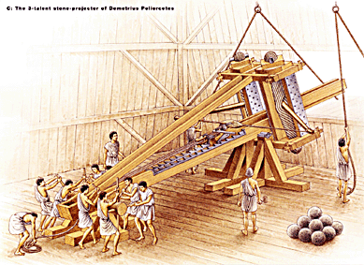
Quantitative Distance: Limitations Unit?
Unit1
Approach Pinarus River
Attack with Unit1
Attack with Unit5
Attack with Unit2
Attack with Unit5
Approach Pinarus River
Unit2
Attack with Unit3
Unit3
Attack with Unit5
Approach Pinarus River
Unit4
Attack with Unit5
Approach Pinarus River
Attack with Unit4
Battle of Issus, 333 BC

Slide 37
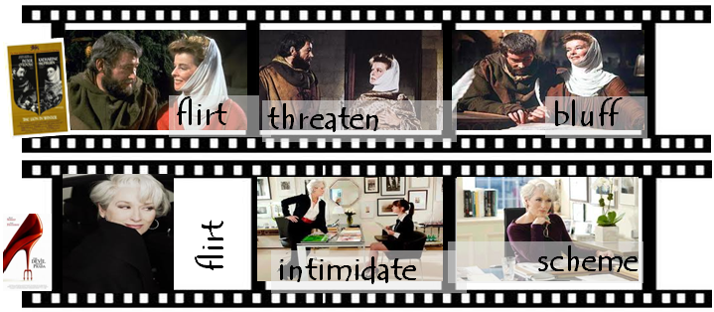
Quantitatively Diverse Plans
Initial State: (Seductive Heroine), Goal: Happy End
37

Slide 38
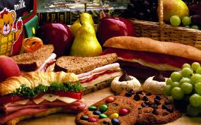
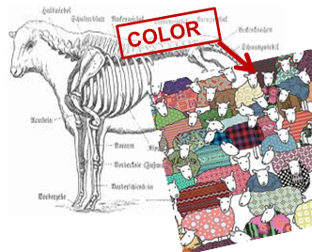
Qualitative Plan Distance
It is based on domain-specific degrees of distance between plan elements
Dist(Add Sugar, Add Vinegar) > Dist(Add Lemon_Juice, Add Vinegar)
Can reflect differences that are truly meaningful to users
Myers and Lee (1999) require domain metatheory. We only require qualitative distance metrics specifying what should differ between plans.
38

Slide 39
Qualitative Distance
Unit1
Approach Pinarus River
Attack with Unit1
Attack with Unit5
Attack with Unit2
Attack with Unit5
Approach Pinarus River
Unit2
Attack with Unit3
Unit3
Attack with Unit5
Approach Pinarus River
Unit4
Attack with Unit5
Approach Pinarus River
Attack with Unit4
Battle of Issus, 333 BC

Slide 40
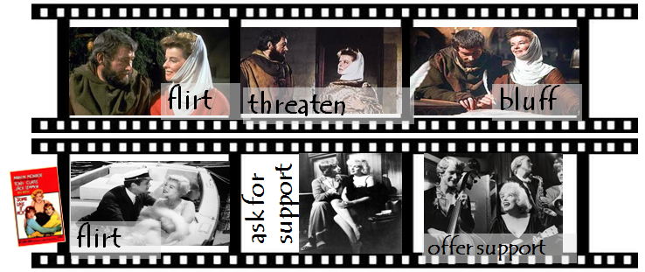
Qualitatively Diverse Plans
Initial State: (Seductive Heroine), Goal: Happy End
40

Slide 41
Diverse Planning Systems

Slide 42
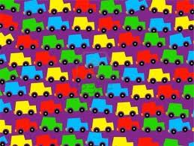
Diverse Planning Systems
DivCBP (ICCBR 2011): diverse case-based planner
42

Slide 43
Diverse Planning Systems
DivCBP (ICCBR 2011): diverse case-based planner
DivFF (AAAI 2011): diverse heuristic planner based on FF (Hoffman & Nebel, 2001)
43
43

Slide 44
Diverse Planning Systems
DivCBP (ICCBR 2011): diverse case-based planner
DivFF (AAAI 2011): diverse heuristic planner based on FF (Hoffman & Nebel, 2001)
DivNDP (current work): diverse nondeterministic planner based on NDP (Kuter et al., 2008)
44

Slide 45
Diverse Planning: General Framework
We are trying to generate k plans which solve the Prob planning problem using DivPL, a diversity-aware variant of the PL planning system.
Π – set of plans , π – plan
π_{C} – candidate (partial) solution plan
SOL_adequacyPL – candidate solution evaluation criterion specific to PL
generatePlan(Crit(π_{C}), Prob) – generates a plan for problem Prob using criterion Crit(π_{C}) to assess candidate solution plan π_{C}
45
45

Slide 46
DivPL
variant of algorithm by Smyth and McClave (2001)
1. Π ← {}
2. π ← generatePlan(SOL_adequacyPL(π_{C}), Prob)
3. Add π to Π
4. Repeat
5. π ← generatePlan(αSOL_adequacyPL(π_{C})+
(1-α)RelDiv(π_{C}, Π))
6. Add π to Π
7. Until |Π| = k plans have been generated
8. Return Π
46
46

Slide 47
Relative Plan Diversity
∏: a non-empty set of plans; π: a plan
47

Slide 48
Case-Based Planning (simplified)
New Problem: Endear self to Henry
1.RETRIEVE
2. ADAPT
Case Base
Prob. 1: Escape
Prob. 2: Revenge
Prob. 3: Endear self to Richard
…
Problem n: …
Prob. 3: Endear self to Richard
Solution Plan:
Be charming
Flatter
Speak of shared memories: childhood music lessons
x
Henry
meeting at King Louis’ court
x
3. Store new problem/solution plan pair for future use
48

Slide 49
DivCBP
DIVERSITY HERE!
New Problem: Endear self to Henry
1.RETRIEVE
2. ADAPT
Case Base
Prob. 1: Escape
Prob. 2: Revenge
Prob. 3: Endear self to Richard
…
Problem n: …
Prob. 3: Endear self to Richard
Solution Plan:
Be charming
Flatter
Speak of shared memories: childhood music lessons
x
Henry
meeting at King Louis’ court
x
3. Store new problem/solution plan pair for future use
49

Slide 50
DivCBP
PROBLEM SIMILARITY
SOLUTION PLAN DIVERSITY
50
50

Slide 51
First-Principles Planning
}
h(st1)
Candidate State 1
…
Initial State
State n
plead
GOAL
flirt
Candidate State 2
}
plot
h: estimated goal distance (length of π_{h}, solution plan to a relaxed problem); pick candidate state with lowest h value
h(st2)
Applicable Actions
FF (Hoffmann and Nebel, 2001)
51

Slide 52
DivFF
DIVERSITY HERE!
}
h(st1)
Candidate State 1
…
Initial State
State n
plead
GOAL
flirt
Candidate State 2
}
plot
h: estimated goal distance (length of π_{h}, solution plan to a relaxed problem); pick candidate state with lowest h value
h(st2)
Applicable Actions
FF (Hoffmann and Nebel, 2001)
52

Slide 53
DivFF
π_{h}
FF HEURISTIC: GOAL DISTANCE
53
53

Slide 54
DivCBP vs. DivFF

Slide 55
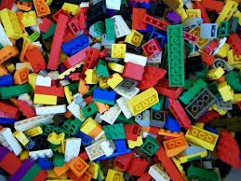
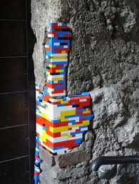
DivFF
+
On case bases of large enough size, DivCBP consistently outperforms DivFF in terms of plan set diversity.
All tested versions of DivCBP are faster than DivFF on all problems.
DivCBP planning time increases with the size of the case base, but at a slow rate.
Requires sufficiently diverse case base.
Does not require a case base.
Can potentially produce maximally diverse plan sets at any time.
However: in practice, this rarely happens.
Planning time increases steeply with the size of the initial state, due to several bottlenecks: preprocessing phase, generating candidate plans & goal distance.
+
+
+
-
-
-
-
DivCBP
55

Slide 56
DivFF + DivCBP
We suggest using DivFF and DivCBP in a complementary manner:
DivFF to populate the case base until it is large enough
DivCBP afterwards
56

Slide 57
Related Studies
Advantages of planning using episodic knowledge over planning from scratch in terms of:
planning efficiency: Veloso (1994), Ihrig and Kambhampati (1997), Gerevini and Serina (2000, 2010), van der Krogt and de Weerdt (2005); Au, Muñoz-Avila, and Nau (2002), Kuchibatla and Muñoz-Avila (2006)
plan stability: Fox et al. (2006)
57
57

Slide 58
Current and Future Work

Slide 59
Plan-Based Character Diversity
Illustrative application (StoryCase, AIIDE 2012), demonstrated in Wargus
Personality traits reflected in actions
Qualitative metrics encoding personality trait indicators
Policies can reflect character personality very well!
PLAN 2
ATTACK!
Eleanor of Aquitaine: seductive, ambitious & crafty
Miranda Priestly: seductive,
ambitious & crafty
Sugar Kane: seductive,
sensitive & caring
59

Slide 60
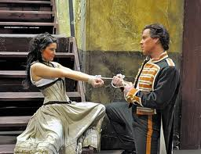
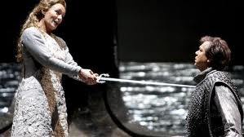
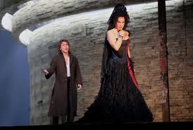
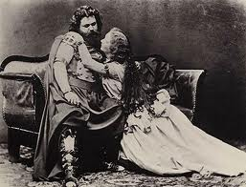
Carmen and Isolde: Diverse Policies
state: (not loved)
state: (not loved)
Reject
Policy 2
Proud and Steadfast
Policy 1
“♪ Si tu ne m’aimes pas, je t’aime
… ♪”
ADIEU!!!
love
love
Reject
state: (loved)
state: (loved)
60

Slide 61
Experimental Evaluation Domain

Slide 62
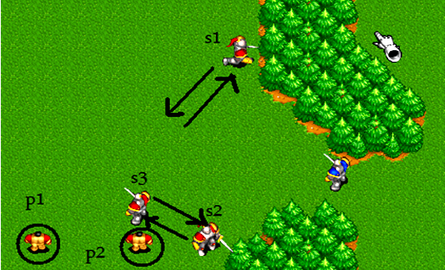
Evaluation Domain
Wargus domain
Based on Wargus RTS
real-time, nondeterministic, partially-observable, adversarial
Generated plans are run in the game, in order to assess their actual diversity
62

Slide 63
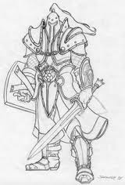
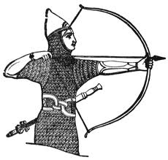
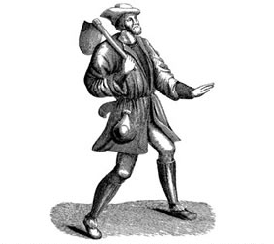
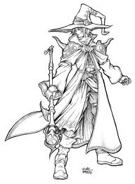
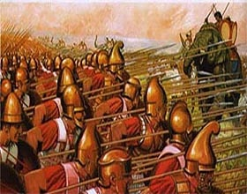
D_{Wargus} Qualitative Distance Metric
Distance based on type of units used for attacking
Differences between units: abilities, strength, attack range, etc.
soldier
archer
peasant
mage
63

Slide 64
Wargus Qualitative Distance Metric
π, π’ : plans
64

Slide 65
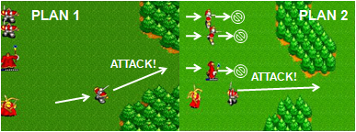
Results Summary (DivCBP, DivFF)
Quantitative vs. Qualitative distance metrics
Generated plans run in the game, variation of score and time observed
Qualitative results more diverse than Quantitative results on the majority of problems
Quantitatively diverse plans are inflated with irrelevant actions:
65

Slide 66
Summary
COMPLETED WORK
Diverse plan generation methods capable of producing both quantitatively and qualitatively diverse plans
case-based planning
heuristic search planning
Application: character diversity
Main contributions:
generating qualitatively diverse plans solely through the use of a qualitative distance metric, without requiring a complex domain model
evaluating diversity of plans by running them in their intended environment, instead of only analyzing the plans themselves
comparison between diverse case-based planner and diverse heuristic planner in terms of solution diversity
CURRENT WORK: Diversity in Nondeterministic Planning
66

Slide 67
References
Smyth B., and McClave, P. 2001. Similarity vs. Diversity. In Proc. of ICCBR 2001, 347–361. Springer.
Shimazu, H. 2001. ExpertClerk : Navigating Shoppers’ Buying Process with the Combination of Asking and Proposing. In Proc. of IJCAI 2001, 1443–1448. Morgan Kaufmann.
McSherry, D. 2002. Diversity-Conscious Retrieval. In Proc. of ECCBR 2002, 219–233. Springer.
McGinty, L., and Smyth, B. 2003. On the Role of Diversity in Conversational Recommender Systems. In Proc. of ICCBR 2003, 276–290. Springer.
Bridge, D. and Kelly, J.P. 2006. Ways of Computing Diverse Collaborative Recommendations. In Proc. of AH 2008. Springer.
Srivastava, B.; Kambhampati, S; Nguyen, T.; Do, M.; Gerevini, A.; and Serina, I. 2007. Domain Independent Approaches for Finding Diverse Plans. In Proc. of IJCAI 2007, 2016-2022. AAAI Press/IJCAI.
Nguyen, T.; Do, M.; Gerevini, A.; Serina, I.; Srivastava, B.; and Kambhampati, S. 2011. Generating Diverse Plans to Handle Unknown and Partially Known User Preferences. Artificial Intelligence 190:1-31.
Myers, K. L., and Lee, T. J. 1999. Generating Qualitatively Different Plans through Metatheoretic Biases. In Proc. of AAAI 1999, 570–576. AAAI Press.
Hoffmann, J., and Nebel, B. 2001. The FF Planning System: Fast Plan Generation Through Heuristic Search. Journal of Artificial Intelligence Research, 14:253-302.
Kuter, U.; Nau, D. S.; Reisner, E.; and Goldman, R. P. 2008. Using classical planners to solve nondeterministic planning problems. In Proc. of ICAPS-08.
67

