Slide 1
CBR in Medicine
Jen Bayzick
CSE435 – Intelligent Decision Support Systems
Notes:
Image:http://www.google.com/imgres?um=1&hl=en&tbo=d&rlz=1C1CHFX_enUS431US431&biw=1517&bih=714&tbm=isch&tbnid=yx1dOlEo5vEg_M:&imgrefurl=http://vector.us/browse/122791/red_cross_nurse_cartoon_health_medicine_stethoscope_metalmarious&docid=J16RacHMsbDHSM&imgurl=http://vector.us/files/images/1/2/122791/red_cross_nurse_cartoon_health_medicine_stethoscope_metalmarious.jpg&w=415&h=425&ei=UTCbUP29O6f-0gHs2IDYBg&zoom=1&iact=hc&vpx=216&vpy=174&dur=1170&hovh=226&hovw=222&tx=130&ty=148&sig=110643283648837826729&page=1&tbnh=144&tbnw=141&start=0&ndsp=41&ved=1t:429,r:2,s:0,i:92

Slide 2
Outline
Motivation
Medical Domain
Uses of CBR System in Medicine
Methods
Real World Systems

Slide 3
Motivation
Huge amount of data (many, many patients)
Data “held” by expert physicians, distributed among records in many hospitals and clinics
Contradicting information
Vague data (complaints of a patient)
Doctors must choose rapidly from a large number of treatment alternatives
[1]

Slide 4
Medicine: Unique Domain
Instance: A human patient
Complex organisms
High biological variance
Lots of Interactive vital processes
High number of possibly contradictory symptoms
Individual processes effected by changes in environment (new resistances, diseases, or pathogens)
[1]

Slide 5
Attributes
Symptoms of diseases, used as triggers to find initial hypotheses
Knowledge on increased risks for a patient associated with certain diseases, therapies, etc.
Frequency of diseases derived from epidemiological studies
Frequency of diseases derived from (doctor’s) individual experience
[1]
Notes:
Information used to make decisions
Epidemiology is the study (or the science of the study) of the patterns, causes, and effects of health and disease conditions in defined populations. It is the cornerstone of public health, and informs policy decisions and evidence-based medicine by identifying risk factors for disease and targets for preventive medicine. Epidemiologists help with study design, collection and statistical analysis of data, and interpretation and dissemination of results (including peer review and occasional systematic review). Epidemiology has helped develop methodology used in clinical research, public health studies and, to a lesser extent, basic research in the biological sciences.. [wiki]
African people are predisposed to sickle cells because of maleria

Slide 6
Uses of CBR in Medicine
Diagnosis (Help-desk system)
Determine cause of heart failure
Classification
Classify type of psychophysiological dysfunctions (a form of stress) from physiological measurements from sensors (EKG, ultrasound, MRI, etc.)
Tutoring
For medical students, etc.
Planning
Construct a therapy program and provide support to elderly for in home help
Prognosis
Required recovery time, additional therapies after surgery
[3], [5]
Notes:
Many different CBR methods used, depending on needs and context, data is the special stuff
Bold - focus on…?
Help desk = siddarth
Tutoring = tashwin
Prototypes = Guilio
ECG = echocardiogram (heart) measures electrical properties of the heart over time
Heart attack if the heart is firing too quickly
Ultrasound = sound waves
MRI = magnetic resonance imaging

Slide 7
Challenges of CBR in Medicine
Acceptability in clinical practice
System needs to:
Explain reasoning process
Solve problems for which the user is unable to provide a complete description
[2]

Slide 8
Construction-oriented properties of system
Hybrid
CBR with other AI (RBR, Neural Nets)
Adaptive
DIFFICULT
Case library size
Degree of generalization into prototypes
Degree of Automation
Level of human interaction needed to make diagnosis
Constraints
Reliability – system works when needed
Safety-criticality – whether incorrect behavior could create dangerous situations
[5?]

Slide 9
CASEY
One of earliest medical decision support systems
Goal: Heart failure diagnosis
Three steps:
1. Search for similar cases
2. Determine whether target case (current patient) is similar enough to most similar case
3. If similar enough, transfer diagnosis to current case. If not, attempt to modify diagnosis
If steps 1-3 fail, uses rule based domain theory
[1], [3]

Slide 10
Conversational CBR (CCBR) = Help Desk System
Query elicited interactively using questions to the user
Aims to minimize number of questions asked to user before conclusion is reached
Drawback: difficult to explain the relevance of questions asked to the user

Slide 11
iNN(k): a new approach to CCBR
Classifier needs fewer problem features than standard kNN classifier
Explains relevance of question it asks user
Assumes all attributes are nominal
Creation of Query
Initially listed as empty
Asks user for values of attributes as needed
‘Unknown’ is a valid answer
Similarity metric
[2]

Slide 12
iNN(k) Retrieval Set
Is used to
Provide an solution (as in most CBR dialogues)
Decide when to terminate dialogue (when enough information has been asked of user)
Has at least k cases
Is created by retrieving any case for which number of more similar cases is less than k (no ties)

Slide 13
iNN(k) Discriminating Power
class G
Attribute a
v in domain(a)

Slide 14
iNN(k) Dialogue Termination
Dialogue terminates when either
All of the cases in the retrieval set belong to the same class
There are no more questions to ask
Another relevant question cannot be determined because there are missing values for the remaining attributes in the cases in the retrieval set
In cases 2 and 3, the decision is determined by votes from cases in the retrieval set

Slide 15
CBR-Confirm and Question Relevance
User can ask why question/attribute is relevant
Target class – class that is currently the majority vote based on the cases in the retrieval set
CBR-Confirm looks one step ahead to determine the effect of an answer on the class distribution of the retrieval set
An answer might confirm the target class or eliminate all (or some) evidence of another class

Slide 16
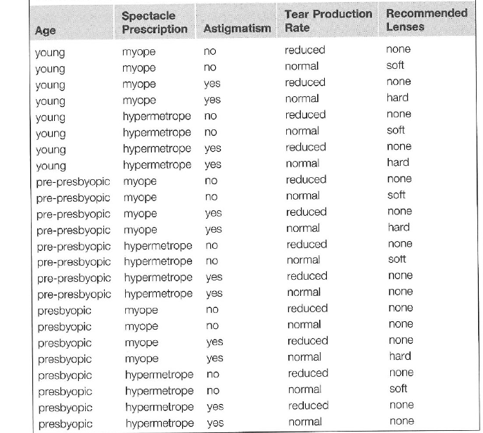

Slide 25
iNN(k) Results
Leave one out cross validation
All attributes are nominal
Dataset | Cases | Attributes | Classes
Contact Lenses | 24 | 4 | 3
Breast Cancer | 286 | 9 | 9
Lymphography | 148 | 18 | 4
SPECT Heart | 267 | 22 | 2

Slide 26
Accuracy

Slide 27
CBR in Medical Tutoring

Slide 28
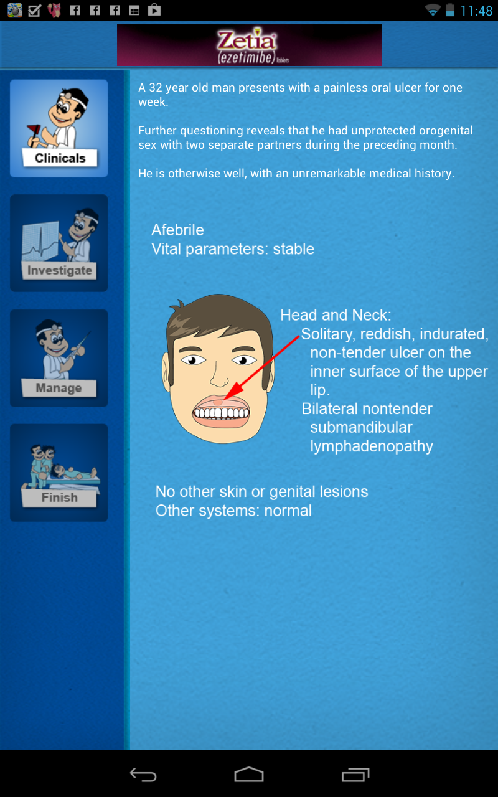

Slide 29
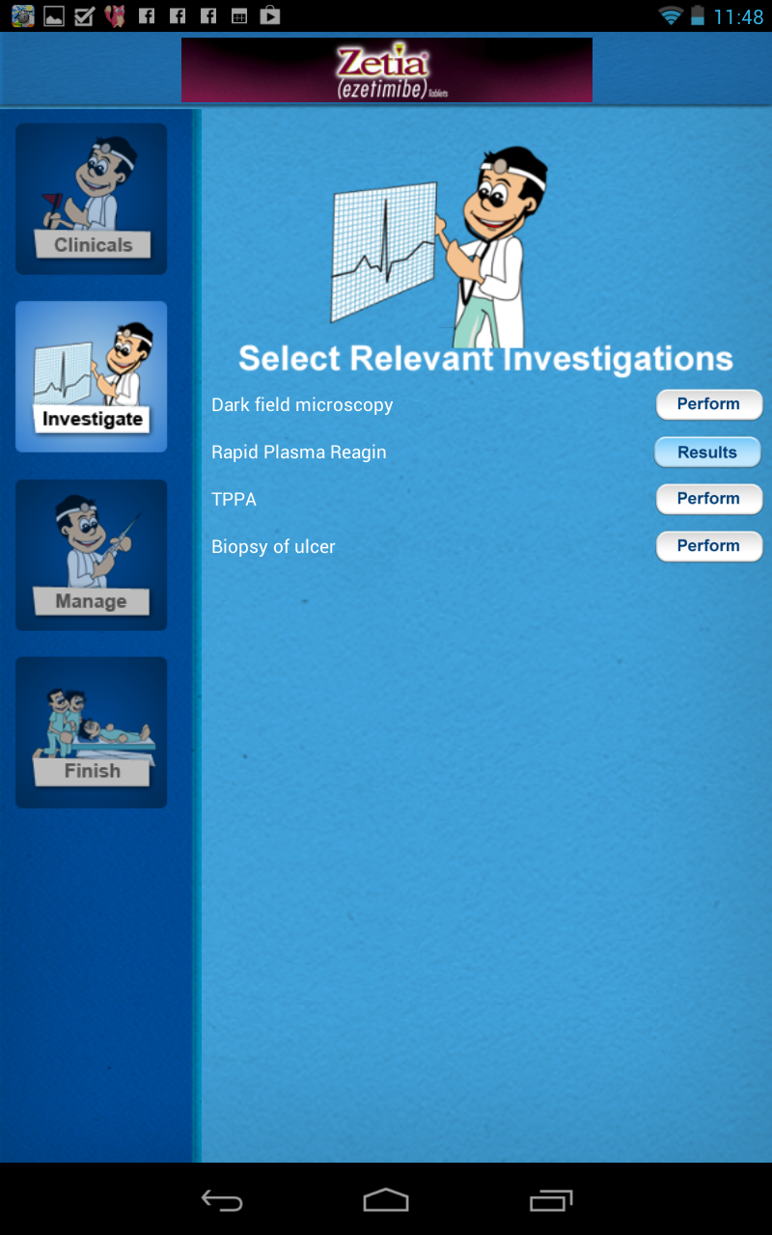

Slide 30
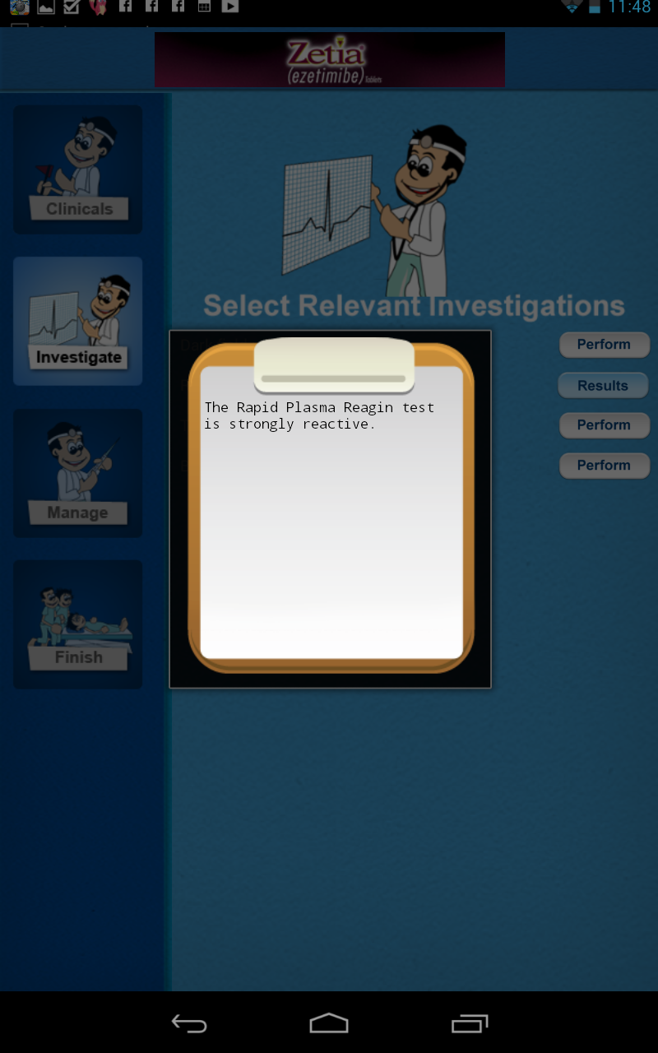

Slide 31
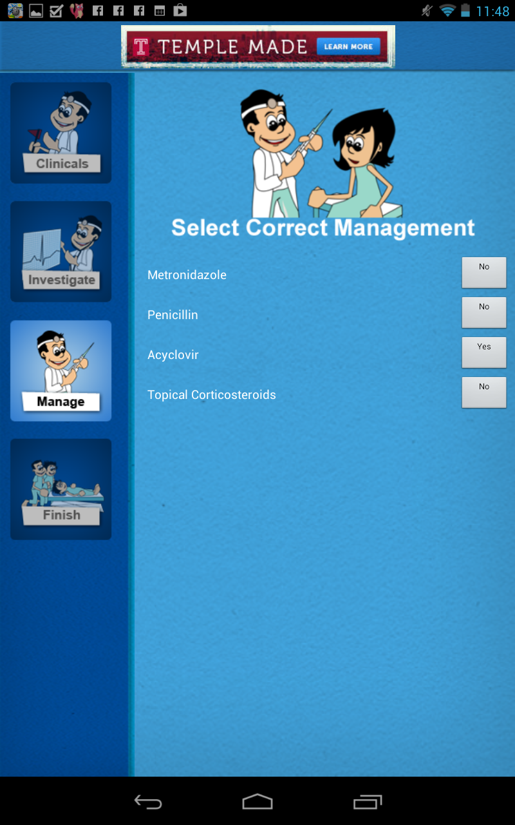

Slide 32
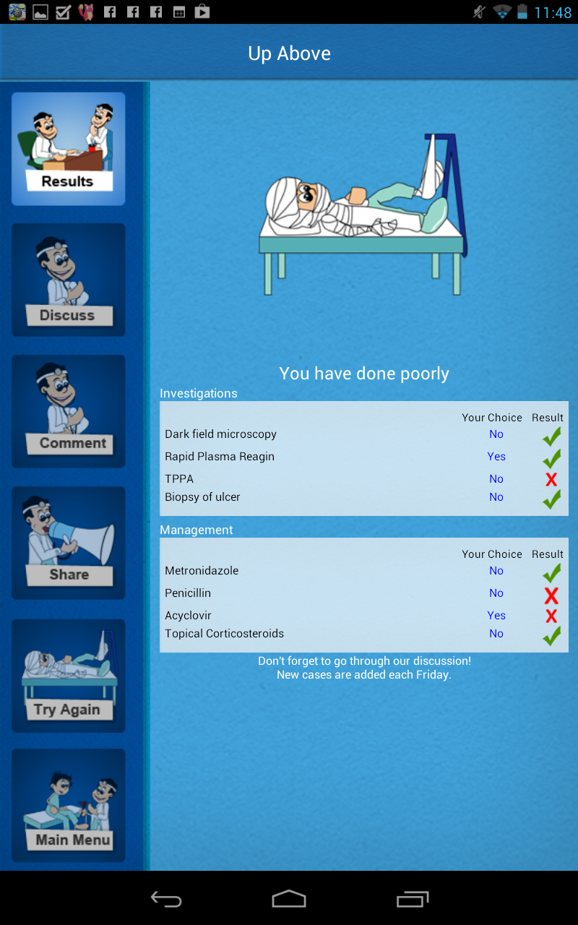

Slide 34
CBR in Medicine:
Problem: adaptation is difficult
No adaptation: retrieval-only systems
Sometimes identify differences between retrieved cases and current case(s)
Justification
Too complicated/impossible to acquire adaptation knowledge
Physicians want info about previous cases, but want to reason about current patients themselves. [3]

Slide 35
Resources
Chapter: CBR in Medicine from alternative source book
http://oucsace.cs.ohiou.edu/~marling/smarthealth/pubs/AIMAG-2012.pdf
http://www.mrtc.mdh.se/publications/0638.pdf
http://www.idi.ntnu.no/~agnar/CBR%20papers/Bichindaritz-carepartner98.pdf
http://people.unipmn.it/stefania/papers-pdf/A7.pdf
http://www.springerlink.com/content/q513k47721765440/

