Slide 1
CBR in the Oil Industry
Dustin Dannenhauer
dtd212@lehigh.edu
Presentation for CSE 435
11/05/2012

Slide 2
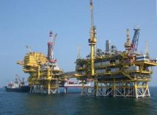
Contents
Oil Industry
Drilling for Oil
Problems
Overview of Using AI
TrollCreek
Drill Edge

Slide 3
Oil Industry

Slide 4
The Oil Industry
Oil and gas main energy sources in many countries
New wells are continuously demanded
Currently about 1190 offshore rigs in the world, %70 operational at any time
Over 3000 rotary land rigs in the world (2000 in US alone)
2025 forecasts an estimated need of 115 million BOPD from 85 million in 2010 (McCormack 2010)
Industry is heavily technology dependent
Notes:
30 seconds

Slide 5
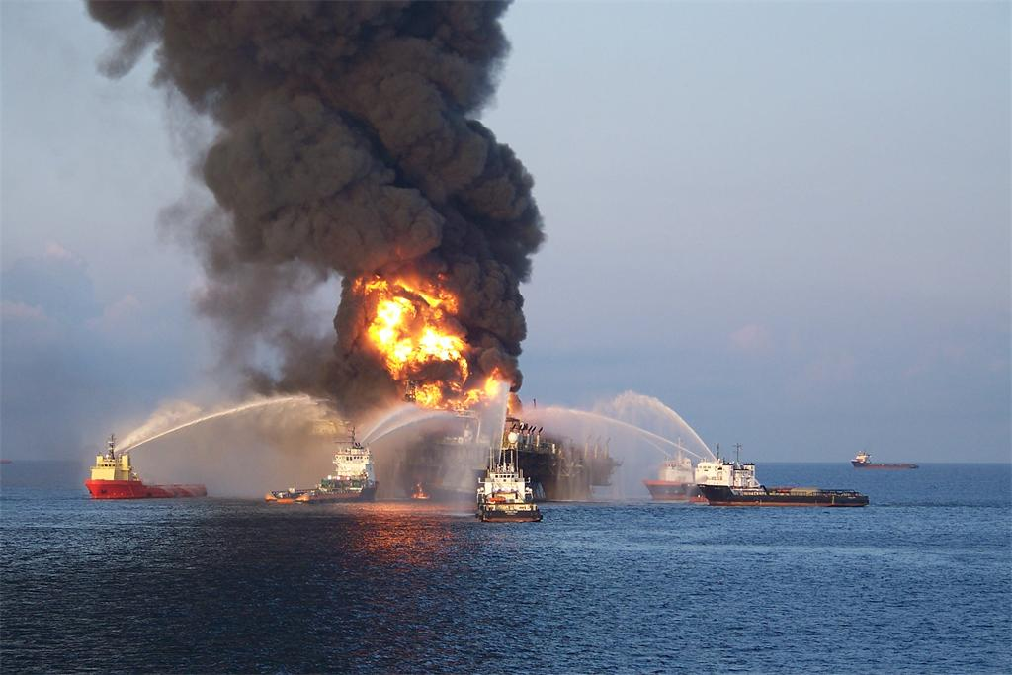
Oil Industry
Goals:
Measurable return on investment
Reduction in accidents (fires, blowouts, sinking/capsizing)
Improvement in oil and gas measurement yield
Fewer lost days of production
CBR can address all of these

Slide 6
Drilling for Oil

Slide 7
Drilling for Oil
Educational Video:
http://www.ustream.tv/recorded/8990220
http://www.youtube.com/watch?v=Q9gGqNUxQ5Q
Tripping: act of pulling drill string out and feeding it back in
Notes:
3 minutes for video – highlight important parts of the process

Slide 8
Process of Drilling
Complex Operation
Symptoms/Problems generally arise around the drill bit
Each well may experience similar and new problems
Especially given trajectories and composition
The source of oil may be as far as 10 km away from drilling rig [3]
Notes:
1 minute

Slide 9
Example: Deviated and Horizontal Drilling

Slide 10
Problems

Slide 11
Specific Problems to Drilling
Hole Cleaning
Hole Collapse
Swelling
Erosion of Weakened Wellbore
Thick Filter Cake
Lost Circulation (TrollCreek)
Dissolving

Slide 12
Problems w/ Knowledge in Industry
“Experience Attrition”
Not just age gap – communication gap (soft and hard skills)
Want “Lessons Learned” and “Best Practices
Study (Brett et al., 98) showed benefit of ~10% with sharing best practices within a company
Real Time Operation Centers
Good but still not perfect
Engineers staring at graphs 12 hours straight
Loss of communication between shifts

Slide 13
Overview of Using A.I.

Slide 14
Why Use CBR/A.I. in Oil Industry
Reduce costs (reduce non-productive time, NPT)
Offshore rigs cost hundreds of thousands of dollars per day per rig
NPT up to 30%
If NPT reduced 5% in a year, savings of 2.1 Billion
Offshore drilling typically takes 1 month high investment
Increase safety
Anything that can improve the process is demanded
Address Knowledge Problems
Limited access to human experts
Age gap problem
Notes:
3-5 minutes

Slide 15
General Sources of Data
Sensors installed at surface and downhole(@ drillbit)
Data is transmitted and translated
Generally monitored by humans reading real-time parameter graphs
Huge amount of data
Keeping live physical models is computationally expensive
Sometimes requires manual computation
Documents:
Daily drilling reports
End of well reports for every single well
Human Engineers

Slide 16
Why machine learning doesn’t work
Could not predict problems directly
Very few serious examples
Stuck pipe, stuck drill string, etc may only happen few times a year
Necessary to learn from very few examples
While generally not more than 10-20 parameters, often not possible to detect symptoms without looking at trends and frequencies over the last 12-24 hours
Machine learning is still used – but not as primary technique

Slide 17
Problems with Knowledge
Knowledge loss from poor communication, between shifts, etc leading to late identification of a problem
Some engineers stare at graphs 12 hours straight
Just becoming aware of a situation is crucial
Example problems:
Drilling pipe gets stuck in the ground because gravel pack around it
Drillstring twists off and drilling mud is lost in the formation

Slide 18
TrollCreek [4]
Skalle and Aamodt, 2005

Slide 19
TrollCreek
Address all phases of drilling process:
Planning (TC addresses drilling engineer)
Plan Implementation (TC addresses the driller and platform superintendent)
Post Analyses (adding the drilling engineer and management)
Cases describe specific situations
Indexed by relevant features
Structured into subcases at several levels
They are indexed by direct, non-hierarchical indices, leaving indirect indexing mechanisms to be take care of by the embedding of the indices with the general domain model

Slide 20
TrollCreek
All cases contain knowledge of:
Identifying information – such as owner, place/date, formation/geology, well section, depth/mudtype
Recorded parameter, specific errors or failures
Necessary procedures to solve the problem, normative cases, best practice, repair path (row of events)
Final path, success ratio of solved case, lessons learned, frequently applied links
Links may go to such things like corporate databases
For example: logging and measurement databases
or textual lessons learned documents or formal drilling reports

Slide 21
TrollCreek
Initial case matching using standard weighted feature sim metric
Each case in this set is either extended or reduced, based on explanations generated within the general domain model
Cases are structured in such a way that makes them suitable for finding the solution of a problem and/or to search for missing knowledge

Slide 22
TrollCreek
An initial repair path is always tried out by the drilling engineer, which usual succeeds.
However, if it fails, it turns into a new case, or new problem.
The model based reasoning with the general domain model may find a solution, even if no case is found. Then this specific situation, with this new solution, gets stored as a new case transforming general domain knowledge combined with case-specific data, into case-specific knowledge

Slide 24
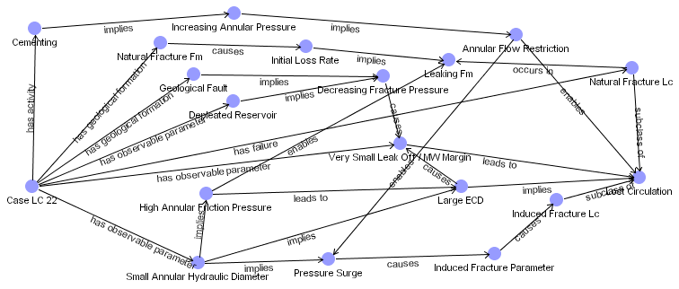

Slide 25
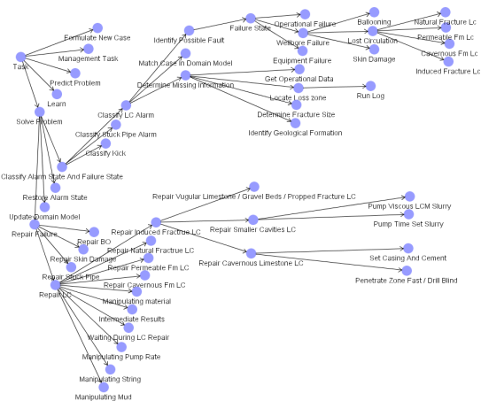

Slide 26
DrillEdge [3]

Slide 27
DrillEdge
Real-Time Decision Support System
High Cost Oil-Well Drilling Operations
Developed by Verdande Technology (Norway)
Awarded Meritous Award for Engineering Excellence for DrillEdge by E&P Magazine
Cost about 4.5 million to reach first commercial version in 2009
Currently 12 full time developers
Deployed on over 200 wells

Slide 28
DrillEdge: Purpose
Predict Problems
Classify different kinds of situations
Give advice how to mitigate problems

Slide 29
DrillEdge: Cases
Two parts: Description and Solution
Description used to compare cases
Solution is an experience transfer from human to human
Cases are captured and written by drilling experts
Represented as tree structures in XML files

Slide 30
DrillEdge: Case Descriptions
Features, such as:
Symptoms (location and time)
Design of bottom hole assembly
Qualities of formation or its composition
Type of drilling fluid and or composition
Trajectory of the well
Notes:
3-5 minutes - Be sure to go into detail about each one of these – also make sure you put effects so that as you click each example pops up

Slide 31
DrillEdge: Case Solution
Textual description intended for humans (4 parts)
Problem description part
Describes the specific situation
Symptoms part
Describes the symptoms they were experiencing
Response action
Actual actions taken
Recommended action
Based on post-analysis – what should have been done
Notes:
1-2 minutes – just let class read slide

Slide 32
DrillEdge: Cases as XML Files
Root node has two main sections:
Problem description
Problem solution
Each of these may contain other sections or leaf nodes
Example:
Problem Description contains:
Formation
Drilling fluid
Bottom hole assembly
Well Geometery
Symptoms
Formation section contains formation name and composition (lithology)
Drilling fluid section contains properties describing the fluid, such as mud weight and whether oil or water based

Slide 33
DrillEdge: Sequence Section of Case Description
Special kind of feature: Sequence Section
Contains “events” (which are symptoms)
Different types depending on type of symptom representing
Two sequence sections:
Distribution of events over a given depth of where the drill bit is
Represents events over a limited time period

Slide 34
DrillEdge: Case Similarity
Compare root nodes
Similarities of root nodes are aggregated into section similarities
Section similarities are combined recursively until the similarity of the root nodes are found
Root nodes can be of different types (ints, doubles, enumerations, sequences).
Different similarity measure can be configured for each comparison
Some are standard, others domain specific

Slide 35
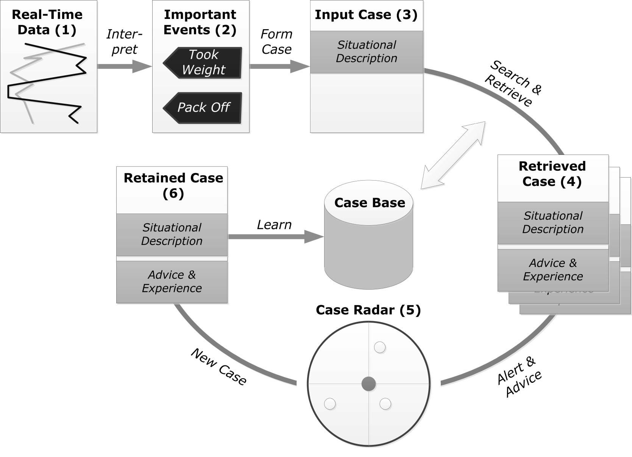
DrillEdge: CBR Cycle
Gunderson, Aamodt, & Skalle (AAAI 2012)

Slide 36
DrillEdge: Overall Process
Continuously compares the current situation with cases in case base
Each time step, real-time data is interpreted
If symptoms of problems are identified, events are fired
Current situation is represented by both important events and contextual information
Events are stored in the case as depth and time sequences

Slide 37
DrillEdge: From Engineer’s Perspective
DrillEdge searches and retrieves cases and compares them to the current case
Sorted on similarity
All past cases above a given threshold are visualized on a GUI element, a radar, to alert and advice the user of past historic cases
New case is created if current situation is not covered by any cases stored in the case base or if other advice applies to this situation
New cases are quality assured through peer review by a group of experts

Slide 39
DrillEdge: Challenges
3 Main Challenges:
Revising symptom recognition
Time used to find and capture a proper case
Real-time demands on similarity comparison

Slide 40
Summary and Questions?
Drilling for oil is a complex operation
Access to data and information is a huge problem in oil industry
CBR integrated with different reasoning methods has proven to be effective in reducing NPT

Slide 41
References
[1] Shokouhi, S. V., Aamodt, A., & Skalle, P. (2010). Applications of CBR in oil well drilling. In Proceedings of 6th International Conference on Intelligent Information Processing (pp. 102-111).
[2] Pål Skalle, Agnar Aamodt and Odd Erik Gunderson Transfer of experience for improved oil well drilling Advances in Drilling Technology - E-proceedings of the First International Conference on Drilling Technology (ICDT - 2010)
[3] Gundersen, Odd Erik, et al. "A Real-Time Decision Support System for High Cost Oil-Well Drilling Operations." Innovative Applications of Artificial Intelligence, IAAI (to appear, 2012) (2012).
[4] Skalle, Pål, and Agnar Aamodt. "Knowledge-based decision support in oil well drilling." Intelligent Information Processing II (2005): 443-455.
[5] Shokouhi, Samad, et al. "Determining root causes of drilling problems by combining cases and general knowledge." Case-Based Reasoning Research and Development (2009): 509-523.

Slide 42
Timeline of CBR Systems
Irrgang et al. (1999)
CSIRO – CBR for well planning – started “Drilling Club”
Skalle et al. (2000) (KI)
CBR during drilling - w/ 50 cases from North Sea – lost circulation
Bhushan et al. (2002)
CBR to globally search for reservoir analogues for planning and development of oil fields
Mendes et al. (2003)
CBR in Well Design – Initiative to model petroleum well design
Fuzzy sets and genetic algorithms
Karvis and Irrgang (2005)
Genesis – CBR for oil field design – multi-level indexing scheme
Khajotia et al. (2007)
Non typical approach – CBR within predictive mathematical model

Slide 43
CBR Systems
Irrgang et al. (1999)
CSIRO – CBR for well planning – started “Drilling Club”
Skalle et al. (2000)
CBR during drilling - w/ 50 cases from North Sea – lost circulation
Bhushan et al. (2002)
CBR to globally search for reservoir analogues for planning and development of oil fields
Mendes et al. (2003)
CBR in Well Design – Initiative to model petroleum well design
Fuzzy sets and genetic algorithms
Karvis and Irrgang (2005)
Genesis – CBR for oil field design – multi-level indexing scheme

Slide 44
Ki-CBR Systems

Slide 45
Knowledge Intensive CBR (Ki-CBR)
Skalle et al. (2000)
CBR during drilling - w/ 50 cases from North Sea – lost circulation
Transfer of Experience
Skalle, Aamodt, Gunderson 2010
TrollCreek
Skalle and Aamodt, 2005
Mendes et al. (<insert year here>)

Slide 46
Skalle et al. (2000) – CBR – North Sea - LC
Offshore oil well drilling
Focused on Lost Circulation
Losing drill fluid in formation – fluid not returning to surface
Many different solutions based on formation, fluid, and current technologies (cement, etc)
Extensive General Knowledge Model
50 different cases created from one North Sea operator
Retrieve 5 top cases
Informal evaluation showed the 2 best fitting cases gave valuable advice to the operator

Slide 47
Skalle et al. (2000) – Cases & GKM
Case represents a user experience
Different attributes may match/not match by related with general knowledge model
General Knowledge Model supports by:
Enables semantic searching for past cases (instead of pure syntactic) – 2 parameters that may seem different might be similar (for example may be different values but both are increasing)
Help explain how past solution can help current situation (adaptation)
Used to explain what to retain in new case (i.e. the ML part)

Slide 48
Skalle et al. (2000) – Overall Process
a) Gather data
b) Detect a possibly approaching problem
c) Decide if gathered data are sufficient to define the situation as a new problem. If not;
d) Perform additional examinations (i.e. check loss rate, check circ. pressure etc.).
e) Search the case base for similar past cases.
f) Generate a set of the most likely hypothesis and present a set of possible solutions in descending order to the current problem.
g) Use general domain knowledge to provide explanatory support for each plausible
hypothesis, and refine the hypothesis list.
h) Interact with user to select the best hypothesis. Generate a detailed "to-do" list,
i) After the case has been solved, the case base can be updated based on the situation just experienced.

Slide 49
CBR in Oil Industry
Cases generally describe abnormal situations
Some cases are normal situations similar to abnormal to help distinguish what makes a situation abnormal

Slide 50
CBR Systems in the Oil Industry
Several researchers and companies have tried out CBR for oil drilling assistance, few reach deployment
CSIRO -> Genesis:
Mendes et al. : Formal Oil Well Planning Methodology
DrillEdge:
only system that links on-line data streams to past cases for real-time decision support
Related domains: well planning, reservoir engineering, petroleum geology

Slide 51
CSIRO -> Genesis
CSIRO -> Genesis
One of the first
Each well was represented as 1 case
Case structure had three levels
Groups of cases
Groups of attributes
Groups of defined drilling phases and operations
Used multiple cases at varying levels of generality
Used automated tools to:
Extract knowledge
Indexes for the case base from text description

Slide 52
Mendes et al.
CBR in offshore well design (planning)
Resulted in a formalization of a methodology for planning an oil well in CBR context
Used fuzzy set theory for indexing and matching of index features
Genetic algorithm to determine the proper trajectory and all pertinent information for drilling

Slide 53
KiCBR applied to Hole Cleaning
Hole Cleaning is one of the most important problems
Continuous process
Extreme situations can cause well failure
Phenomenon is not completely understood
Especially with deviated and horizontal drilling
Shokouhi, Aamodt, Skalle, Sormo (2009)

Slide 54
KiCBR: Hole Cleaning
Why CBR?
Allows us to view a large set of parameters as a single unit
Previous studies only focused on one paramter at a time
Goal: Reduce Non Productive Downtime (NPT)
Real Time data is main source of problem description
Predict possible problems ahead of drill bit

Slide 55
KiCBR: Hole Cleaning
Three knowledge models needed:
Taxonomy – extracting important terms from domain
Causal Model – model that describes causes and effects
Case base
Features:
Administrative Data, wellbore formation characteristics
Plan data, static and variable drilling data
Drilling activity before case occurence, response action
Conclusion

Slide 56
Case Structure

Slide 57
Similarity Metric

Slide 58
KiCBR: Sim Metric Explained
Relevance Factor is a numerical weight of a feature
Symbolic term only used with model based part
Three types of Features:
Direct Observations – Inferred Paramters –Interpreted Events
0.25 0.5 1.0

Slide 59
KiCBR: Model

Slide 60
Example Event: Pack Off
Notes:
Another example of why ML doesn’t work

Slide 61
KiCBR: Experiments
Leave-one-out cross validation
7 Cases
Using general knowledge (model) 2 benefits:
Increase similarity
May change which case is most similar

Slide 62
Additional Information

