Slide 1
Class Presentations
Guidelines:
You should go beyond the assigned material
Prepare for a full class presentation (50 minutes)
e-mail to me a draft of the powerpoint presentation at least 1 week before the due date
You are responsible for understanding the material you are presenting. If there are things you don't understand, look for the citations, and read the references needed for you to understand.
Be prepared for interruptions during your presentation. I want to understand your presentation very well; when I don't understand something I will ask.

Slide 2
Example Domains
So far we have discussed domains for analysis tasks:
Help-desk systems
Medicine
Yes/No classification for waiting in a restaurant
Prediction of debt recovery (credit card)
Domains for synthesis tasks:
Printer configuration domain
Machining domain
Military domain: non combatant evacuation operations

Slide 3
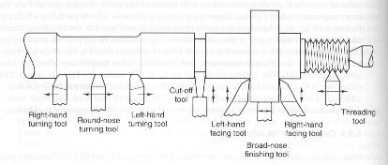
Mechanical Manufacturing Domain
Process planning problem: to determine the methods and sequence of machining operations to produce a finish component to design specifications
Machines
Tools
Sequence of steps
Timing
Routing/cost combinations
Provision for alternate and concurrent operations

Slide 4
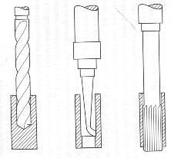
Mechanical Manufacturing Domain (II)
I. diameter < 0.5”
A. true position > 0.01
1. tolerance > 0.01
Drill the hole
2. tolerance < 0.0
drill and ream
B. true position < 0.01
1. tolerance > 0.01
drill and finish bore
2. Tolerance < 0.01
drill, semi-bore, and finish bore ……
III. …...
drilling
boring
reaming

Slide 5
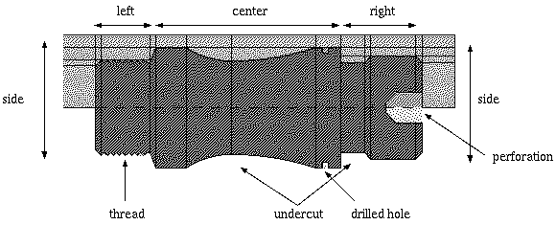
Mechanical Manufacturing Domain (III)

Slide 6
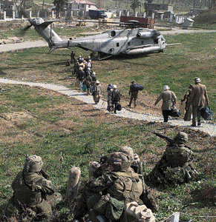
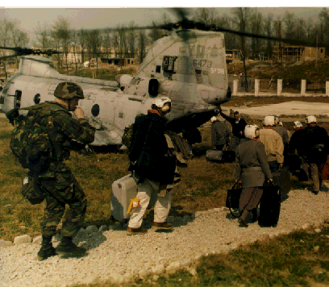
Noncombatant Evacuation Operations Domain
Goal: Assist DoS to evacuate noncombatants, whose lives are in danger
Characteristics:
Uncertainty; complex (200+ tasks); distributed
US Ambassador is senior authority!!
Planning: Responsibility of geographic combatants
Resources: Doctrine, DoS, EAP, etc.

Slide 7
Noncombatant Evacuation Operations Domain (II)
Some Interesting Happenings:
- During Operation Desert Shield
- Mid air refueling: Fuel spill, inexperienced pilots
- Buzzing the embassy the hostiles scattered
- Transported evacuees to embassy (e.g., non-citizen ambassadors)
- Night Vision Goggles & Problems with Lights
- Pistol removed upon entry to a helicopter
- Bribe to a Somali Major
- Clown on board
- Birth on-board; 281 → 282 evacuees

Slide 8
Case Representation
Sources:
Chapter 3 (Book)
www.iiia.csic.es/People/enric/AICom.html
www.ai-cbr.org

Slide 9
Contents of a Case
Generally a case contains specific knowledge about a previous problem solving experience
Typically a case contains the following information:
Problem/Situation
Solution
Adequacy (utility)
Scope of the information:
Complete solution/partial solution
Detail or abstracted solution
Representation formalism:
Attribute-value pairs
Structured representation: Objects, trees
High-order: predicate logic, plans
(example: help-desk systems)
(example: planning)

Slide 10
Information About the Problem/Situation
A problem/situation may described:
A solved problem
An analyzed situation
(example: diagnosis)
(example: military domain)
The description of a situation must contain all information necessary to determine if a case can be reused in other situations (the Eastern Exit Operation example)
Situation/problem description may contain:
Goal of the case
Constraints and conditions
In general, any relevant information

Slide 11
Example of Case Conditions
Title: Perform Long Range Troop Insertion (Eastern Exit)
Goal: Determine Insertion Procedure
Conditions:
1. Aerial refueling aircraft available
2. Helicopters equipped for aerial refueling
3. Pilots trained for aerial refueling
…
Actions:
1. Embark troops in helicopters
2. Determine intermediate refueling point
3. Fly helicopters to refueling point
4. Continue helicopters to final destination

Slide 12
Information About the Solution
The kind of information about the solution depends on the adaptation procedure:
Simple Yes or No
Sequence of actions
Complex structure including constrains and justifications
(example: help-desk)
(example: manufacturing)

Slide 13
Example of Complex Solution
Mount Piece on the Lathe machine at position X, Y
Rotate machine at Z speed
Select drilling tool with M cm head diameter
Justification: tool and speed determine possible trajectories
Select trajectory for the tool

Slide 14
Information About Adequacy
Feedback from the environment:
Was the solution applicable?
What was the cost of adapting this solution?
(example: help-desk)
(example: manufacturing)
Example:
Is the diagnostic correct?
How long does it took to adapt the manufacturing plan?
What is the cost of the machining operations of the new plan?

Slide 15
Complete/Partial Solution
This question arises primarily for synthesis tasks
If there are too many interdependencies between pieces of the solutions, cases will contain the whole solution.
(example: manufacturing plans)
If pieces of the solutions are more or less independent, cases will contain those pieces.
(example: military domain)

Slide 16
Detail/Abstract Solution
This question arises primarily for synthesis tasks
If there are ways to abstract the concrete solutions and vice-versa, we could consider storing these abstracted solutions. Why?
To increase the re-usability of the cases
If such a way doesn’t exists, we are “stuck” with the concrete solutions

Slide 17
Attribute-Value Case Representation
Case: a collection of attribute-value pairs
Example: Each row in the wait-restaurant table is a case
Examples in the IDT context correspond to cases
Attributes can be the same for all cases or vary from case to case
Each attribute is from a certain type. For example:
Integer: all integers or an interval
Real: all numbers or an interval
Symbol: finite set of alternatives (e.g., Thai, Italian,…)
Hypertext: HTML (e.g., HICAP)

Slide 18
Formalization
Attributes: A₁, A₂, .., A_{n}
Types: T₁, T₂, …, T_{n}
Values a₁ in T₁, a₂ in T₂, …, a_{n} in T_{n}
Unknown values is the main difference between a case and an example in the sense of IDT
A case is defined as follows:
If all cases have the same number of attributes, a case is a vector:
(a₁, …, a_{n}) in T₁ ∪ {unknown} × … × T_{n} ∪ {unknown}
If cases have a varying number of attributes, a case is a set: {A_{p} = a_{p}, …, A_{k} = a_{k}}
(attributes that are not in the set are considered unknown)

Slide 19
Selection of Attributes
Situation description:
Independence: Attributes should represent independent features whenever possible
Completeness: the attributes should be sufficient to determine if the case can be reused in a new situation
Minimalist: The only attributes that should be included in a case are those used in to compute similarity
(ex: type of restaurant versus week day)
(not always possible: patrons and day of the week are related)

Slide 20
Selection of the Types
Selection of the types is defined by the elements needed to compute similarity
Symbolic:
Ideal for a small number of alternatives (e.g., type of restaurant)
Integer/Real
Ideal for measures and other numeric values
Computation of similarity is straightforward
Text:
Ideal for unstructured information
Computation of similarity can be very difficult

Slide 21
Example
Case 1
Symbol: work,doesn’t work
Symptoms:
Front-light = doesn’t work
Car-type = Golf II, 1.6
Year = 1993
Batteries = 13.6V
…
Symbol: Golf, Mercedes,…
Symbol: 1960, …, 2002
Real: 1V … 30V
Solution:
Diagnosis:
Front-lights-safeguard = broken
Help measures:
“Replace front lights safeguard”
Symbol: ok, broken
Text

Slide 22
Homework Assignment
(ALL) Select a machine that you feel particularly familiar with it (e.g., your PC, the graphic card of your pc). List at least 10 attributes and their types that you feel are relevant to make a diagnosis of a failure for that machine
(ALL) Suppose that (1) you have a classification-task domain with many attributes (say 1000+ attributes) and (2) there is a lot of data collected (basically a table with many rows, whose columns are the attributes). Suppose that you know there are many attributes that are not needed for the classification problem. Indicate how to determine a subset of relevant features

Slide 23
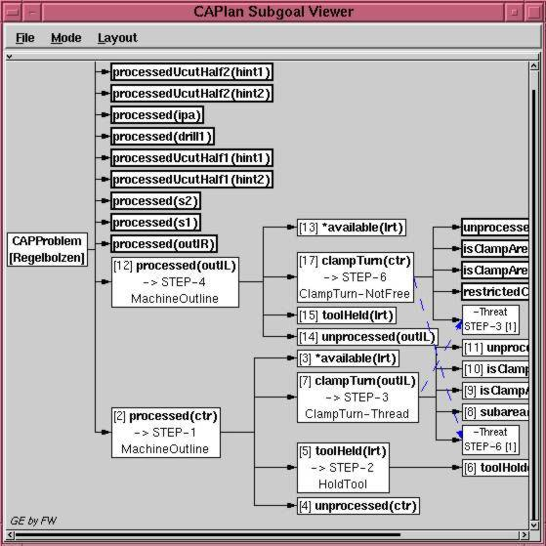
Tree Representation
Structured representations are needed when there are multiple relations between elements of the problem

Slide 24
Objects and Classes
An object class describes the structure of an object through a (finite) collection of attributes and their types
An instance (or an object) of an object class assigns values of the corresponding type for each attribute in the class

Slide 25
Example (Objects and Classes)
Class: Symptoms
Instance: Entry # 314
Front-light: symbol
Car-type : symbol
Year: Symbol
Batteries: Real
…
Front-light = doesn’t work
Car-type = Golf II, 1.6
Year = 1993
Batteries = 13.6V
…

Slide 26
Relations Between Objects
Relations between objects are important
Typical kinds of relations:
Taxonomical relations: “is-a-kind-of” indicates abstraction/refinement relations between objects
Compositional relations: “is-a-part-of” indicates that objects are parts of other objects
(example: car is a kind of transportation means)
(example: motor is a part of a car)

Slide 27
Compositional Relations
Car
Fuel system
Motor
Electrical system
Carburator
Exhaust
…
Compositional relations are described through relational attributes
Relational Attributes are attributes whose values are objects

Slide 28
Example (Compositional Relation)
Class: CarC
Instance: Toyota Tercel
Model: symbol
Make : symbol
Year: Symbol
Motor: MotorC
…
Model: Tercel
Make : Toyota
Year: 1991
Motor:
…
Class: MotorC
Instance: …
SerialN: int
Liter : real
Carburator: CarbC
…
SerialN: 1263455233
Liter : 1.5
Carburator: …
…

Slide 29
Taxonomical Relations
Transportation Means
Air trans.
Land trans.
Sea trans
car
…
Sport utility
Taxonomical relations are explicitly represented
The subclass inherits all the attributes of the superclass

Slide 30
Example (Taxonomical Relation)
Class: Land Transport
Max speed: int
horseP: int
…
instance: ToyotaTercel
Max speed: 100 mph
horseP: …
…
Model: Tercel
Make : Toyota
Year: 1991
Price: $2000
…
Class: CarC
Model: symbol
Make : symbol
Year: Symbol
Price: int
…

Slide 31
Analysis of Object-Oriented Case Representations
Advantages:
Structured and natural in many domains
Relations between objects are explicitly represented
More compact storage compared to with attribute-values
Structured relations can be used to define similarity
Example domain: design and configuration
Disadvantages:
Similarity computation and retrieval can be time costly
Time order cannot be represented
Example domain: planning

Slide 32
Predicate Logic Representation
Problem/Solution from a case can be represented through predicates:
predicate
term
Case:
Symptoms:
Case(
symptoms(frontLight(dw),
carType(GolfII_1.6),
year(1993),
batteries(13.6),…),
diagnosis(broken(fls),
measures(rfls)))
Front-light = doesn’t work
Car-type = Golf II, 1.6
Year = 1993
Batteries = 13.6V
…
Solution:
Diagnosis:
Front-lights-safeguard = broken
Help measures:
“Replace front lights safeguard”

Slide 33
Predicate Logic Representation (cont’d)
Attribute-value pairs representation of cases can be represented as predicates (each attribute is represented as a term and a predicate “encapsulates” all terms)
Tree can also be represented as predicates
(each node is a predicate and the links are terms)
Object representations can also be represented as predicates
(terms represent the hierarchical relations)

Slide 34
Predicate Logic Representation (cont’d)
Advantages:
As flexible as it gets (I am exaggerating)
Complex structural relations can be represented
Can take advantage of inference mechanism (i.e., prolog)
Disadvantages:
Computing similarity can be very complicated
Inference procedures are frequently very time costly
SAT is NP-complete.

Slide 35
Formulas (SAT): Definition
Definition. A Boolean formula is defined recursively as follows:
A Boolean variable is a Boolean formula
If φ₁ and φ₂, are Boolean formulas then:
(φ₁ ∧ φ₂)
(φ₁ ∨ φ₂)
(φ₁ ⇒ φ₂)
are also Boolean formulas
If φ is a Boolean formula then ¬(φ) is a Boolean formula
Assume that there are no redundancies in parenthesis
Example: ((x ∧ y) ∨ ¬x) → y
Definition. (SAT) Given a Boolean formula φ, is there an assignment of the variables in φ that makes the formula true?

Slide 36
Graph Representation
Graph representations are useful in many domains:
Data flow
Planning
Query answer
Mount Piece on the Lathe machine at position X, Y
Rotate machine at Z speed
Select drilling tool with M cm head diameter
Can’t be represented as a tree
Select trajectory for the tool

Slide 37
Analysis of Graph Representations
Advantages:
Structured and natural in many domains
Relations between objects are explicitly represented
Structured relations can be used to define similarity
Disadvantages:
Similarity computation and retrieval can be time costly
Graph-Subgraph Isomorphism is NP-complete!

Slide 38
Graphs: Definition
G = (V, E)
Edges (arcs)
Vertices (nodes)
Edges are a subset of V × V
{(v,v’) : v and v’ are in V}
We also write v→ v’ instead of (v.v’)

Slide 39
Subgraphs
Given a graph G = (V, E) and a graph G’ = (V’, E’), G is a subgraph of G’ if:
V ⊆ V’
E ⊆ E’
Every element in the left set is an element in the right set

Slide 40
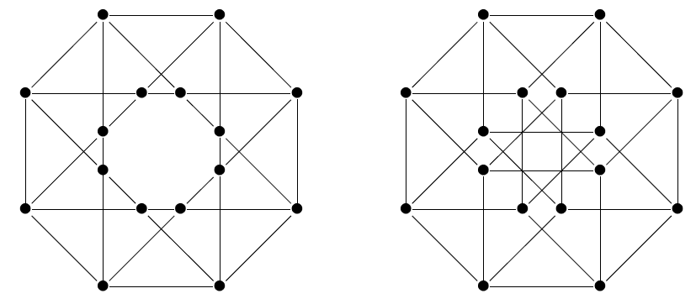
Graph-Subgraph Isomorphism
Two graphs G1 = (V1,E1) and G2 = (V2,E2) are isomorphic if a bijective function f: V1 → V2 exists such that:
If (u,v) is in E1 then (f(u),f(v)) is in E2
If (u’,v’) is in E2 then (f(u’),f(v’)) is in E1
Graph-Subgraph Isomorphism problem is NP-complete: Given two graphs G1 and G2 is G1 isomorphic to a subgraph of G2?
Example of 2 isomorphic graphs:

