Slide 1
Homework

Slide 2
Homework (next class)
Read Chapter 2 of the Experience Management book and answer the following questions:
Provide an example of something that is data but not information, something that is information but not knowledge, and something that is knowledge
Give an example of experience. Why can’t experience be general knowledge?
What is the relation between experience management and CBR? What is/are the difference(s)?
Provide an example for each of the 4 phases of the CBR cycle for a domain of your own (can’t be the restaurant example). First you would need to think what is the task that you are trying to solve. Please specify. Is this a classification or a synthesis task? Please specify

Slide 3
From Data to Knowledge
Abstract
Clauses or meta-relations:
GrandParent(X,Z) if
Parent(X,Y) and
Parent(Y,Z)
Experience
Knowledge
Information
Relations: parent(john, Sebastian)
Data
Simple objects: john, Sebastian
Concrete

Slide 4
Experience Management vs CBR
Complex problem solving
Problem acquisition
Experience Management
Development and Management Methodologies
Reuse-related knowledge
Experience evaluation and retrieval
Experience base
(Organization)
Experience presentation
Experience adaptation
CBR
BOOK
Case Library
4. Retain
1. Retrieve
Background Knowledge
(IDSS)
3. Revise
2. Reuse

Slide 5
Decision Trees
CSE 335/435
Resources:
Main: Artificial Intelligence: A Modern Approach (Russell and Norvig; Chapter “Learning from Examples”)
Alternatives:
http://www.dmi.unict.it/~apulvirenti/agd/Qui86.pdf
http://www.cse.unsw.edu.au/~billw/cs9414/notes/ml/06prop/id3/id3.html
http://www.aaai.org/AITopics/html/expert.html
(article: Think About It: Artificial Intelligence & Expert Systems)
http://www.aaai.org/AITopics/html/trees.html

Slide 6
Motivation # 1: Analysis Tool
Suppose that a company have a data base of sales data, lots of sales data
How can that company’s CEO use this data to figure out an effective sales strategy
Safeway, Giant, etc cards: what is that for?

Slide 7
Motivation # 1: Analysis Tool (cont’d)
Sales data
Decision Tree
Ex’ple | Bar | Fri | Hun | Pat | Type | Res | wait
x1 | no | no | yes | some | french | yes | yes
x4 | no | yes | yes | full | thai | no | yes
x5 | no | yes | no | full | french | yes | no
x6
x7
x8
x9
x10
x11
induction
“if buyer is male & and age between 24-35 & married
then he buys sport magazines”

Slide 8
Motivation # 1: Analysis Tool (cont’d)
Decision trees has been frequently used in IDSS
Some companies:
SGI: provides tools for decision tree visualization
Acknosoft (France), Tech:Inno (Germany): combine decision trees with CBR technology
Several applications
Decision trees are used for Data Mining

Slide 9
Parenthesis: Expert Systems
Have been used in (Sweet; How Computers Work 1999):
medicine
oil and mineral exploration
weather forecasting
stock market predictions
financial credit, fault analysis
some complex control systems
Two components:
Knowledge Base
Inference Engine

Slide 10
The Knowledge Base in Expert Systems
A knowledge base consists of a collection of IF-THEN rules:
if buyer is male & age between 24-50 & married
then he buys sport magazines
if buyer is male & age between 18-30
then he buys PC games magazines
Knowledge bases of fielded expert systems contain hundreds and sometimes even thousands such rules. Frequently rules are contradictory and/or overlap

Slide 11
The Inference Engine in Expert Systems
The inference engine reasons on the rules in the knowledge base and the facts of the current problem
Typically the inference engine will contain policies to deal with conflicts, such as “select the most specific rule in case of conflict”
Some expert systems incorporate probabilistic reasoning, particularly those doing predictions

Slide 12
Expert Systems: Some Examples
MYCIN. It encodes expert knowledge to identify kinds of bacterial infections. Contains 500 rules and use some form of uncertain reasoning
DENDRAL. Identifies interpret mass spectra on organic chemical compounds
MOLGEN. Plans gene-cloning experiments in laboratories.
XCON. Used by DEC to configure, or set up, VAX computers. Contained 2500 rules and could handle computer system setups involving 100-200 modules.

Slide 13
Main Drawback of Expert Systems: The Knowledge Acquisition Bottle-Neck
The main problem of expert systems is acquiring knowledge from human specialist is a difficult, cumbersome and long activity.
Name | KB | #Rules | Const. time (man/years) | Maint. time (man/years)
MYCIN | KA | 500 | 10 | N/A
XCON | KA | 2500 | 18 | 3
KB = Knowledge Base
KA = Knowledge Acquisition

Slide 14
Motivation # 2: Avoid Knowledge Acquisition Bottle-Neck
GASOIL is an expert system for designing gas/oil separation systems stationed of-shore
The design depends on multiple factors including:
proportions of gas, oil and water, flow rate, pressure, density, viscosity, temperature and others
To build that system by hand would had taken 10 person years
It took only 3 person-months by using inductive learning!
GASOIL saved BP millions of dollars

Slide 15
Motivation # 2 : Avoid Knowledge Acquisition Bottle-Neck
Name | KB | #Rules | Const. time (man/years) | Maint. time (man/months)
MYCIN | KA | 500 | 10 | N/A
XCON | KA | 2500 | 18 | 3
GASOIL | IDT | 2800 | 1 | 0.1
BMT | KA (IDT) | 30000+ | 9 (0.3) | 2 (0.1)
KB = Knowledge Base
KA = Knowledge Acquisition
IDT = Induced Decision Trees

Slide 16
Example
Ex’ple | Bar | Fri | Hun | Pat | Alt | Type | wait
x1 | no | no | yes | some | yes | French | yes
x4 | no | yes | yes | full | yes | Thai | yes
x5 | no | yes | no | full | yes | French | no
x6 | yes | no | yes | some | no | Italian | yes
x7 | yes | no | no | none | no | Burger | no
x8 | no | no | yes | some | no | Thai | yes
x9 | yes | yes | no | full | no | Burger | no
x10 | yes | yes | yes | full | yes | Italian | no
x11 | no | No | no | none | no | Thai | no

Slide 17
Example of a Decision Tree
Patrons?
none
Full
some
no
yes
waitEstimate?
0-10
>60
30-60
10-30
no
Alternate?
Hungry?
yes
no
yes
No
Yes
Reservation?
Fri/Sat?
yes
Alternate?
no
yes
no
yes
no
yes
Bar?
Yes
No
Yes
yes
Raining?
no
yes
no
yes
No
Yes
no
yes

Slide 18
Definition of A Decision Tree
A decision tree is a tree where:
The leaves are labeled with classifications (if the classification is “yes” or “no”. The tree is called a boolean tree)
The non-leaves nodes are labeled with attributes
The edges out of a node labeled with an attribute A are labeled with the possible values of the attribute A

Slide 19
Some Properties of Decision Trees
Decision trees represent rules (or more formally logical sentences):
∀r (patrons(r,full) ∧ waitingTime(r,t) ∧ t > 60
→ ¬willWait(r))
Decision trees represent functions:
F: Patrons × WaitExtimate × Hungry ×
type × Fri/Sat × Alternate × Raining → {True,False}
F(Full, >60, _, _, _, _, _) = No
F(Full,10-30,Yes,_,_,Yes,Yes) = Yes
…

Slide 20
Some Properties of Decision Trees (II)
Lets consider a Boolean function:
F: A₁ × A₂ × … × A_{n} →{Yes, No}
F can obviously be represented in a table:
A₁ | A₂ | … | A_{n} | y/n
Homework Question: What is the maximum number of rows does the table defining F has assuming that each attribute A_{i} has 2 values?

Slide 21
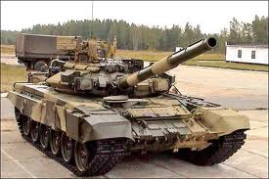
Some Properties of Decision Trees (III)
Answer: A lot!
(You are tasked with give a formula for the exact number)
Danger (not just for decision trees but for learning in general):
Overfitting: learner adjust to features of the data that do not reflect the target function
Infamous example

Slide 22
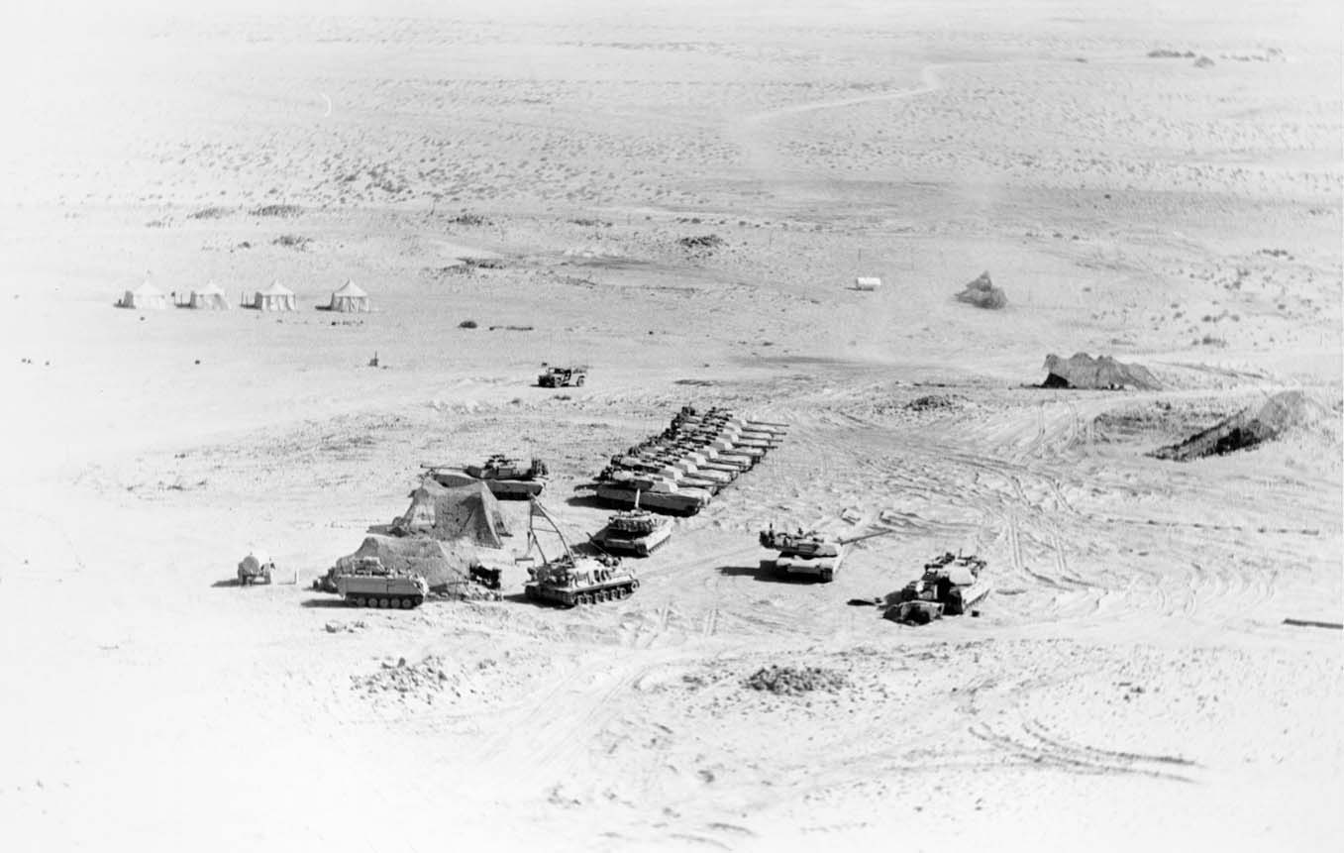

Slide 23
Some Properties of Decision Trees (IV)
We observed that given a decision tree, it can be represented as a Boolean function.
Question: Given a Boolean function:
F: A₁ × A₂ × … × A_{n} →{Yes, No}
Where each of A_{i} can take a finite set of attributes. Can F be represented as a decision tree?
Answer: Yes!. Make A₁ first node, A₂ second node, etc. (Brute force)
A table may have several possible decision trees

Slide 24
Homework Next Class
Assignment:
We never test the same attribute twice along one branch in a decision tree. Why not?
See Slide 22
(CSE 435) Investigate and write down the definition for NP-complete
(CSE 435) Provide an informal explanation of what this means

