Slide 1
Knowledge Containers
Giulio Finestrali
CSE 435 – Intelligent Decision Support Systems
Instructor: Prof. Hector Muñoz-Avila
Lehigh University – Fall 2012

Slide 2
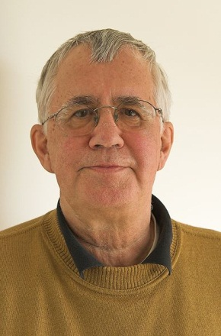
Introduction
The notion of Knowledge Containers was introduced by Michael M. Richter
Richter, M. M. (2003). Knowledge containers. Readings in Case-Based Reasoning. Morgan Kaufmann Publishers.
Picture source: Wikipedia

Slide 3
Representing Knowledge

Slide 4
Representing Knowledge
A knowledge based system is often organized in modules
The system’s knowledge can be organized in modules as well!
To represent the knowledge in our system we need to define a representation language

Slide 5
What is a Knowledge Container
A representation language is a collection of description elements.
Example: in logic programming, one has to define facts and rules.
We call such description elements knowledge containers

Slide 6
Kinds of Knowledge
Knowledge can be of two kinds:
Expressed Knowledge
Inferred Knowledge
The inferred knowledge is obtained by reasoning on the expressed knowledge
We can express knowledge by the use of data structures

Slide 7
Knowledge Container ≠ Data structure
A data structure is essential for representing knowledge, but it does not constitute a knowledge container by itself
A knowledge container can require several data structures
Also, the same data structure can be used in multiple containers

Slide 8
Knowledge Containers: Summary
Knowledge Containers are a modular representation of the Available Knowledge in a knowledge-based system
The Available Knowledge is partitioned in different KC by arbitrary logical and semantic rules
Knowledge containers do not contain only simple knowledge. Instead, they can also contain its formulation
This lets KCs to hold not only expressed knowledge but also inferred knowledge, by storing the way this kind of logic is obtained

Slide 9
The CBR Knowledge Model

Slide 10
The CBR Knowledge Model
CBR is different than most knowledge representation systems: more flexible and sometimes more powerful.
In CBR, we can improve the system by carefully handling knowledge containers: we can shift knowledge between containers in order to improve the performances of a CBR system.

Slide 11
Knowledge Containers in CBR
In CBR we define four knowledge containers:
Vocabulary
Similarity Measure
Case Base
Solution Transformation
These containers are not static but they interact between each other and their contents change throughout the execution of the system.

Slide 12
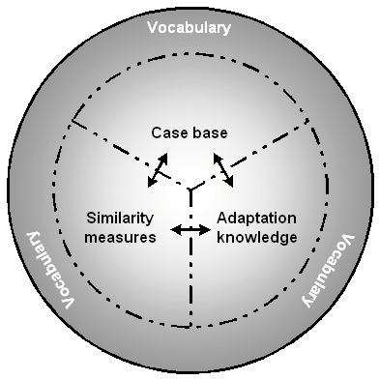
Containers interaction in CBR
Observation:
No container is able to solve completeley a task using exclusively its knowledge.
The containers depend on each other to solve a given task.

Slide 13
Vocabulary
The Vocabulary is the most basic Knowledge Container, yet probably the most important
It is common in every Knowledge-based system, not only in CBR
It contains everything we can talk about explicitly
In the case of CBR systems with attribute-value representation, the Vocabulary contains every attribute definition, the possible values for each attribute, the attribute weight etc.

Slide 14
Vocabulary - continued
Consider a computable attribute C (like the quotient between two attributes). C is called a virtual attribute
When we have such attributes, we don’t know their relevance
Adding a virtual attribute to the Vocabulary can improve the performances of the system. Sometimes it can lead to the deletion of other (less useful) attributes

Slide 15
Vocabulary – Sub-containers
We can identify several sub-containers in the Vocabulary:
Retrieval Attributes
Input Attributes
Output Attributes
These sub-containers are often used in real world application domains

Slide 16
Similarity Container
In this container we store all the knowledge that is needed to compute similarity between cases
In CBR it is important to quantify similarities.
The Similarity Container will hold the similarity metrics used by the system

Slide 17
Case Base Container
Contains the experiences, which can either be available or constructed by variations of existing cases.
The experiences are usually stored in pairs (p, s), where p is the problem (the case) and s is the solution.
An optimal Case Base container has three requirements:
It must contain only cases (p,s) such that the utility of s for the problem p is maximal (or a good approximation)
It has to be competent
It has to be efficient

Slide 18
Case Base Container
The last two requirements are conflicting
Inserting a new case in the Case Base increases its competence but decreases its efficiency
We have to reach an optimal state where we only store cases that maximize the system’s competence without impacting too much on the system’s efficiency
To do so, it’s crucial that we keep our Case Base updated, trashing useless cases (more on this later)

Slide 19
Solution Transformation Container
Also called the Adaptation Container
The solutions obtained from the Case Base by the Similarity Container may be inappropriate
This might be because we have a bad similarity metric, or simply because there was no case in the Case Base having sufficient utility

Slide 20
Solution Transformation Container
The Adaptation process usually utilizes rule bases. In this case the Transformation Container contains such rules.
We can use this knowledge mainly for two purposes:
Transform an existing solution into a new one
Generate a new solution (e.g. planning)

Slide 21
Learning
Improving the structure and
performance of Knowledge Containers
Reference
Case-Based Reasoning: a Textbook
Michael M. Richter – Rosina O. Weber

Slide 22
Learning
CBR usually uses a lazy learning technique: the results of the learning process are learned only when they are used (at runtime)
In contrast, eager learning is a learning technique in which the learning results are known right away and are compiled into the system for later use. This happens for example when we learn similarity measures and weights
Even if CBR follows the lazy learning approach, we can still improve parts of a CBR system by eager learning. The results of this process will be compiled into the system (causing immediate improvements)

Slide 23
Improving Performances
When we talk about “improvement” we have to define what is good and what is better
This sounds easy, but is actually very hard! Even if formulated precisely, learning procedures cannot achieve this fully in reasonable time
Conclusion: we have to live with inexactness

Slide 24
Handling Inexactness
First, we can give a threshold ε for an error in the learned result R. Such errors are tolerated
Instead of enforcing that this tolerance is always respected, we require it to be respected with probability of at least 1-δ:
$$Prob\left(error\left(R\right)≤ε\right)≥1−δ$$
ε and δ are defined by the user
This type of learning is called PAC Learning: “Probably Almost Correct”

Slide 25
Overfitting and Underfitting
A learning method that is “very exact” is very susceptible to errors and noise in the data
Another cause to overfitting other than noise is missing attributes
We have underfitting when there is something missing that is needed for understanding
Underfitting produces excessive bias while overfitting produces excessive variance

Slide 26
Learning to Fill the Containers
Improving the Vocabulary
Filling this container means to find useful/necessary terms for our problem
It is almost impossible to automate this process
As of today, expanding the Vocabulary is still a creative process that requires the help of domain experts

Slide 27
Filling the Vocabulary
There are ways we can improve the Vocabulary:
Removing irrelevant attributes (feature selection)
Detect dependencies between attributes
Finding virtual attributes

Slide 28
Filling the Case Base
As we said, there are two conflicting requirements for the case base:
Competence
Efficiency
A case base system $S_{1}=\left(CB_{1},sim_{1}\right)$ is better informed than $S_{2}=\left(CB_{2}, sim_{2}\right)$ if $S_{1}$classifies more problems correctly than $S_{2}$
A case base CB of a case based system (CB,sim) is called minimal if there is no sub case CB’ of CB s.t. (CB’,sim) classifies at least so many cases correctly than (CB,sim) does

Slide 29
Filling the Case Base
The task for an optimal CB can be formulated as: Find a case base CB such that: (i) CB is as informative as the whole set of given cases (ii) Minimal
There are three broadly used algorithms to fill a case base, IB1, IB2, and IB3. IB Stands for Instance Based

Slide 30
Filling the Case Base – IB1
IB1 is the most primitive form of learning
It takes all cases into the case base
We are guaranteed that CB will be as informed as it can get
But almost always it will not be minimal

Slide 31
Filling the Case Base – IB2
IB2 refines IB1 by taking cases only if the actual CB performs a misclassification
The problem is that there might be no misclassification is the training base but only in the final case base. This leads to errors when using IB2
IB2 stores much less cases than IB1. It was shown that its competence is almost as good as IB1

Slide 32
Filling the Case Base – IB3
IB3 further refines IB2 by also removing bad cases
Two predicates occur:
Acceptable(c) -> c should enter CB
Bad(c) -> c is significantly bad and should never enter CB
0
α
β
1
bad
don’t know
acceptable

Slide 33
Filling the Case Base – IB3
The goal is to learn a case base $CB_{acc}$ consisting of acceptable cases only
We calculate the precision of a case as the percentage of correctly classified objects: $Precision\left(c\right)=\frac{\left|correct classifications using c\right|}{|classifications using c|}$
This leads to the definitions:
$Acceptable\left(c\right)→Precision\left(c\right)≥β$
$Bad\left(c\right)→Precision\left(c\right)≤α$

Slide 34
Filling the Case Base – Summary
We have seen 3 algorithms to fill the case base container
Advantages:
Easy to implement
IB2 reduces significantly the case base size (producing a tolerable error)
IB3 further improves IB2 and handles noise
Learning can be influenced by knowledge
Disadvantages:
The methods do not consider adaptation
IB2 results depend on the ordering of the input cases
Small concepts may have a higher inaccuracy when learned
IB2 is sensitive to noise

Slide 35
Emptying the Case Base
The only algorithm that forgets cases is IB3, but not efficiently
We call a case Pivotal when the set of cases that can be reached from it when adaptation is used is the case itself. In other words, if c is the query there is no other case that can solve the problem of c
Forgetting c would reduce the competence
Forgetting non-pivotal cases does not reduce the competence of the system, but it must be done carefully: future cases might not have a solution if we delete too many cases

Slide 36
Filling the Similarity Container
There are two kinds of measures that we want to learn:
Local Similarity Metrics
Global Similarity Metrics
We have two kinds of learning for similarity:
Supervised Learning
Unsupervised Learning

Slide 37
Filling the Similarity Container Unsupervised Learning
Unsupervised learning relies on pattern recognition and clustering
A2
A2 is useless and can be deleted!
A1

Slide 38
Filling the Similarity Container Supervised Learning
Supervised learning relies on qualitative feedback from the user
From Supervised Learning we can get information about:
Similarity Relations
Weights
Local Similarities

Slide 39
Filling the Similarity Container Supervised Learning – Local Similarity
The easiest way to learn similarity relations is to correct errors in NN search.
Consider a K-NN algorithm that returns a result in this format:
$$sim_{ord}=s_{1}≥s_{2}≥…≥s_{k}$$
By user feedback, we can modify this result and get a new ordering:
$$feedback_{ord}=s_{3}≥s_{1}≥s_{5}≥…$$
This is a qualitative improvement, not a numerical one, but it is satisfactory!

Slide 40
Filling the Similarity Container Supervised Learning – Global Similarity
To learn global similarity metrics, we have to learn the weights to use in our aggregation function
To achieve this we can use reinforcement learning:
Perform a test with the solution: this provides the feedback
If the outcome is positive, give a positive reward to the weights
If it’s negative, give a negative reward to the weights

Slide 41
Filling the Similarity Container Supervised Learning – Global Similarity
This is great, but it is not perfect. Why?
Because it reasons on single queries! Suppose the first query has a negative outcome, lowering the weights. The next query might have a positive outcome, raising the weights. As a result, no asymptotic judgement can be made!
Therefore, it makes sense to consider larger set of queries simultaneously. This set of queries must be randomly selected to be statistically significant.

Slide 42
Filling the Adaptation Container
Filling this container means learning the rules that will control the adaptation process
A great way to represent rule bases is the induction of decision trees

Slide 43
Contexts

Slide 44
Contexts
A context is a subset of the available knowledge related to the problem that is considered (which is theoretically infinite)
A context contains everything of interest to the problem i.e. Goals, costs, constraints...
We distinguish between internal and external contexts:
An external context deals with everything that happens around the performing agent (in particular unexpected events)
An internal context represents the knowledge and experience of the agent.

Slide 45
Contexts
Let us define contexts more precisely:
A knowledge unit is a primitive type
A context is a set of knowledge units
A context $C_{1}$ is more specific than a context $C_{2}$ for a term T if the term T is less ambiguously described in $C_{1}$ than in $C_{2}$
Of course, what (iii) really means is that $C_{1}$ contains more knowledge. This will let it describe T less ambiguously.

Slide 46
Context Generality
A context can be more or less general
A context that is more general contains less specific knowledge
Also, the more general a context is, the easier it is to describe (and retrieve) the knowledge that it contains

Slide 47
Context Generality – Context Levels
We can define three levels of generality for Contexts:
General Level: everybody uses the knowledge contained in it in the same way
Group Level: each group has a specific context that differs from a group to another
Individual Level: the context changes from a specific user to another

Slide 48
Context Generality – Summary
Contexts should be the first concern when building a CBR system
There are two major problems associated with contexts that should be considered:
Contexts are not static but they change over time
Contexts are not completely known. A good solution to this problem is direct user interaction, which leads to conversational CBR

Slide 49
Context and Knowledge Containers
Vocabulary Container: The context determines which terms are acceptable and which are not
Similarity Container: The preference relations that determine utility and similarity measure depend on the context. Small changes in contexts should cause small changes in the similarity measure
Case Base Container: Since the CB contains the solutions, it also depends on the current context. Some solutions may be preferred (or rejected) in some contexts.
Adaptation Container: The context here can determine the availability of some adaptation methods. The adaptation can also change dynamically with the context

Slide 50
KC Maintenance - Vocabulary
Maintainance in the Vocabulary mostly means changing attribute names
This might happen because of an external request (usually made by the user)
Other possible (less frequent) operations are the addition of a new attribute (which then produces a change in the similarity measure), and the deletion of an attribute
These changes need to be propagated immediately to the other containers. They greatly influence the performance and the success of the whole system.

Slide 51
KC Maintenance – Case Base
Maintaining the case base is directly connected to building a case base as we discussed before.
Applicable methods:
Adding and deleting a case
Specializing a case: adds a variable to restrict the applicability of the solution
Generalizing a case: removes a variable to extend the applicability of the solution
Modifying a case: a combination of the two above
Alter a case: remove a variable from an attribute and add it to another attribute
Cross cases: merge two cases with equal solution attributes

Slide 52
KC Maintenance – Similarity
Maintaining the Similarity Container is easier when we have user feedback
The most common maintenance applicable methods are:
Change a weight
Change a local measure
Extend a measure to a new attribute: this is usually caused by a change in the Vocabulary Container

Slide 53
KC Maintenance – Adaptation
Changes in the adaptation container affect greatly the performance of the system
Every change (insertion, deletion or modification) of the rules affect the case base container, because cases may become redundant or missing.

Slide 54
CBR Application: Image Retrieval

Slide 55
Problem Description
We will now discuss the implementation of a CBR system that accomplishes the following tasks:
Given a picture, returns a symbolic description
Given a symbolic description, returns a picture
Given a picture, returns a picture
Finding similarities between different pictures is usually an easy task for a human being, but it is a very hard problem for an automated system!
We will now concentrate on the implementation of the Similarity and Case base container for this Domain.

Slide 56
Similarity Container
This is the hardest part of this system’s implementation
We define four context levels:
Pixel Level: the attributes are the pixels. There are well known algorithms that we can use to implement similarity at this level
Geometric Level: the attributes are geometric entities with their properties. The similarity metric here needs to have a good error tolerance
Symbolic and Domain Specific Level: here we take into consideration combinations of geometric objects that form more complicated objects that need to be defined at a domain specific level (such is the state of the art currently)
Overall Level: this is the level where the reasoning occurs and where we have to identify the objects formed in the previous level. At this level we will implement a global similarity metric that takes into account the local similarities of the previous levels

Slide 57
Casebase Container
As previously said, we have three possible queries types.
A technique broadly used to retrieve images is to use meta data for indexing
When we search for images as documents, and the index is present, then the retrieval is trivial (e.g. Your facebook account pictures)
If instead we search for similar images for a given image, we can use pattern recognition to accomplish this task. We don’t need to understand the picture itself!
Finally, the hardest retrieval task, is when we are requested to find contents starting from either an image or a symbolic query.

Slide 58
Content Retrieval
A viable way to do this is to present to the system a prototype of what we are looking for
This prototype is associated with informations that usually are not present in the query and that we will use to improve our retrieval phase
First, our system will check the casebase to retrieve the prototype. Then it will use it, together with the informations associated with it, to find a good match for our query

Slide 59
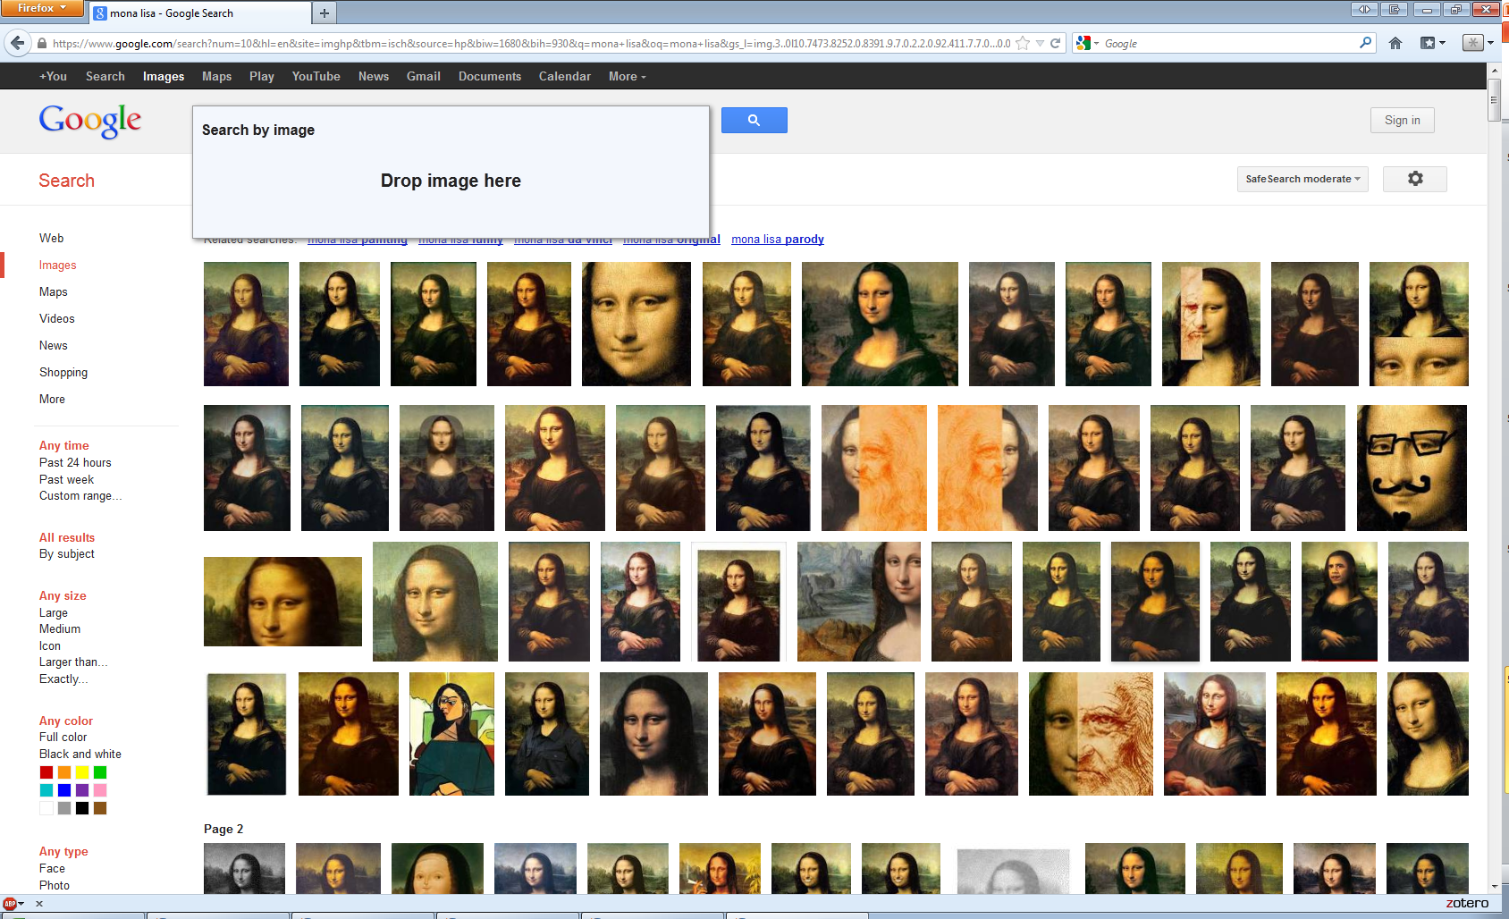
Example: Google Images

Slide 60
Thank you!

