Slide 1
Show a counter-example proving that using information gain does not necessarily produce an optimal decision tree
Intelligent Decision Support Systems – CSE 435
Fall 2012
Giulio Finestrali

Slide 2
Consider the following table
 | Container Type | Drink Type | Temperature | Drink
1 | Cup | Tea | Cold | No
2 | Glass | Tea | Hot | No
3 | Cup | Water | Cold | Yes
4 | Cup | Tea | Hot | Yes
5 | Glass | Tea | Cold | No

Slide 3
Gain(Container Type)
Container Type | Positive Results | Negative Results | Total
Cup | 2 | 1 | 3
Glass | 0 | 2 | 2
Total | 2 | 3 | 5
$$Remainder\left(Container Type, Cup\right)=\frac{2}{3}\lg_{2}{\frac{3}{2}+\frac{1}{3}\lg_{2}{3}}=0.918$$
$$Remainder\left(Container Type, Glass\right)=0$$
$$EV\left(Container Type\right)=\frac{2}{5}\lg_{2}{\frac{5}{2}+\frac{3}{5}\lg_{2}{\frac{5}{3}=0.971}}$$
$$Gain\left(Container Type\right)=0.971−\frac{3}{5}0.918=0.421$$

Slide 4
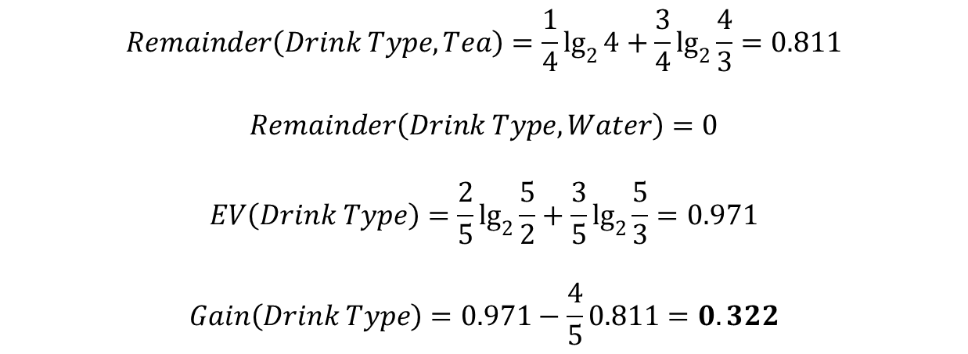
Gain(Drink Type)
Drink Type | Positive Results | Negative Results | Total
Tea | 1 | 3 | 4
Water | 1 | 0 | 1
Total | 2 | 3 | 5
$$Remainder\left(Drink Type, Tea\right)=\frac{1}{4}\lg_{2}{4+\frac{3}{4}\lg_{2}{\frac{4}{3}=0.811}}$$
$$Remainder\left(Drink Type, Water\right)=0$$
$$EV\left(Drink Type\right)=\frac{2}{5}\lg_{2}{\frac{5}{2}+\frac{3}{5}\lg_{2}{\frac{5}{3}=0.971}}$$
$$Gain\left(Drink Type\right)=0.971−\frac{4}{5}0.811=0.322$$

Slide 5
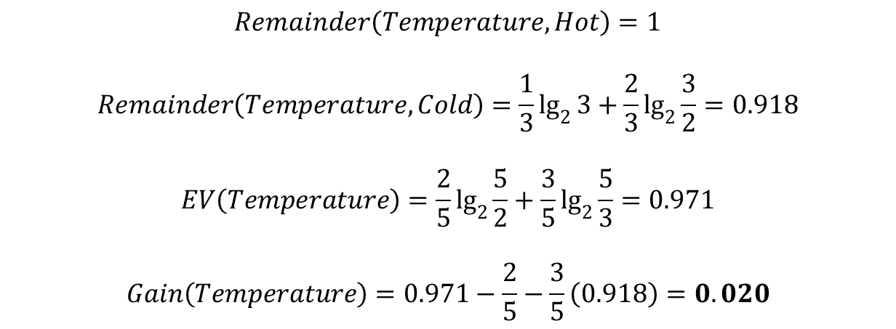
Gain(Temperature)
Temperature | Positive Results | Negative Results | Total
Hot | 1 | 1 | 2
Cold | 1 | 2 | 3
Total | 2 | 3 | 5
$$Remainder\left(Temperature, Hot\right)=1$$
$$Remainder\left(Temperature, Cold\right)=\frac{1}{3}\lg_{2}{3+\frac{2}{3}\lg_{2}{\frac{3}{2}=0.918}}$$
$$EV\left(Temperature\right)=\frac{2}{5}\lg_{2}{\frac{5}{2}+\frac{3}{5}\lg_{2}{\frac{5}{3}=0.971}}$$
$$Gain\left(Temperature\right)=0.971−\frac{2}{5}−\frac{3}{5}\left(0.918\right)=0.020$$

Slide 6
So we pick Container Type!
When Container Type = Glass, we can already output No.
For Container Type = Cup, we are left with sample 1, 3, and 4. We have to run the algorithm again.
 | Container Type | Drink Type | Temperature | Drink
1 | Cup | Tea | Cold | No
2 | Glass | Tea | Hot | No
3 | Cup | Water | Cold | Yes
4 | Cup | Tea | Hot | Yes
5 | Glass | Tea | Cold | No

Slide 7
Comparison
Drink Type | Positive Results | Negative Results
Tea | 1 | 1
Water | 1 | 0
Temperature | Positive Results | Negative Results
Hot | 1 | 0
Cold | 1 | 1
Obviously they have the same Information Gain. Skipping… the result is
Gain(Drink Type) = Gain(Temperature) = 0.251
We decide to pick Drink Type.

Slide 8
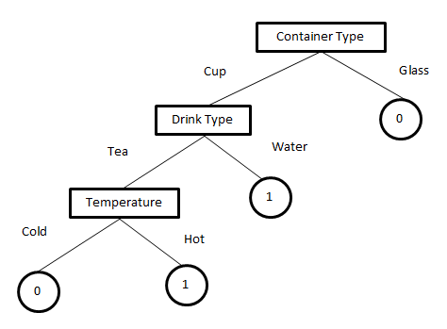
Resulting Decision Tree
$$APL=\frac{3+3+2+1}{4}=2.25$$

Slide 9
Alternative
What if at the beginning we pick Temperature (the worst information gain attribute) as the root for our decision tree?
Turns out we can build a shorter tree this way.

Slide 10
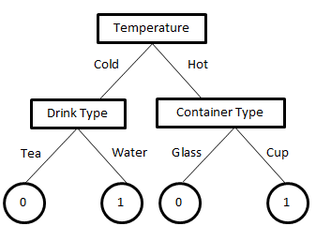
Resulting Decision Tree
$$APL=\frac{2+2+2+2}{4}=2$$
 | Container Type | Drink Type | Temperature | Drink
1 | Cup | Tea | Cold | No
2 | Glass | Tea | Hot | No
3 | Cup | Water | Cold | Yes
4 | Cup | Tea | Hot | Yes
5 | Glass | Tea | Cold | No

Slide 11
Why?
Just ideas:
Not much data to work with. The table is short.
Also, the table is not complete (a lot of missing combinations)

