Slide 1
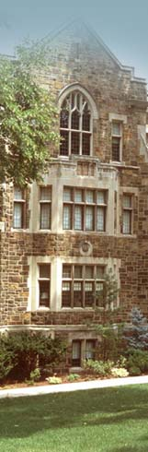
Markov Chains, Markov Decision Processes (MDP), Reinforcement Learning: A Quick Introduction
Hector Munoz-Avila
Stephen Lee-Urban
Megan Smith
www.cse.lehigh.edu/~munoz/InSyTe

Slide 2
Disclaimer
Our objective in this lecture is to understand the MDP problem
We will touch on the solutions for the MDP problem
  But exposure will be brief
For an in-depth study of this topic take CSE 337/437 (Reinforcement Learning)

Slide 3
Introduction

Slide 4
Learning
Supervised Learning
  Induction of decision trees
  Case-based classification
Unsupervised Learning
  Clustering algorithms
Decision-making learning
  “Best” action to take
(note about design project)

Slide 5
Applications
Fielded applications
  Google’s page ranking
  Space Shuttle Payload Processing Problem
  …
Foundational
  Chemistry
  Physics
  Information Theory

Slide 6
Some General Descriptions
Agent interacting with the environment
Agent can be in many states
Agent can take many actions
Agent gets rewards from the environment
Agents wants to maximize sum of future rewards
Environment can be stochastic
Examples:
  NPC in a game
  Cleaning robot in office space
  Person planning a career move

Slide 7
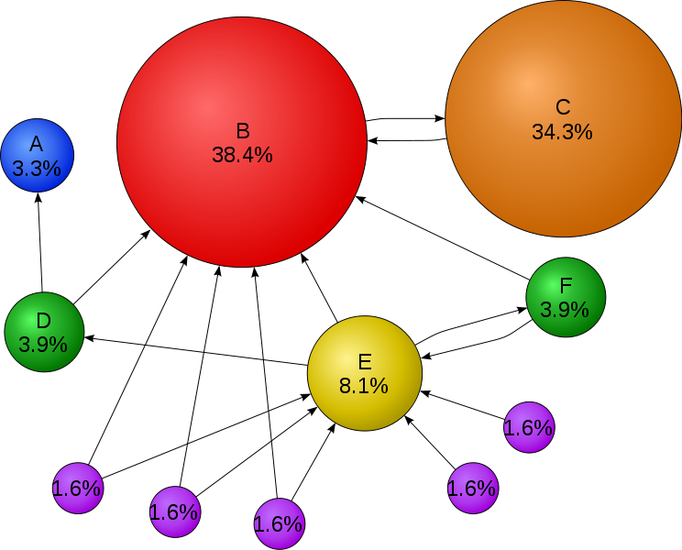
Quick Example: Page Ranking
The “agent” is a user browsing pages and following links from page to page
We want to predict the probability P(ρ) that the user will visit each page ρ
States: the N pages that the user can visit: A, B, C,…
Action: following a link
P(ρ) is a function of:
{P(ρ’): ρ’ point to ρ}
Special case: No rewards defined
(Figure from Wikipedia)

Slide 8
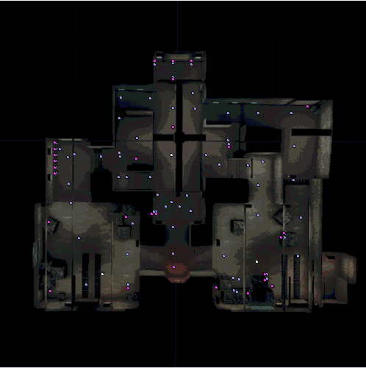
Example with Rewards: Games
A number of fixed domination locations.
Ownership: the team of last player to step into location
Scoring: a team point awarded for every five seconds location remains controlled
Winning: first team to reach pre-determined score (50)
(top-down view)

Slide 9
Rewards
In all of the following assume a learning agent taking an action
What would be a reward in a game where agent competes versus an opponent?
  Action: capture location B
What would be a reward for an agent that is trying to find routes between locations?
  Action: choose route D
What is the reward for a person planning a career move
  Action: change job

Slide 10
Objective of MDP
Maximize the future rewards
R1 + R2 + R3 + …
  Problem with this objective?

Slide 11
Objective of MDP: Maximize the Returns
Maximize the sum R of future rewards
R = R1 + R2 + R3 + …
  Problem with this objective?
  R will diverge
Solution: use discount parameter γ ∈ (0,1)
Define: R = R1 + γ × R2 + γ² × R3 + …
R converges if rewards have upper bounds
R is called the return
Example: Monetary rewards and inflation

Slide 12
The MDP problem
Given:
  States (S), actions (A), rewards (R_{i}),
  A model of the environment:
    Transition probabilities: P_{a}(s,s’)
    Reward function: R_{a}(s,s’)
Obtain:
  A policy π*: S × A → [0,1] such that when π* is followed, the returns R are maximized

Slide 13
Dynamic Programing
Notes:
Tactic versus strategy?

Slide 14
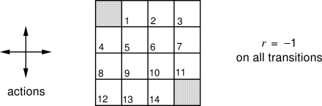
Example
What will be the optimal policy for:
(figures from Sutton and Barto book)

Slide 15
Requirement: Markov Property
Also thought of as the “memoryless” property
A stochastic process is said to have the Markov property if the probability of state X_{n+1} having any given value depends only upon state X_{n}
In situations were the Markov property is not valid
  Frequently, states can be modified to include additional information

Slide 16
Markov Property Example
Chess:
  Current State: The current configuration of the board
  Contains all information needed for transition to next state
  Thus, each configuration can be said to have the Markov property

Slide 17
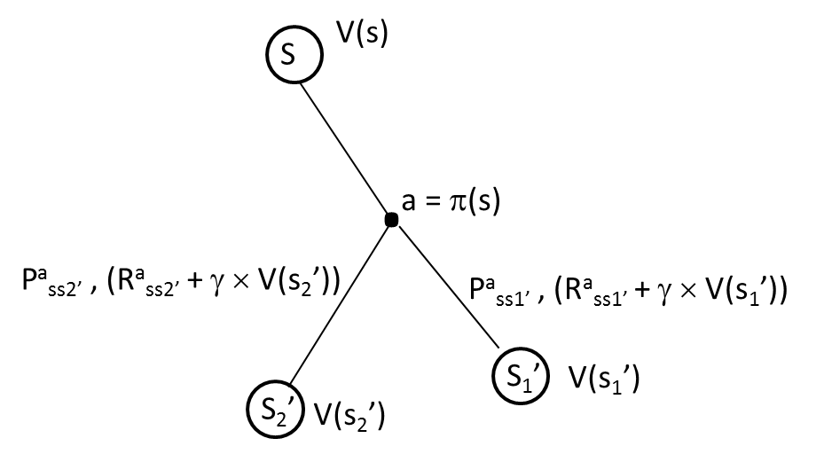
Obtain V(S)
(V(s) = approximate “Expected return when reaching s”)
Let us derive V(s) as a function of V(s’)

Slide 18
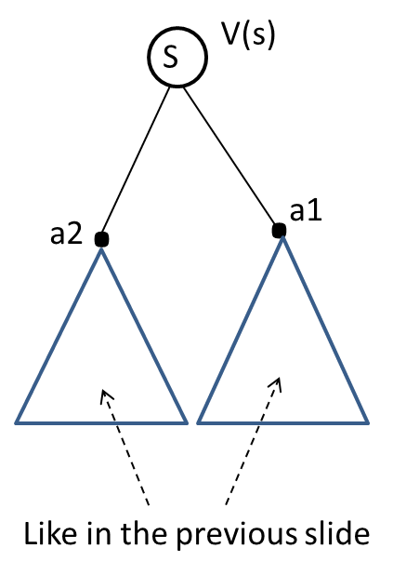
Obtain π(S)
(π(s) = approximate “Best action in state s”)
Let us derive π(s)

Slide 19
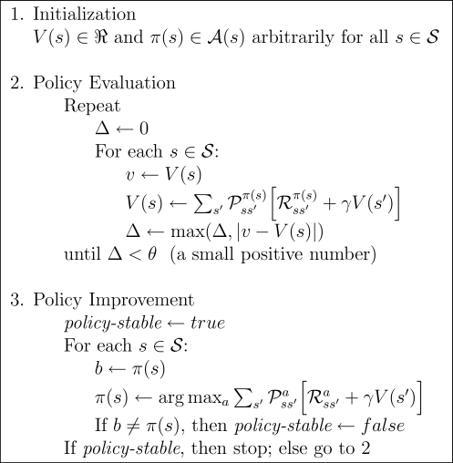
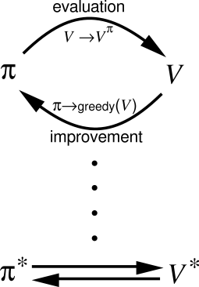
Policy Iteration
(figures from Sutton and Barto book)

Slide 20
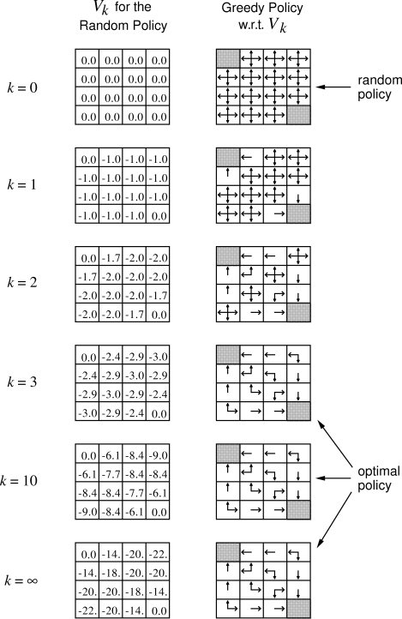
Solution to Maze Example
(figures from Sutton and Barto book)

Slide 21
Reinforcement Learning
Motivation: Like MDP’s but this time we don’t know the model. That is the following is unknown:
    Transition probabilities: P_{a}(s,s’)
    Reward function: R_{a}(s,s’)
    Examples?
Notes:
Tactic versus strategy?

Slide 22
Some Introductory RL Videos
http://www.youtube.com/watch?v=NR99Hf9Ke2c
http://www.youtube.com/watch?v=2iNrJx6IDEo&feature=related

Slide 23
UT Domination Games
A number of fixed domination locations.
Ownership: the team of last player to step into location
Scoring: a team point awarded for every five seconds location remains controlled
Winning: first team to reach pre-determined score (50)
(top-down view)
Notes:
Top down view of the map

Slide 24
Reinforcement Learning
Agents learn policies through rewards and punishments
Policy - Determines what action to take from a given state (or situation)
Agent’s goal is to maximize returns (example)
Tabular Techniques
We maintain a “Q-Table”:
  Q-table: State × Action → value
Notes:
Supervisor -> labeled training; access to correct output
Curse of dimensionality
Tabular limited to small numbers of states and actions; not just memory, but time and data needed to fill accurately
Generalization uses limited subset of state space to produce good approximation over much larger subset

Slide 25
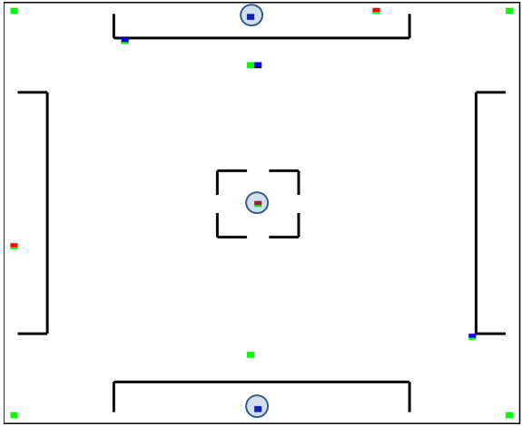
The DOM Game
Domination Points
Wall
Spawn Points
Lets write on blackboard: a policy for this and a potential Q-table

Slide 26
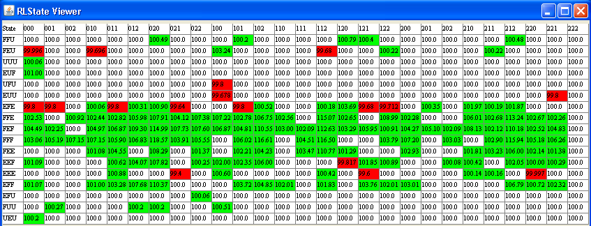
Example of a Q-Table
ACTIONS
STATES
“good” action
“bad” action
Best action identified so far
For state “EFE” (Enemy controls 2 DOM points)

Slide 27
Reinforcement Learning Problem
ACTIONS
STATES
How can we identify for every state which is the BEST action to take over the long run?

Slide 28
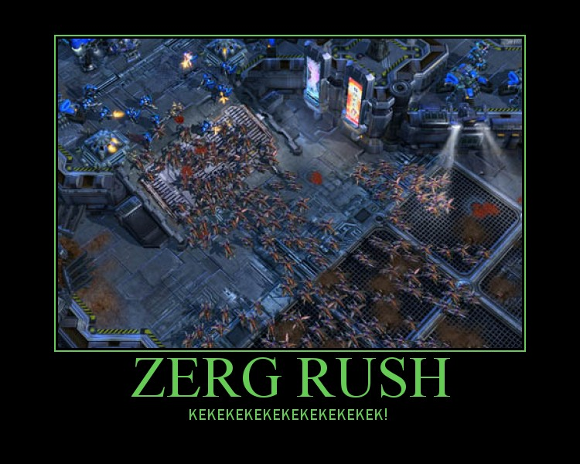
Let Us Model the Problem of Finding the best Build Order for a Zerg Rush as a Reinforcement Learning Problem

Slide 29
Adaptive Game AI with RL
RETALIATE (Reinforced Tactic Learning in Agent-Team Environments)
Notes:
Tactic versus strategy?

Slide 30
The RETALIATE Team
Controls two or more UT bots
Commands bots to execute actions through the GameBots API
  The UT server provides sensory (state and event) information about the UT world and controls all gameplay
  Gamebots acts as middleware between the UT server and the Game AI
Notes:
Emphasize that bots are plug-ins. We learn strategies, not individual bot tactics.

Slide 31
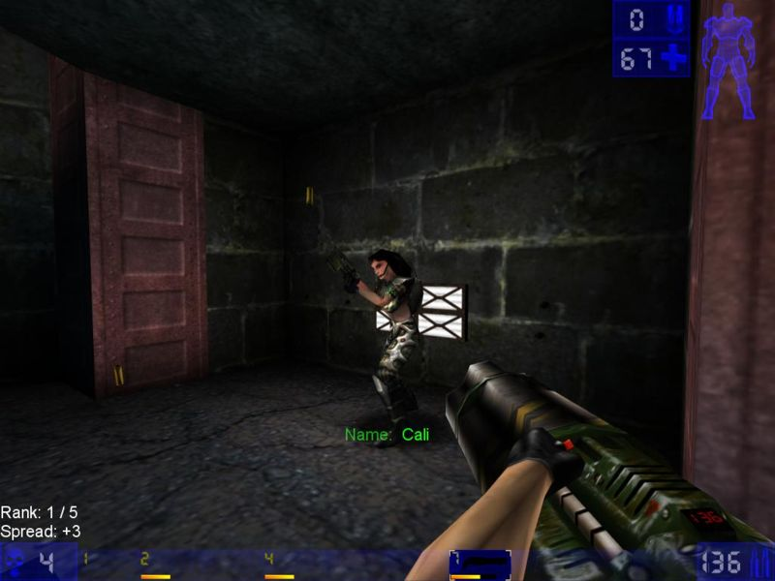
State Information and Actions
Player Scores
Team Scores
Domination Loc. Ownership
Map
TimeLimit
Score Limit
Max # Teams
Max Team Size
Navigation (path nodes…)
Reachability
Items (id, type, location…)
Events (hear, incoming…)
SetWalk
RunTo
Stop
Jump
Strafe
TurnTo
Rotate
Shoot
ChangeWeapon
StopShoot
x, y, z
Notes:
Curse of dimensionality

Slide 32
Managing (State x Action) Growth
Our Table:
  States: ( {E,F,N}, {E,F,N}, {E,F,N} ) = 27
  Actions: ( {L1, L2, L3}, …) = 27
  27 x 27 = 729
  Generally, 3^{#loc} x #loc^{#bot}
Adding health, discretized (high, med, low)
  States: (…, {h,m,l}) = 27 x 3 = 81
  Actions: ( {L1, L2, L3, Health}, … ) = 4³ = 64
  81 x 64 = 5184
  Generally, 3^{(#loc+1)} x (#loc+1)^{#bot}
Number of Locations, size of team frequently varies.

Slide 33
The RETALIATE Algorithm

Slide 34
Initialization
Game model:
  n is the number of domination points
  (Owner₁, Owner₂, …, Owner_{n})
For all states s and for all actions a
  Q[s,a] ← 0.5
Actions:
  m is the number of bots in team
  (goto₁, goto₂, …, goto_{m})
Team 1
Team 2
…
None
loc 1
loc 2
…
loc n

Slide 35
Rewards and Utilities
U(s) = F( s ) – E( s ),
  F(s) is the number of friendly locations
  E(s) is the number of enemy-controlled locations
R = U( s’ ) – U( s )
Standard Q-learning ([Sutton & Barto, 1998]):
  Q(s, a) ← Q(s, a) + α ( R + γ max_{a’} Q(s’, a’) – Q(s, a))

Slide 36
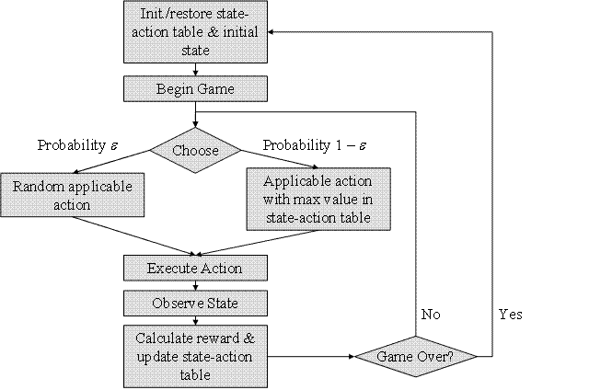
Rewards and Utilities
U(s) = F( s ) – E( s ),
  F(s) is the number of friendly locations
  E(s) is the number of enemy-controlled locations
R = U( s’ ) – U( s )
Standard Q-learning ([Sutton & Barto, 1998]):
  Q(s, a) ← Q(s, a) + α ( R + γ max_{a’} Q(s’, a’) – Q(s, a))
“step-size” parameter α was set to 0.2
discount-rate parameter γ was set close to 0.9
Notes:
???But will not necessarily converge to an optimal policy

Slide 37
Empirical Evaluation
Opponents, Performance Curves, Videos

Slide 38
The Competitors
Team Name | Description
HTNBot | HTN planning. We discussed this previously
OpportunisticBot | Bots go from one domination location to the next. If the location is under the control of the opponent’s team, the bot captures it.
PossesiveBot | Each bot is assigned a single domination location that it attempts to capture and hold during the whole game
GreedyBot | Attempts to recapture any location that is taken by the opponent
RETALIATE | Reinforcement Learning
Notes:
Htn is previous work that beat the other three. We didn’t modify the HTN bots .. And its KB was successful. Therefore HTN bots is NOT a “straw-man” for proving retaliate, just a good opponent that IS currently FREELY available (since 2005)

Slide 39
Summary of Results
5 runs of 10 games
opportunistic → possessive → greedy
Against the opportunistic, possessive, and greedy control strategies, RETALIATE won all 3 games in the tournament.
  within the first half of the first game, RETALIATE developed a competitive strategy.
Notes:
Possibly get rid of OLD, and replace with the graphs depicting performance on the static opponents
Make a point to say HTNBots won all games against non RL opponents.
Maybe include the raph that cycles through opponents w/ retained q-table because it motivates that the strategy needs to remain dynamic!

Slide 40
Summary of Results:
HTNBots vs RETALIATE (Round 1)
60
RETALIATE
50
HTNbots
Difference
40
30
Score
20
10
0
-10
Time
Notes:
Epsilon isn’t changing … so can’t talk about exploring vs. exploiting
What I really mean is how well the exploitation is working.

Slide 41
Summary of Results:
HTNBots vs RETALIATE (Round 2)
60
RETALIATE
50
HTNbots
40
Difference
30
Score
20
10
0
-10
Time
Notes:
Same thing about exploit vs. explore… be careful

Slide 42
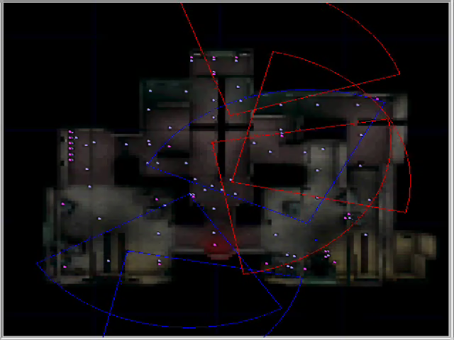
Video: Initial Policy
http://www.cse.lehigh.edu/~munoz/projects/RETALIATE/BadStrategy.wmv
RETALIATE
Opponent
(top-down view)
Notes:
Add caption on left. What is red, blue? Draw wedge of a circle, explain apex is center, and rest is angle of view

Slide 43
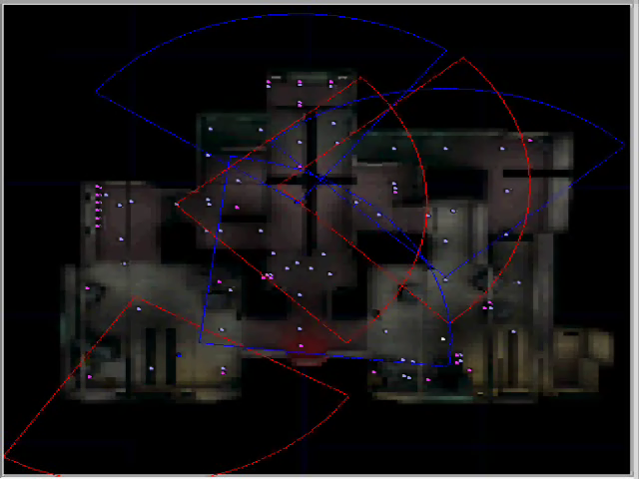
Video: Learned Policy
http://www.cse.lehigh.edu/~munoz/projects/RETALIATE/GoodStrategy.wmv
RETALIATE
Opponent
Notes:
Keep same key on this slide.

Slide 44
Combining Reinforcement Learning and Case-Based Reasonning
Motivation: Q-tables can be too large
Idea: SIM-TD uses case generalization to reduce size of Q-table
Notes:
Tactic versus strategy?

Slide 45
Problem Description
Memory footprint of Temporal difference is too large:
  Q-Table: States × Actions → Values
Temporal Difference is a commonly used reinforcement learning technique.
  Formal definition uses a Q-table (Sutton & Barto, 1998)
Q-Table can become too large without abstraction
  As a result, the RL algorithm can take a large number of iterations before it converges to a good/best policy
Case similarity is a way to abstract the Q-Table

Slide 46
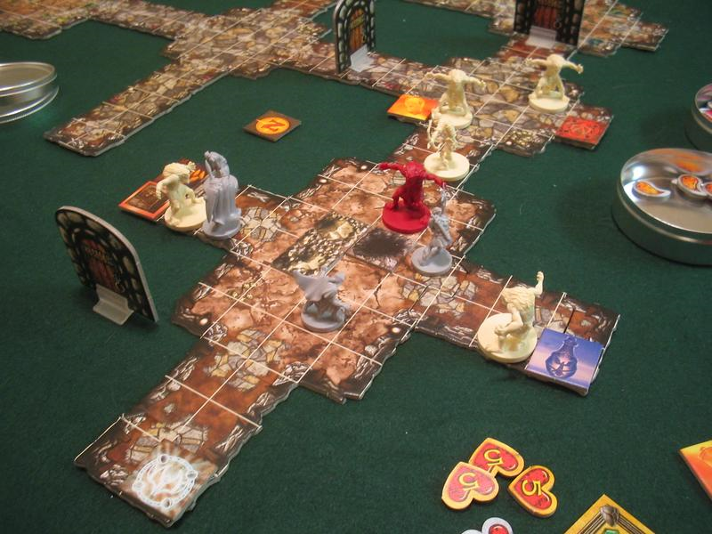
Motivation: The Descent Game
Descent: Journeys in the Dark is a tabletop board game pitting four hero players versus one overlord player
The goal of the game is for the heroes to defeat the last boss, Narthak, in the dungeon while accumulating as many points as possible
  For example, heroes gain 1200 points for killing a monster, or lose 170 points for taking a point of damage
Each hero has a number of hit points, a weapon, armor, and movement points
Heroes can move, move and attack, or attack depending on their movement points left
Here is a movie. Show between 2:00 and 4:15:
http://www.youtube.com/watch?v=iq8mfCz1BFI

Slide 47
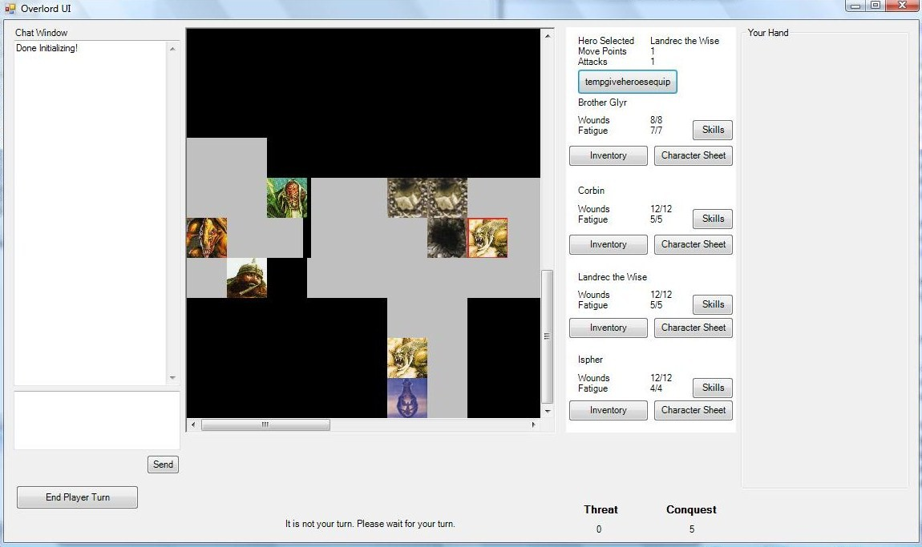
Our Implementation of Descent
The game was implemented as a multi-user client-server-client C# project.
Computer controls overlord. RL agents control the heroes
Our RL agent’s state implementation includes features such as:
the hero’s distance to the nearest monster
the number of monsters within 10 (moveable) squares of the hero
The number of states is 6500 per hero
But heroes will visit only dozens of states in an average game.
So convergence may require too many games
Hence, some form of state generalization is needed.
hero
treasure
monster

Slide 48
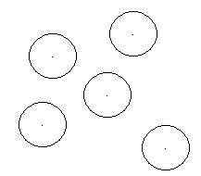
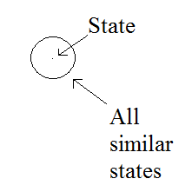
Idea behind Sim-TD
We begin with a completely blank Q-table. The first case is added and all similar states are covered by its similarity via the similarity function.
After 5 cases are added to the case table, a graphical representation of the state table coverage may look like the following picture.

Slide 49
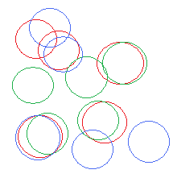
Idea behind Sim-TD
After many cases, the graphical representation of the coverage might show overlaps among the cases as depicted in the figure below.
In summary:
Each case corresponds to one possible state
When visiting any state s that is similar to an already visited state s’, the agent uses s’ as a proxy for s
New entries are added in the Q-table only when s is not similar to an already visited state s’

Slide 50
Sim-TD: Similarity Temporal Difference
Slightly modified Temporal Difference (TD). Maintains original algorithm from Sutton & Barto (1998), but uses slightly different ordering and initialization.
The most significant difference is in how it chooses action a from the similarity list instead of a direct match for the state
Repeat each turn:
s ← currentState()
if no similar state to s visited then
make new entry in Q-table for s
s’ ← s
else
s’ ← mostSimilarStateVisited(s)
Follow standard temporal difference procedure assuming state s’ was visited

Slide 51
Cases in Descent
Case = (state, action)
Heroes mostly repeat two steps: advance and battle until Narthak is defeated
But occasionally they must run if they believe they will die when they attack the next monster
  A player will lose 850 points when his/her hero’s dyes. When a hero dies, the hero respawns at the start of the map with full health
Our reinforcement learning agent performs online learning because cases are acquired as it plays
Possible actions:
distance to monster
monsters in range
expected damage
health
Advance: move closer to the nearest monster
Battle: advance and attack
Run: retreat towards beginning of map

Slide 52
Maps and Case Similarity in Descent
We perform tests on two maps:
  A large map: Slightly modified version of the original map
  A small map: A shortened version of the original map
We implemented 3 similarity metrics for Sim-TD, our RL agent:
  Major similarity: allows more pairs of states to be similar
  Minor similarity: more restrictive than major similarity (allowing fewer cases to be counted as similar)
  No similarity: two states are similar only if they are identical
    Sim-TD with No similarity is equivalent to standard temporal difference
The similarities are dependent on the size of the map
  For example, a difference of hero’s health of 7 in the current state compared to the case is considered similar for the large map but not for the smaller map

Slide 53
Experiments - Setup
Slightly modified first map in Descent was used for experimentation for the large map.
Smaller map is a modified version of the large map to be smaller. More monsters are added to compensate for cutting the map in half.
Trial: a sequence of game runs with either major, minor or no similarity keeping the case base from previous runs
  Small map: 8 game runs per trial
  Large map: 4 game runs per trial
Each trial was repeated 5 times to account for randomness
Performance metrics:
  Number of cases stored (= rows in the Q-Table)
  Game score:
ω_{k} * kills + ω_{h} * healthGain − ω_{d} * deaths − ω_{h} * healthLost − ω_{L} * length

Slide 54
Results: Number of Cases Generated
Using major similarity, the Q-table had a much smaller number of entries in the end
For minor similarity, about twice as many were seen
For no similarity, about twice as many again were seen, in the 425 range.
This shows that case similarity can reduce the size of a Q-table significantly over the course of several games; the no similarity agent used almost five times as many cases as the major similarity agent.

Slide 55
Scoring Results: Small Map
With either the major or minor similarity it had a better performance than without similarity in the small map
Only in game 1 for the smaller map it was not better and in game 6 the scores became close
Fluctuations are due to the multiple random factors which results in a lot of variation in the score
A single bad decision might result in a hero’s death and have a significant impact in the score (death penalty + turns to complete the map)
Performed statistical significance tests with the Student’s t-test on the score results
The difference between minor and no-similarity and between major and minor are statistically significant .

Slide 56
Results: Large Map
Again, with either the major or minor similarity it had a better performance than without similarity
Only in game 3 it was worse with major similarity
Again, fluctuations are due to the multiple random factors which results in a lot of variation in the score
The difference between minor and no-similarity is statistically significant but the difference between the major and the minor similarity is not significant.

Slide 57
Thank you!
Questions?

