Slide 1
Music Composition
Hana Harrison
CSE 435
November 19, 2012

Slide 2
Overview
Artificial Intelligence and Music
Compositional Systems
Improvisation Systems
Performance Systems
TempoExpress
SaxEx
This is a broad topic with many applications; this presentation will utilize examples to explain the possibilities within this field

Slide 3
Compositional Systems
Hiller and Isaacson’s ILLIAC (1958)
Generate-and-test problem solving approach
Generated random notes using Markov chains
Notes were tested against classical harmony rules
Illiac Suite – string quartet
Excluded emotional or expressive content

Slide 4
Compositional Systems
Rothgeb’s SNOBOL (1969)
Automatic harmonization using AI
Focused on the unfigured bass
Unfigured bass – inferring chords that accompany set of bass notes
Used the program to test two bass harmonization theories from 1800s

Slide 5
Compositional Systems
David Cope’s EMI project
Emulation of styles of composers
It searches for patterns (aka signatures) in different works of a composer
It takes these signatures and inserts motives between signatures
These are determined by analyzing the directions and repeated notes in the composer’s other works
Insertion is done using augmented transition network
Represents transitions between notes or phrases

Slide 6
Improvisation Systems
FLAVORS BAND by Fry (1984)
A procedural language embedded in Lisp
It takes a score as input
Modifies score based on a new desired style
Generates improvisational variations
BAND-OUT-OF-A-BOX (BoB) by Thom (2001)
Strives to incorporate interactivity
“Music companion” for real-time improvisation
Performs a greedy search over a constrained list of possible notes to play next; the algorithm learns the constraints from the human player

Slide 7
Performance Systems
Work in this field is more recent
These systems are concerned with the expressiveness of music
Auditory neurons respond to changes in their firing rate
Music is more interesting if it is not repetitive (dynamic, pitch, rhythm)
ExpressTempo and SaxEx are both performance systems

Slide 8
ExpressTempo
Attempts to make tempo transformations sound natural
Input
Score of music
Recording of the song
XML file containing melodic description of the performance (TempoExpress relies on external system to generate this)
Desired target tempo
Output
XML file with modified melodic description at desired tempo

Slide 9
CBR in TempoExpress
Cases contain:
Scores of phrases
12 performance annotations for each phrase at varying tempos
Edit-distance between score and input performance can be calculated
Transformation events that make up the performance annotation (used for input and output)
Note insertions
Deletions
Consolidations
Fragmentations
Ornamentations

Slide 10
CBR in TempoExpress
1st step (Retrieval)
Find most similar case, assessed by calculating edit distance between notes
2nd step (Retrieval)
Figure out an optimal alignment between case and input
3rd step (Retrieval)
Extract performance annotation for tempo

Slide 11
CBR in TempoExpress
4th step (Reuse)
Link performance annotation at source tempo with that at target tempo
Partial solutions are created by splitting phrases into smaller segments
Constructive adaptation is process of constructing complete solution from partial solutions

Slide 12
TempoExpress Results
Output of TempoExpress was compared to that of Uniform Time Stretching (UTS)
Compared each to a target performance by a professional musician at target tempo
Computed similarity using a distance measure modeled after human perceived similarity between performances
TempoExpress improves result of tempo transformation, especially when music is slowed down

Slide 13
SaxEx System
Generates expressive performances of melodies based on examples of human performances
Uses Spectral Modeling Synthesis (SMS) for extracting parameters from real sounds
Incorporates background musical knowledge based on Narmour’s IR models and Lerdahl and Jackendoff’s GTTM
Implemented in Noos, an object centered language that supports knowledge modeling

Slide 14
SMS
Used for analysis, transformation, and synthesis of musical sounds
Sound analysis extracts attributes such as attack and release times, vibrato, pitch, amplitude
Used as a preprocessor for SaxEx, to discover musical attributes
Used as a post-processor to add transformation specified by CBR system

Slide 15
Background Musical Knowledge (IR)
Narmour’s Implication-Realization Model
Theory of cognition of melodies
What users have already heard creates expectations for what is to come
Based on set of structures that characterize patterns of melodic expectations
Provides musical analysis of piece’s melody

Slide 16
Background Musical Knowledge (GTTM)
Lerdahl and Jackendoff’s Generative Theory of Tonal Music (GTTM)
Music is built from notes and a set of rules
Rules assemble notes into a sequence and organizes them into structures of musical cognition
Grouping
Metric strength – notes played on down vs. up beats
Time-span reduction – relation of notes within rhythmic unit
Prolongational reduction – tension-relaxation among notes

Slide 17
Noos
Modeling in Noos requires 3 types of knowledge:
Domain knowledge: specifies concepts (notes, chords, IR structure, expressive parameters) and relations between concepts
Problem solving knowledge: specifies the set of tasks to be solved; methods model the ways to solve tasks
Meta-level knowledge: knowledge about domain and problem solving knowledge (e.g. can help decide how to rank cases)
Episodic memory is the collection of problems that a system has solved; aids in CBR and learning

Slide 18
CBR in SaxEx
Cases contain:
Score: Concepts related to score of the phrase (notes, chords)
Analysis: Concepts related to background musical theories (IR, GTTM)
Performance: Concepts related to the performance of the musical phrase
Input:
Musical phrase described by score
An inexpressive interpretation of the phrase
Output:
Sound file containing expressive performance of the input phrase

Slide 19
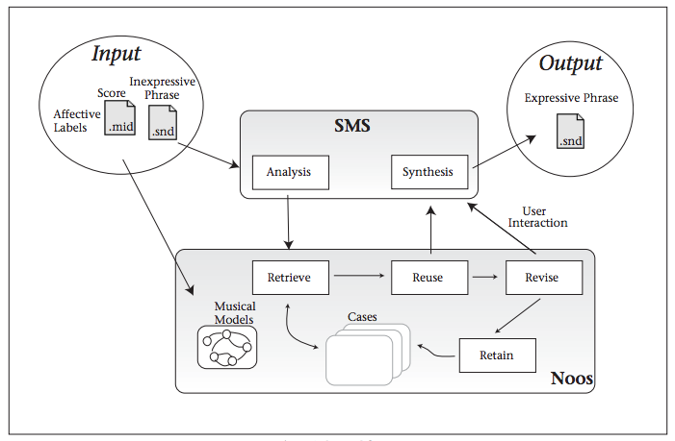
SaxEx Model

Slide 20
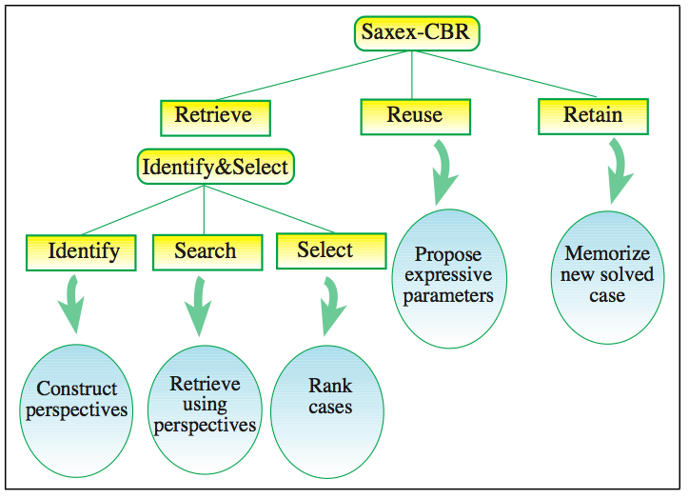
CBR in SaxEx

Slide 21
CBR in SaxEx
Retrieve
Retrieve a set of notes most similar to current input
Reuse
Choose expressive transformations to apply to current problem from set of similar cases
Retain
Incorporate newest solved problem into memory of cases (Noos does so automatically)

Slide 22
SaxEx Experiment
Set of cases in system
Several recording of sax performer playing Jazz ballads with different degrees of expressiveness
Scores of each piece
SaxEx generates new expressive interpretations of new ballads
Used same ballad to generate expressive performance of other phrases in the piece

Slide 23
SaxEx with Interactivity
Human interactivity is added to CBR system
Performances are generated with human creativity incorporated
User influences solutions to fit their personal style or preference

Slide 24
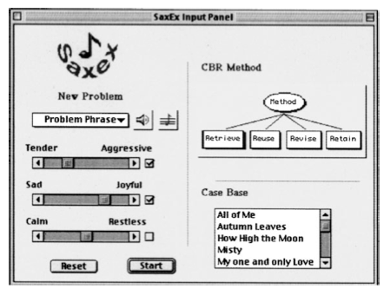
SaxEx Panel for New Problem

Slide 25
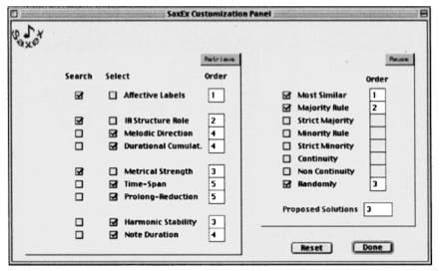
SaxEx Panel for Reuse and Retain

Slide 26
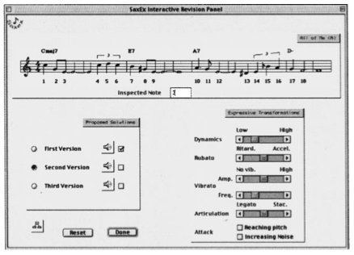
SaxEx Panel for Revision and Retention

Slide 27
SaxEx Examples
“Autumn Leaves”
Inexpressive input / Expressive output http://www.iiia.csic.es/~arcos/noos/Demos/Example.html
“All of Me”
Inexpressive input http://www.iiia.csic.es/~arcos/noos/Demos/Allme-syn.wav
Joyful http://www.iiia.csic.es/~arcos/noos/Demos/Allme-jexp.wav
Sad http://www.iiia.csic.es/~arcos/noos/Demos/Allme-pexp.wav

Slide 28
Conclusions/Final Remarks/Opinions
This is a difficult field of work to perfect because music is based on personal preferences
It is difficult to mimic the creativity that humans add to musical production
I do not think that this is a promising line of research, because of the two ideas mentioned above
However, I can see how it may be beneficial for students learning music

