Slide 1
Recommender Systems
Eric Nalisnick
CSE 435

Slide 2
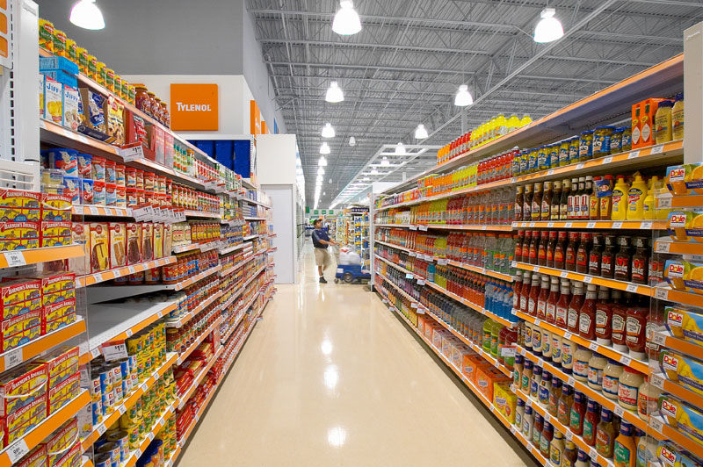
Notes:
A traditional can organize their store into departments, putting like items near one another, making it easy for customers to find what they are looking for.
– the user knows exactly what he/she wants; – the user has a desire but does not know the name of the product;
– the user does not know precisely what he/she is looking for.

Slide 3
…
Notes:
But sorting things into departments doesn’t work when you have a massive amount of inventory. Look at the number of items in each department in Amazon’s grocery section. There are over 132,000 types of beverages!!!!

Slide 4
How can businesses direct customers to groups of similar, interesting, relevant, and undiscovered items?

Slide 5
Recommender Systems!

Slide 6
Method #1:
Memory-Based Collaborative Filtering

Slide 7
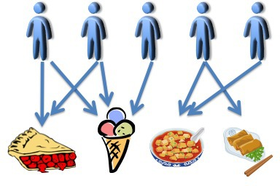
A
B
C
D
E
Notes:
Imagine we have a set of users and we know their likes and dislikes. The intuition is that if two users like similar items, we can infer they have the same tastes. Personal tastes are correlated. For example, examine the picture.

Slide 8
0
1
=
0
C
0

Slide 9
Customer—Item Matrix
 | Pie | Ice Cream | Soup | Egg Rolls
A | 1 | 1 | 0 | 0
B | 1 | 1 | 0 | 0
C | 0 | 1 | 0 | 0
D | 0 | 0 | 1 | 1
E | 0 | 0 | 1 | 0

Slide 10
Notes:
But we can make this similarity measure even more precise. You know how after you buy something from Amazon, you get one of those emails asking you to review the item you just bought? That’s not for the benefit of other customers so they can make more informed buying decisions or anything like that. They really just want to understand your likes and dislikes better.

Slide 11
=
0
B
0

Slide 12
Customer—Item Matrix
with User Reviews
 | Pie | Ice Cream | Soup | Egg Rolls
A | 5 | 1 | 0 | 0
B | 2 | 5 | 0 | 0
C | 0 | 4 | 0 | 0
D | 0 | 0 | 3 | 3
E | 0 | 0 | 4 | 0
Sim
.44
2.13
-
0
0

Slide 13
Evaluation of Memory-Based Collaborative Filtering

Slide 14
1. Best for post-purchase recommendations.

Slide 15
2. Does not scale well.
Customers
Items

Slide 16
3. Very popular and very unpopular items are problematic.
*In practice, can multiply values by inverse frequency

Slide 17
4. Cold Start Problem
How do we recommend new items?
How do we make recommendations for new users?

Slide 18
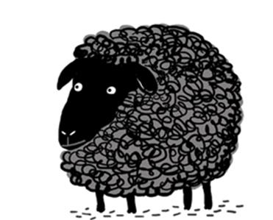
5. Susceptible to Black and Gray Sheep

Slide 19
Method #2:
Knowledge-Based Collaborative Filtering

Slide 20
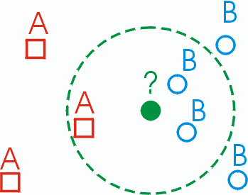
Like traditional CBR systems…

Slide 21
Similarity function?

Slide 23
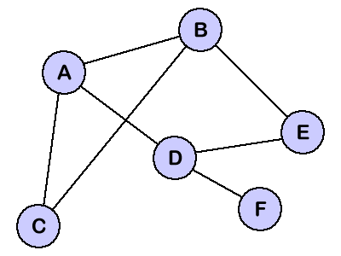
13
12
9
17
1
15
7

Slide 24
*Director, year, and color had unstable or negative weights.

Slide 25
Evaluation of Knowledge-Based Collaborative Filtering

Slide 26
1. Better at pre-purchase recommendations than Memory-Based.

Slide 27
2. Efficient runtime. Can be as simple as descending K-D Tree.

Slide 28
3. Cold Start problem and popularity of an item are not an issue.

Slide 29
4. Not good at modeling the general preferences of a user.

Slide 30
Method #3:
Hybrid Item-to-Item Collaborative Filtering

Slide 31
A
B
C
D
E
Notes:
Imagine we have a set of users and we know their likes and dislikes. The intuition is that if two users like similar items, we can infer they have the same tastes. Personal tastes are correlated. For example, examine the picture.

Slide 33
Item-to-Item Collaborative Filtering Algorithm
For each item i₁:
For each customer c who has bought i₁:
For each item i₂ bought by c:
Sim(i₁, i₂)

Slide 34
Customer—Item Matrix
 | Pie | Ice Cream | Soup | Egg Rolls
A | 1 | 1 | 0 | 0
B | 1 | 1 | 0 | 0
C | 0 | 1 | 0 | 0
D | 0 | 0 | 1 | 1
E | 0 | 0 | 1 | 0

Slide 35
Industry Example:
The Netflix Prize

Slide 36
$1,000,000 prize
Notes:
Began Oct 2006
2000 teams
Must reduce RMSE by 10% from cinematch
For each user, must predict their last 9 ratings (on what movies)

Slide 37
Winning Team:
“Bellkor’s Pragmatic Chaos”
RMSE Reduction: 10.9%

Slide 38
Lessons Learned…
1. Baseline Predictors

Slide 39
Lessons Learned…
2. Binary view of Data: Rated or not rated.

Slide 40
Lessons Learned…
3. Restricted Boltzmann Machines.

Slide 41
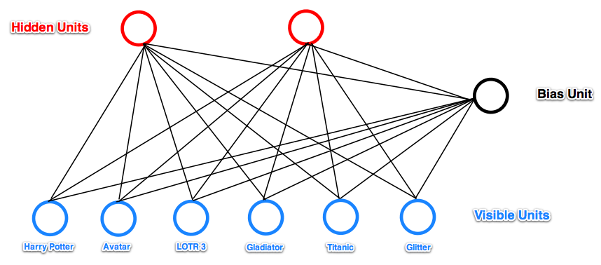

Slide 42
Lessons Learned…
4. No one recommendation technique is best. Need to combine several.

Slide 43
Summary
Memory-Based CF is best for post-purchase
Knowledge-Based CF is best for pre-purchase.
Hybrid methods generally work best
The data is as important as the algorithm

Slide 44
Questions?

