Slide 1
Intelligent Decision Support Systems: A Summary
H. Munoz-Avila

Slide 2
Case-Based Reasoning
Retrieval
case similarity
case retrieval
programming project
Customer Support (Sicong Kuang)
Recommender Systems (Eric Nalisnick)
Retain
Indexing
K-D trees
Induction
Maintenance of CBR systems (Aziz Doumith)
Specification
Example: Slide Creation
1. Retrieve
New Slides
5. Retain
Repository of Presentations:
5/9/00: ONR review
8/20/00: EWCBR talk
4/25/01: DARPA review
New Case
Slides of
Talks w/
Similar
Content
- - 12/7/12: talk@ CSE 335
4. Review
Talk@
CSE335/435
Reuse
Adaptation
Rule-based systems
Plan adaptation
Revised
talk
3. Revise
2. Reuse
First draft
Knowledge Containers (Giulio Finestrali)

Slide 3
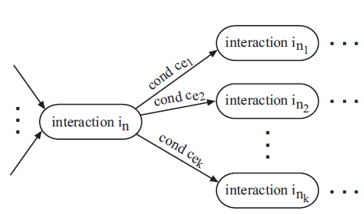
Knowledge Representation
(Prof. Jeff Heflin)
User-System Interactions in Case Base Reasoning
(Sicong
Kuang)
Ontology
DL Reasoner
Two tasks:
Problem Acquisition Task
Experience Presentation Task
Adaptable dialog strategy
Illustrate two applications
Web-based CBR system
GE call center
Inferred Hierarchy
table & view
creation
Database operation

Slide 4
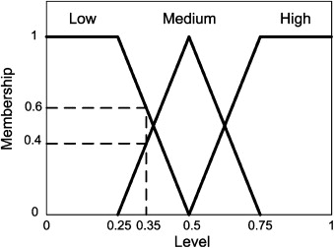
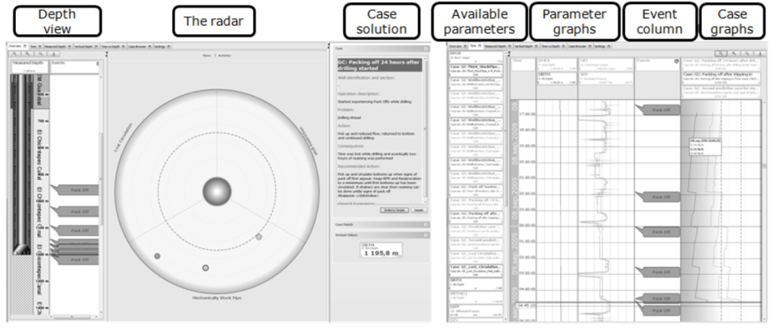
Decision making and finance
(Konstantinos Hatalis)
An application of CBR to oil drilling (Dustin Dannenhauer)
CBR for market surveillance
Input: Transaction info…
Output: unusual trend
Residential profit valuation
Ideal CBR application (i.e., compare similar houses)
Use fuzzy logic in similarity computations
Bank lending decision
Economic sentiment: optimistic, neutral, …
Complexities of oil drilling
Data mining couldn’t be made to work here
Model-based solution didn’t worked well either
CBR solution worked well
Cases describe specific situations
Radar interface when potential anomalies occur

Slide 5
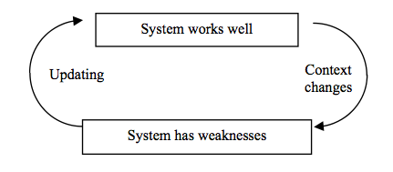
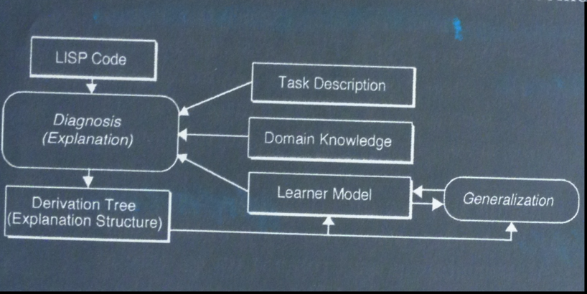
Intelligent Tutoring Systems (Tashwin Khurana)
Maintenance of CBR systems (Aziz Doumith)
Conventional model doesn’t work (“one model fits all”)
Solution: use cases for the student and domain models
Introduce personalization
Cases can contain
Complete solutions, or
Snippets of solutions
Provides ability for novel combinations
3-level experience base: from specific to generic knowledge
Categories of revision: corrective & adaptive
Provenance:
history of cases
Where does cases came from?
Event-condition-action

Slide 6
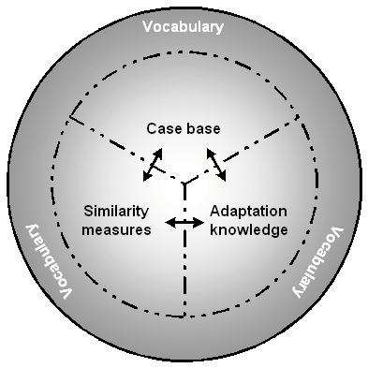
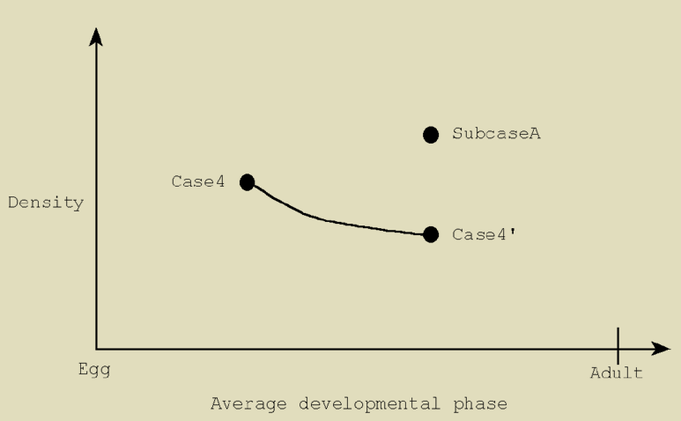
Bio-control: pest control, fish farms, and others (Choat Inthawongse)
Knowledge Containers (Giulio Finestrali)
Explains (in part) success in fielded CBR applications
Vocabulary
Similarity Measure
Case Base
Solution Transformation
Learning of these containers
PAC learning
Grasshoppers control
Balance: cost vs reward
Cases include features such as grasshopper density and temperature
Temporal projection

Slide 7
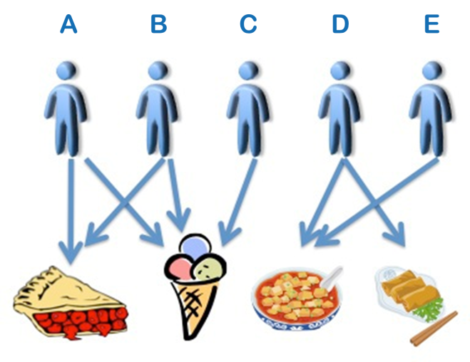
Help-desk systems (Siddarth Yagnam)
Recommender Systems (Eric Nalisnick)
Collaborative filtering
Issues: scalability, extremely popular/unpopular items,…
Knowledge-based collaborative filtering
Use similarity to address some of these issues
Hybrid Item-to-Item Collaborative Filtering
Text-based help desk systems
Mixed results: reduced to keywords search
Rule-based help desk systems
Ask relevant questions but are difficult to create
CBR-based help desk systems
Alleviate the knowledge engineering effort
Go beyond keyword search
Result in significant reductions of call-in

Slide 8
Music composition (Hana Harrison)
Decision Support Systems in Medicine (Jennifer Bayzick)
Domain complexities: lots of data, individuals vs. environment
Potential applications: diagnosis → prognosis
Challenge: acceptability
iNN(k): variant of kNN that requires fewer features
An ITS for medicine
History of efforts in the field
Performance Systems: expressiveness of music
ExpressTempo: make tempo transformations sound natural
Similarity captures perceived similarity between performances
SaxEx: Generates expressive performances of melodies
Uses deep background musical knowledge

Slide 9
Design Project
Hana. Restaurant recommender.
Zach. Web search using link (context)
Qin: Amazon recommender.
Giulio. Learning explanations in interactive system.
Jen. Intelligent music player.
Nick. State park recommender.
Sean. Music completion.
Drew. Texas Hold’em.
Tashwin – Intelligent Tutoring Systems.
Yu Yu. Search engine for university events.
Marek. Windows Vista assistant.
Sicong. Case-based support for business.
Choat. Using CBR to alleviate business processes
Siddarth. Augmenting Lehigh LTS system
Aziz. Vacation recommender.
Kostas. Portfolio managing system.
Dustin. College admissions.

Slide 10
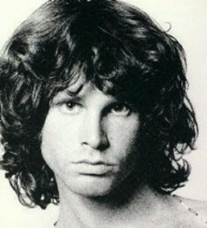
The Summary
Programming project
AI
Introduction
Overview
IDT
Attribute-Value Rep.
Decision Trees
Induction
CBR
Introduction
Representation
Similarity
Retrieval
Adaptation
Rule-based Inference
Rule-based Systems
Expert Systems
Synthesis Tasks
Planning
Rule inference
Uncertainty (MDPs,
Fuzzy logic)
(the end)
Applications to IDSS:
Analysis Tasks
Help-desk systems
Classification
Diagnosis
Recommender systems
Synthesis Tasks
Military planning
Oil drilling, finance, music,..
Knowledge management

