Slide 1
User-System Interactions in Case Base Reasoning
Sicong Kuang
Instructor: Prof. Hector Munoz-Avila
CSE 435

Slide 2
Two new communication channels
The ultimate goal of experience management is to achieve a communication of experience between an experience provider and an experience user:
the communication of the experience provider with the experience management system and
the communication of the experience user with the experience management system.
Notes:
The first channel requires much more effort than the second one. Talk more about the second channel.

Slide 3
Two new communication channels
This communication is of bidirectional nature:
The user must be able to tell the experience management system about his problem.
The experience management system must be able to communicate appropriate experience to the experience user.
The diﬃculties involved here are to organize this communication eﬃciently and to enable access from several experience users at a time.

Slide 4
A basic communication architecture
The communication between the experience user and the experience management system involves two directions:
From experience user to the experience management system during the problem acquisition phase.
From experience management system to experience user during the experience presentation phase.
Notes:
the problem must be captured and formalized and transferred to the experience management system
the experience, or more precisely the lesson contained in the experience, must be presented in an appropriate form to the experience user.

Slide 5
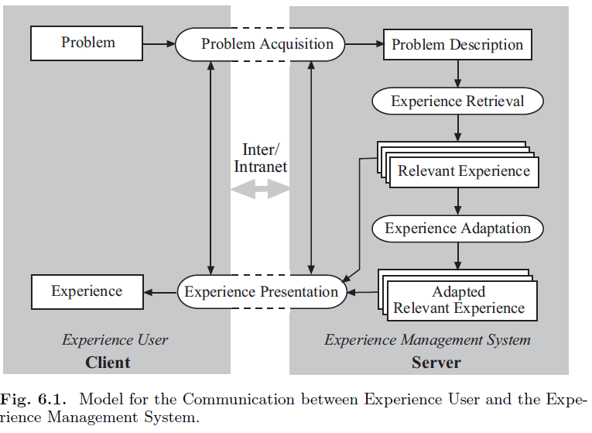
Notes:
1.Two tasks
2.Client server
3.Retrieve reuse revise review retain

Slide 6
Problem Acquisition Task
Acquire sufficient information from the user in order to present to her/him one or several experience items that are useful to the user for solving the problem
The difficulties are when (the order) and what should ask, what should not ask.
The output of this task should be problems in a known problem space. We could use input mask

Slide 7
Experience Presentation Task
Show the retrieved (and possibly adapted) experience to the user. Formally, this task displays lessons in a known lesson space in an appropriate way.
Interactions between problem acquisition task and experience presentation task:
The whole cycle from problem acquisition to experience presentation is usually executed several times until a satisfying lesson has been found
During the iterations, problem description is refined; feedback for the retrieved cases is obtained
Notes:
Problem acquisition and experience presentation can often not be completely
separated. The reason for this is that the whole cycle from problem acquisition
to experience presentation is usually executed several times until a satisfying
lesson has been found. In successive iterations, the problem description is
refined, i.e., additional information about the problem is asked that allows to
evaluate the utility of the available experience items more properly. Hence,
there can be a feedback through the set of retrieved cases to the problem
acquisition component. Further questions to be asked can be determined with
respect to currently retrieved best experience.

Slide 8
General requirements for user communication
The requirements are for both problem acquisition and experience presentation:
Small Number of Questions
Comprehensible Questions
Low Answering Cost of Questions
Comprehensible Question Clustering
Present Appropriate Amount of Information
Choose Appropriate Presentation Form
High Interaction Speed
Notes:
1.Only ask questions that is related to the reusability of the experiences
2.Different culture language, novice expert, prepare different style of questions
3.Answer imediately
Ideally give the information the user wants

Slide 9
Distribution between Client and Server side
Thin client approach
Leave most of the computation on the server side; client software work load is reduced to minimum. No installation, no download, but low interaction speed.
Fat client approach
Move most of the computation on the client side. Good for experienced user; high interaction speed
Medium-sized client
Workload distributes evenly. But case data and similarity measures is left on server side.
Notes:
Dialog control case data/

Slide 10
A formal dialog model overview
A dialog can be modeled as a state machine. The state characterizes a particular instance in time of a particular dialog enacted between the user and the experience management.(dialog situation)
In a given state, a certain set of interactions (with the user) can be initiated.(dialog interaction)
There are many diﬀerent applicable interactions in a particular dialog. We need a strategy to choose an optimum one.(dialog strategy)
Notes:
For example all information gathered from the user up to this point in time.as well as all experience that is considered relevant for the problem as it stands at the moment

Slide 11
Dialog Situation
We define the dialog situation space S= P×Q×H consists of the problem space P, a question state space Q, and a hypothesis space H. A dialog situation s = (p, q, h) is an instance of the dialog situation space, i.e., s ∈ S.
p is the aggregation of all problem attribute values collected so far. Initially p is empty.
q describes the history of the dialog. (finite state variable)
h contains current hypotheses concerning the reusability of experience. Usually a subset of the current case base.
Notes:
It is inspired by dialog models that occur in diagnostics. Diagnostics can be considered as a problem acquisition
task plus a classification task.

Slide 12
Dialog Interactions
We define the dialog interaction space I= {i₁, . . . , i_{k}} consists of a set of dialog interactions. A dialog interaction is a function i_{ν} : U → (S→ S) that determines from a certain user input (out of the set of possible user inputs) U a transformation function of the current dialog situation s into a successor situation s’, i.e., i_{ν}(u)(s) = s’.
Different kinds of dialog interactions are:
Gathering Information
Checking Consistency
Updating Hypotheses
Presenting Experience

Slide 13
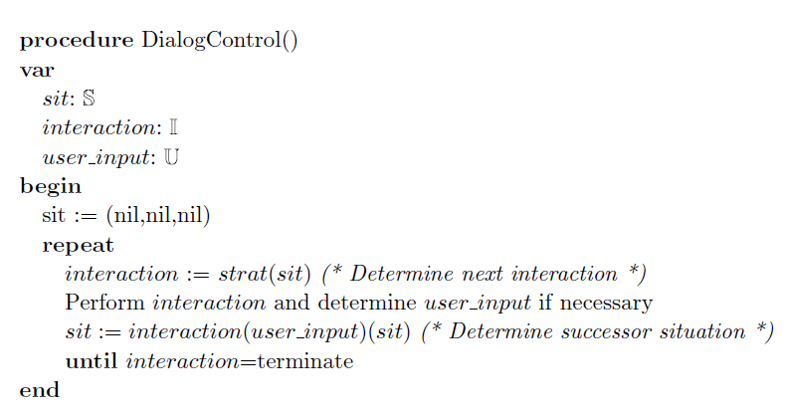
Dialog Strategy
A dialog strategy controls the whole dialog
A dialog strategy is a function strat : S → I that determines for a given current dialog situation the next dialog interaction to be executed.
Notes:
The simple algorithm describes the toplevel
loop in which the dialog strategy is executed. It assumes a particular
interaction that indicates the termination of the dialog.

Slide 14
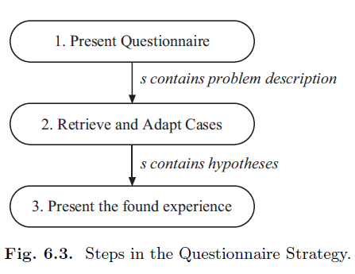
User-system communication approach based on the formal dialog model
Predefined Static Dialog: the dialog interactions and strategy are manually modeled in advance by the developer of the experience management system.
Three-Step Questionnaire-Based Problem Acquisition

Slide 15
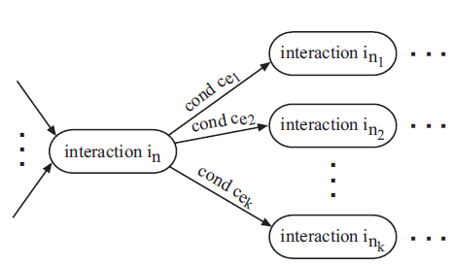
Modeling dialog strategy in specific domain based on the formal dialog model
Modeling the dialog strategy with a directed graph
Modeling the dialog strategy with rules

Slide 16
Dynamic and Adaptable Strategies(1)
Previous static dialog strategies is modeled by hand. Static means the dialog strategies will not change even when case base changes.
To overcome this problem, we want to find a way to dynamically produce dialog strategy according to the case base we has.
The basic idea behind this approaches is to analyze the distribution of cases in the case base to select questions according to their relevance for deciding the reusability of a case.

Slide 17
Dynamic and Adaptable Strategies(2)
Problem attributes to be asked to users should be selected according to if they contribute information that is relevant to decide among the reusability of the cases in the case base. (a case base with all patients are male)
Selection criteria for attributes (questions to ask)
Information gain for classified cases(learned in class)
Information gain for unclassified cases: selects k representative cases, called medoids, and clusters the other cases according to their similarity to the medoids. (such as numeric cases)

Slide 18
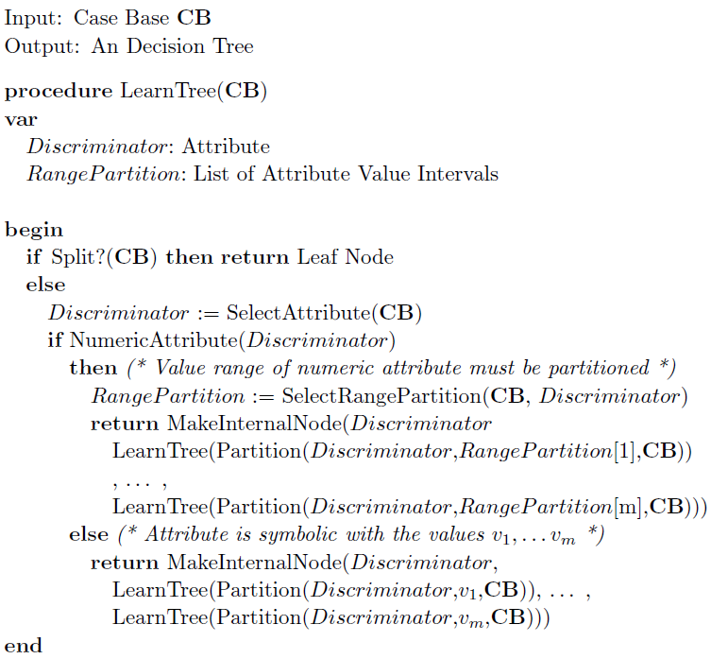
Using decision tree to implement dialog strategy(example)

Slide 19
Conclusion
There are two tasks between the communication between the user and the experience management system: problem acquisition and experience presentation.
A formal dialog model contains dialog situation, dialog interaction, and dialog strategy.
Here we use information gain to choose the right question and the right order to ask; we use decision tree to implement a dialog strategy.
Next we will see a practical applications of Case based reasoning system using a distributed CBR to support field service.

Slide 20
A distributed CBR Application for engineering sales support
Background
Price of a previous similar installation gave a more accurate estimation than price giving by personnel using a proprietary software.
Solution #1 – a database: 10,000 records, more than 60 fields plus a list of file names for specification.
Solution #2 – case-based reasoning

Slide 21
Problem with the database solution
honeymoon period
– initially head office engineers liked it
then complain…
– too hard to query
– simple queries = too many matches
– complex queries were too difficult
– they browsed the database
– relied on a favorite few dozen projects

Slide 22
solution #2 - a CBR system
A carefully controlled and monitored trial in need:
Avoid losing firm money
Test hardware limitation
Test on moderately complex residential compared to high value commercial contracts
Goal for CBR system
A system that could find similar installations without making the query too complex for the engineer(engineer should expect to involve as less as possible)

Slide 23
solution #2 - a CBR system
A case-based reasoning system solves new problems by using or adapting solutions that were used to solve old problems
Use and adapt old HVAC installations to create new ones
Base cost estimates on price of similar projects
Put the system on the web for sales engineers to use
Increase profit margin
Increase efficiency

Slide 24
Web-based CBR system
A web site that sales staff could access anywhere
Input: Prospect’s requirement
Output: Similar installation along with FTP address for initial quote
Automatically passed back to head office for engineers to double check the process
Java: implementation language on server and client side
XML: communication language for client/server applets.

Slide 25
System Architecture Overview
Java applet: gather the customer's requirements and send them as XML to the server.
Java servlet: On the server side uses input information to query the database to retrieve a set of relevant records
The Java servlet then converts the records into XML and sends them to the client
Use a nearest neighbor algorithm to rank the set of cases according to some metric such as similarity
See system architecture graph in the next slide

Slide 26
Notes:
Here compared to slide 5, question acquisition is through XML query, experience presentation is through XML cases

Slide 27
System Architecture-Case Retrieval
Two stage case retrieval
Stage 1
retrieve small set (<20) of similar records from database uses query relaxation
retrieval is an iterative process
increases the relaxation with each iteration
Query relaxation: relax user’s input to ensure a certain number of useful cases can be retrieved
Symbolic attribute: relax based on symbol hierarchy.
Numeric attribute: relaxation is expressed as a term a percentage (e.g., “Relax_Temp = 10% ”)

Slide 28
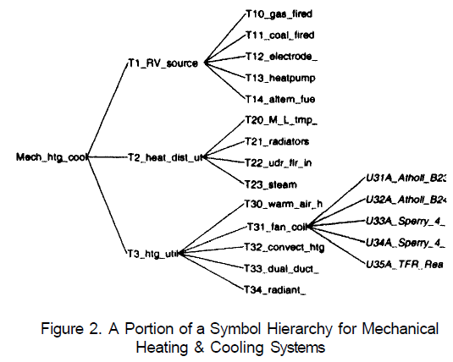
System Architecture-Case Retrieval
Notes:
Symbol relaxation display

Slide 29
System Architecture-Case Retrieval
Stage 2 retrieval
– use nearest neighbor algorithm (formula below) to calculate the similarity between the original query and the retrieved records
– allows user to express preferences through feature weights W_{i}
Where:
T is the target case(retrieved case)
S is the source case(original query)
n is the number of features in each case
i is an individual feature from 1 to n
f is a similarity function for feature i in cases T and S
w is the importance weighting of feature

Slide 30
Lessons learned
The initial query relaxation method (performing a restrictive query and then relaxing the query through successive iterations until a sufficiently large set of cases was retrieved ) can cause error.
An improved method is to relax the initial query far enough to ensure that a large set of cases would be retrieved (e.g., several hundred cases) and then refine the query to reduce the sub-set to around twenty cases.

Slide 31
Conclusion
A distributed CBR system can be created in a short amount of time (6 months in this case)
The system has a ready made case library. Ways to relaxation and similarity measure have to be configured
XML is a useful communications protocol enabling large packets of formatted information to be exchanged thereby reducing network traffic.
Further work is planned to investigate the possibility of providing support or possibly automating some aspects of case adaptation.
Next we will see how CBR helps General Electric to improve customer support quality.

Slide 32
Case-based reasoning for General Electric appliance customer support
When a customer calls General Electric for help, a call-taker uses the CBR system to diagnose the problem and step the customer through its solution
CBR resulted in an increase in the probability the customer’s problem can be solved over the phone from 3.9% to 20%

Slide 33
Call center problem
Call centers provide help to customers who have questions, problems, complaints, or need assistance.
However, correctly diagnosing all problems was difficult because of the following issues:
The growing complexity of products
The diagnosis can be confusing
There is a limited supply of qualified people
Off-line training is expensive
Low pay / high turnover (60% per year)
There needs to be consistency among call takers
Little or no feedback on failures

Slide 34
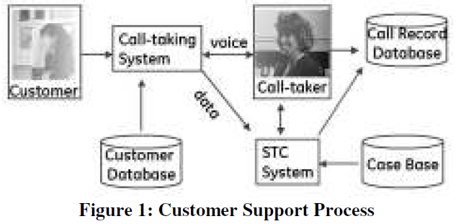
The “Support The Customer” (STC) project
The STC system is just one part of the call-taking process.
The full process is shown in the figure below.
STC uses a case base to assist the call-taker in helping the customer.
STC writes information about the diagnostic process to the call record database.
Each case includes a description of a problem, solution and a series of questions to diagnose the problem.
Notes:
The STC system is just one part of the call-taking process.
The full process is shown in Figure 1. In this process, the
customer calls a 1-800 number provided for scheduling
home visits of field service technicians. A custom calltaking
system receives the call, accesses a customer
database to retrieve information, such as the customer’s
address and registered products, then displays this
information to the call-taker who answers the phone.
Before STC was developed the call-taker would answer the
questions to the best of their ability then type in some
information about the call, which would be saved in the call
record database. After STC was developed the call-taking
system also sends data about the customer to STC. Then,
STC uses a case base to assist the call-taker in helping the
customer. After the call is completed STC writes
information about the diagnostic process to the call record
database. Each case includes a description of a problem
and solution to that problem and a series of questions to
diagnose the problem. The cases can have attachments
including diagrams. The STC system also has rules to
automatically answer questions.

Slide 35
How does “STC” work
STC answers as many of the questions as possible based on the information passed in from the call-taking system.
According to the STC user interface, the call taker would provide answers to the questions by the conversation with the customer.
After each answer is given, the list of potential questions and results are updated. (results are a list of possible solutions for the customers problem.)
Step 3 will be recursive until only one result is left in the list of results.
The solution suggested would be automated sent to user by email or fax.

Slide 36
Use of CBR
STC was created using a CBR tool from Inference Corporation called KnowledgeAgent.
KnowledgeAgent now is a single search box. It offers guided help(CBR), user profiles search, keyword and intent-based search, natural language processing.
STC is a mixed initiative conversational CBR system that acts as an intelligent assistant for the call taker. But the natural language processing still relies on the call taker.

Slide 37
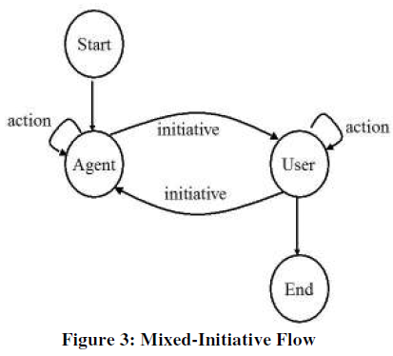
Mixed initiative system
STC represented by the Agent and the user in the figure below, will take the initiative alternatively. This scheme greatly release the burden of the call taker and accelerate the process speed.

Slide 38
Conversational CBR(CCBR)
A problem solving technique that is used when all the information needed to solve a problem may not be available at the beginning of the problem solving process. For example, users can not provide a complete description of the problem at the very beginning.
In CCBR, a query describing a target problem is incrementally elicited in an interactive dialog with the user, often with the aim of minimizing the number of questions the user is asked before a solution is reached.

Slide 39
Conversational CBR(CCBR)
The initial query is based on user’s brief description in free text.
In each dialog cycle, the user is shown any cases with an above-threshold similarity to the current query.
Dialog is terminated when the user find the case that can solve his problem, or some predefined termination criteria is satisfied, such as the max dialog cycle is reached.

Slide 40
Use of CBR in STC
Two kinds of cases:
abstractions of a class of problem that may have taken place many times in the past and
hypothetical cases of problems that may take place in the future.
Each case has title, description, set of questions, solution and attachment.
In order to ease the effort of case collection and maintenance, use decision tree in organizing and classification of cases.
Next slide shows a decision tree that was created for organizing the refrigerator case base.(using Visio)

Slide 41
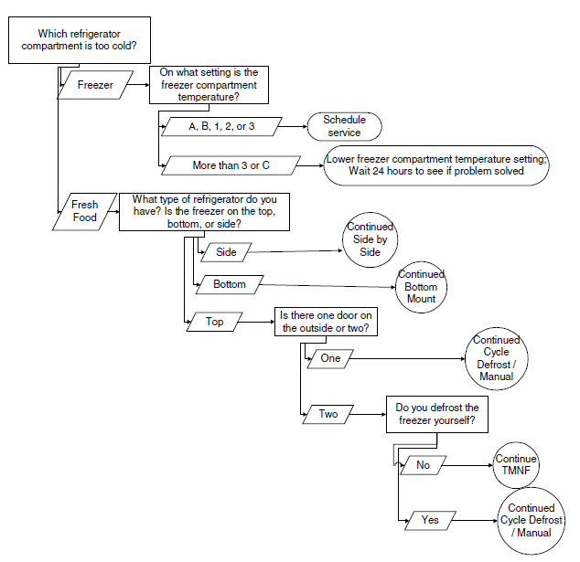
Use of decision tree in classification of cases

Slide 42
Application Development and Deployment
The development of the STC system was a five-step process.
Standardize the process and knowledge: determine the correct questions to ask and the correct order to ask (last slide).
Digitize the inputs and outputs so that we can process a large mount of data quickly.
Automate the process as much as possible: call taker or agent should involve as less as possible.
Control the quality of the system
Leverage the system and knowledge for improved impact: the system is not only benefited by call takers. Users schedule their own field service through GE’s web site
Notes:
What should ask what should not ask

Slide 43
Maintenance
One full time case author and forty part-time technician.
Regular updates are now released monthly.
Special updates from new products or important updates to existing products take place at needed intervals, but these are less frequent than the regular updates.

Slide 44
Conclusion
GE’s “Support The Customer” project utilizes CBR to help call takers to query the customer and acquire information to make a better and quicker diagnosis of the possible results.
STC is a mixed-initiative conversational CBR system. CBR and user together elicit the possible solution for the proposed problem.

Slide 45
Summary
We discuss the two tasks in user-system interactions in case based reasoning.
To complete the two tasks, we introduce a formal dialog model. We conclude that the process of case based reasoning is a series of recursive dialog cycles until a termination criteria is satisfied.
We analysis two CBR applications. How GE use CBR to help their call takers to support the customers. And how a distributed case based reasoning system is implemented by Western Air Ltd.

Slide 46
Reference
Conversational Case-Based Reasoning – David Aha, Leonard Breslow, Hector Munoz-Avila, Sept 1999
Experience Management – Ralph Bergmann
Case-Based Reasoning for General Electric Appliance Customer Support – William Cheeetham
A Distributed Case-Based Reasoning Application for Engineering Sales support – Ian Watson, Dan Gardingen

Slide 47
Any questions?

Slide 48
Backup slides

Slide 49
Recall: information gain
Criteria for attribute selection
Recall: information gain
The information content expected in a correct answer:
I(p/(p+n),n/(p+n))
Bits of information to classify an example after testing attribute A:
Reminder(A) = p(A,1) I(p₁/(p₁+ n₁), n₁/(p₁+ n₁)) +
p(A,2) I(p₂/(p₂+ n₂), n₂/(p₂+ n₂)) +…+
p(A,v) I(p_{v}/(p_{v}+ n_{v}), n_{v}/(p_{v}+ n_{v}))
The information gain of testing an attribute A:
Gain(A) = I(p/(p+n),n/(p+n)) – Remainder(A)

