Slide 1
General Pathfinding: Tables and Navigation
Jeremy Christman

Slide 2
Introduction: Why Pathfinding and Navigation Systems are Important
Pathfinding provides a basis for every navigation system; lookup tables are the fastest way to find the best path from a starting point to a destination
Navigation systems are necessary for fluid movement and animation; they are also a necessary part of what makes agents intelligent, it tells them where to go based on information about the environment
Agents on the player’s side would quickly frustrate the player and slow him down a lot whereas the enemies would be too easy
Thus, it is important for AI programmers to understand pathfinding and navigation for agents in these increasingly complex games and environments

Slide 3
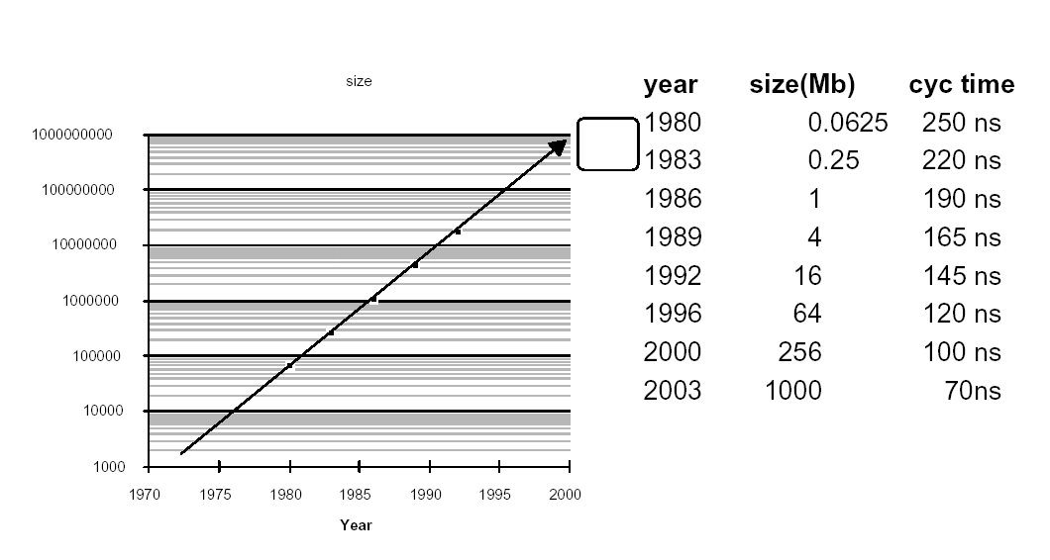
Memory Capacity

Slide 4
The Power of Game Computing and Its Consequences
Every year, computers are made with more and more memory
This makes for bigger and bigger maps in games
Much effort must be spent on pathfinding which could be better utilized elsewhere
The amount of memory gained goes into the bigger maps and unfortunately a lot of it must be spent on navigation

Slide 5
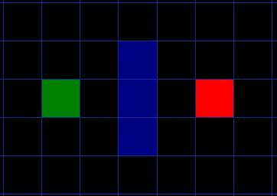
How Nodes are Generated

Slide 6
The First Step: Simplify The Search Area
By breaking the search area into a grid as shown above, it is possible to form a simple two dimensional array
Nodes can actually be any shape one wants; they are very versatile

Slide 7
One Basic Pathfinding Tool: The Transition Table
Each generalized position on the map is represented by a node in a graph
Each path to get there is represented by an edge
The mapping of edges to nodes is called a navigation map
The mapping of a source node to the optimal node to get to a goal node is called a transition table

Slide 8
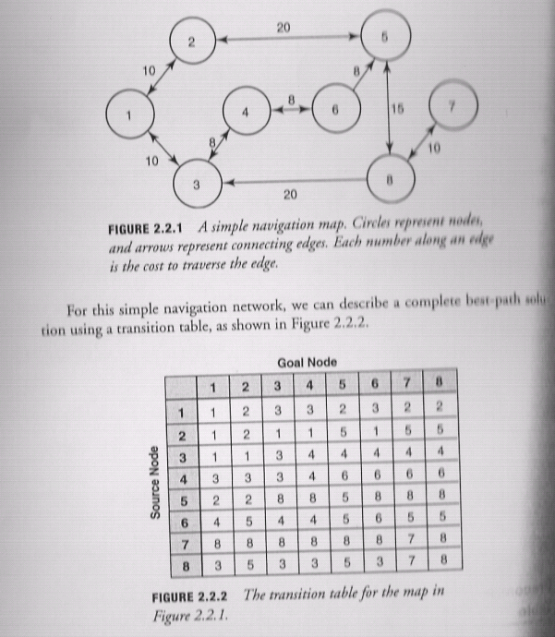

Slide 9
The Fastest Way to Find a Path
Recall the A* algorithm
It is an informed search that is better suited than the greedy algorithm
In summary, it is optimal, complete, and efficient if the heuristic is admissible
Although A* is an excellent pathfinding algorithm, it is faster to look up a path from a table than to search for it
Pathfinding can be made exponentially faster with lookup tables than with any searching algorithm

Slide 10
Review of Searching Algorithms
 | Type | Ordering | Optimal? | Complete? | Efficient?
Depth First | Uninformed | LIFO | No | No | If lucky
Breadth First | Uninformed | FIFO | If step costs are identical | Yes | No
Uniform Cost | Uninformed | g(n) | If step cost>0 | If step cost>0 | No
Greedy | Informed | h(n) | No | No | Usually
A* | Informed | g(n)+h(n) | If heuristic is admissible | Yes | Yes

Slide 11
Using the Table Recursively to Find the Correct Path
Simply use the lookup table to match the node you start with to the goal node
If the node you get is not the goal node, repeat the process with that node instead
while(source != goal)
{ source=transition_table[source][goal];
  path.push_back(source); }

Slide 12
The Downfall…..
The map and table previously shown were simple: they required almost no thought
Unfortunately, due to growing map sizes, these navigation nodes could contain thousands of nodes
Since the table is of O(n²), millions of cells of the table must be generated
All in all, this method is not very effective
A way to reduce search space would be very helpful

Slide 13
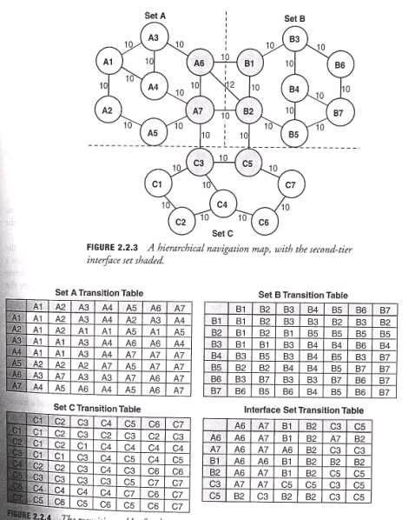

Slide 14
Summary: Monolithic vs. Hierarchical
 | Total Nodes | Navigation Sets | Transition Table Entries
Monolithic Map | 21 | 1 | 441 (21)²
Hierarchical Map | 21 | 4 | 183 (7²+7²+7²+6²)
Partitions | Transition Table Entries | Interface Nodes | Interface Table Entries | Total Table Entries
1 (monolith) | 1,000²=1,000,000 | 0 | 0 | 1,000,000
2 | 2*500²=500,000 | 10 | 100 | 500,100
5 | 5*200²=200,000 | 25 | 625 | 200,625
10 | 10*100²=100,000 | 50 | 2,500 | 102,500
50 | 50*20²=20,000 | 250 | 62,500 | 82,500

Slide 15
An Important Goal for Hierarchical Pathfinding
Choke points are small collections of nodes that connects two larger collections of nodes
All paths coming to and from each partition must enter and exit through one of the choke points
A big issue is to try to use the least number of choke points as possible
This results in the final interface table being as small as possible which saves memory
The fewer interface nodes there are, the faster the pathfinding process will be because there are less paths to consider

Slide 16
Applying the Hierarchical Approach
Inner set pathfinding is trivial: it is no different from the monolithic approach
Inter set pathfinding is more difficult and requires four steps
1. Determine the best path from the source node to the choke point. This is no different from the monolithic approach
2. Determine the best path from the boundary of the source set to the boundary of the destination set
3. Determine the best path from the boundary of the destination set to the destination node
4. Create a list of all possible paths from the first three steps and choose the minimal path

Slide 17
Is It Really Worth the Effort?
Many different paths and path costs to consider; one may wonder if this really is better than a monolithic pathfinding case
However, it turns out that the number of paths that must be searched is ENTIRELY dependant on how many interface nodes there are in the source and goal sets
Thus, maps can be big and complicated, but if there are a limited number of interface nodes, the cost of the set path will still be very small
The growth involved is so small that big maps can be made with ease of pathfinding as long as their boundary nodes are kept to a limited size

Slide 18
Specialized Benefits of Hierarchical Pathfinding
Heterogeneous regions: Different navigation regions such as vehicle games with pedestrian areas. Since each region can be represented by its own pathfinding solution, the modular nature can be perfectly implemented by choke points
Data on Demand: Lends itself easily to the fact that only certain parts of the map may be available in memory at any one time; a navigation set often provides all the data that is needed
Extension: So far only a two-tiered example was provided, but more tiers may be required to handle much larger maps. The modular nature of the hierarchy easily lends itself to higher tiers
Ease of Implementation: A minimal amount of work may be required to place the nodes into sets, but it is fairly trivial compared to the amount of memory saved which could be better used on other aspects of the game

Slide 19
Disadvantages to Lookup Tables
As previously stated, looking up information on a table is faster than searching for a path
However, any changes made to terrain on maps may be difficult to change on tables
Look up tables are generally not good for representing variable movement capabilities
Although memory use can be optimized, on average it is still much greater than the A* search even if it is faster

Slide 20
Pathfinding Comparisons
Pathfinding Approach | Memory Use
Optimized A* | 32KB
Path Look-Up Matrix | 4572KB
Area-based look-up Table | 274KB

Slide 21
Path Look Up Matrices: A Monolithic Example
Advantages: This is the absolute fastest way to find the shortest path. It works just as well on a flat field as it does on a maze.
Disadvantages: For n waypoints or nodes, the matrix will be n by n; again, this is O(n²). This by far uses the most memory. Also, static memory is used, this will reflect poorly with changes to the environment. It may take O(n³) to fix environmental changes!

Slide 22
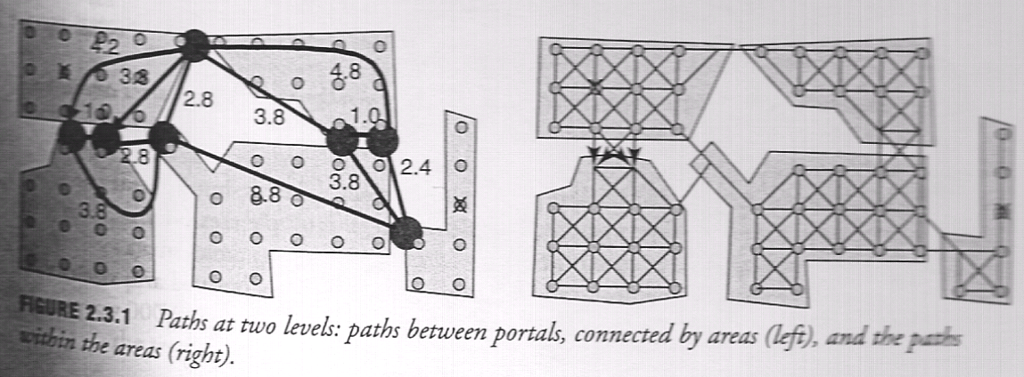
Area Based Path Look Up Tables: A Hierarchical Example

Slide 23
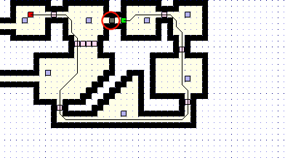
Example of Areas and Portals

Slide 24
Systems of Navigation
The definition of a navigation system varies among developers, but the most basic can be thought of as a separate component responsible for synthesizing movement behaviors
Software engineering tells us that modularization makes for the ease of testing each unit separately and independently
Two important components of Navigation Systems: Interfaces and Movement Paradigms: decisions must be made based on circumstances

Slide 25
Abstraction
It is often unclear how much responsibility the navigation system puts on pathfinding
It can often be grouped to three categories
Planner: the agent makes the path request and uses the result
Pathfinder: trusts the navigation system a bit more, can now make decisions based on paths, but the tedious computations are already done for it
Sub-Architecture: trust the navigation system to find the shortest path with movement behaviors

