Slide 1
Other Potential Machine Learning Uses
A Quick look
Sources:
Artificial Intelligence – Russell & Norvig
Artifical Intelligence - Luger
By: Héctor Muñoz-Avila
Marc Ponsen

Slide 2
Game AI: The Last Frontier
“Progress in graphics and sound has slowed in recent years… Now, more than ever, good game play is at the forefront and AI is one of the most critical components” (Rabin 2004).
“… Interactive computer games provide a rich environment for incremental research on human-level AI… Populating games with realistic, human-level characters will lead to fun, challenging games with great game play” (Laird 2000).
Notes:
Here are two quotes illustrating the importance of game AI in modern games. The first quote is by Rabin, the author of the AI Programming Wisdom book. He more or less represents the game industries perspective. (Say quote)
Game AI is not only a hot topic amongst game developers, also academic people are more and more looking into games. This a quote from a famous AI researcher John Laird. He wrote a famous paper called: Human-level AI's Killer Application, wherein he makes the case that computer games are the ideal test bed for incremental AI research.

Slide 3
Why Learning of Game AI?
The process of learning in games generally implies the adaptation of behavior for opponent players in order to improve performance
Self-correction
  Automatically fixing exploits
Creativity
  Responding intelligently to new situations
Scalability
  Better entertainment for strong players
  Better entertainment for weak players
Notes:
Why do we need learning in games?
Learning could be applied to automatically fix weaknesses in the game AI. Designing strong AI for computer games is a very challenging task considering the tremendous complexity of modern computer games. It is feasible that an AI developer overlooked certain aspects of the game, and left the AI with weaknesses or exploits. Human players generally discover these exploits really easy. Through learning, the AI can automatically fix these exploits so that the human player is forced to continuously search for new tactics to beat the AI.
This can be considered as reactive learning, but we learning could also be used proactively. Rather than responding to human playing styles, through learning the AI could also develop a notion of creativity, make it respond seamlessly intelligent in new situations.
Definition not always true (maybe for academic people). You do not want to always improve the AIs performance. In some situation you might even want to dumb down the AI for scalability purposes > Improve performance against strong players, Decrease performance against weak players. The third point is strictly from a game developers point of view. Game developers want to create an entertaining AI, one that puts up a good challenge. Academic people on the other hand are mostly trying to develop the best AI they can.

Slide 4
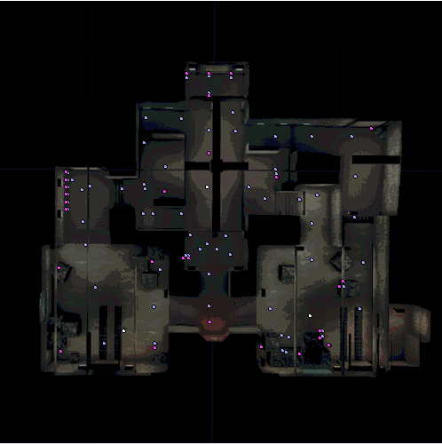
What Is Machine Learning?
“Logic is not the end of wisdom, it is just the beginning” --- Spock
time
Game
Game
System
System
Action₁
Action₂
Knowledge
Knowledge
changed

Slide 5
Offline vs. Online Learning
Online – during gameplay
  Adapt to player tactics
  Avoid repetition of mistakes
  Requirements: computationally cheap, effective, robust, fast learning (Spronck 2004)
Offline - before the game is released
  Devise new tactics
  Discover exploits
Notes:
Two different types of learning in games: online and offline:
Online learning takes place during gameplay against human players. The main applications for online learning are to adapt to player tactics and playing styles and avoid the repetition of mistakes. However, online learning has rarely been applied in commercial games because most game companies are not comfortable with shipping their games with an online learning technique included in the game. What if the NPC learns something stupid? What if the learning takes too long or is too computational expensive? Therefore we set a couple of requirements for online learning:
Computationally cheap: Should not disturb flow of gameplay.
Effective: Should not generate too many bad inferior opponents.
Robust: Should be able to deal with randomness incorporated in games. For instance you don’t want permanently unlearn a specific behavior because it performed badly at some point. The reason for the bad performance could be subscribed to chance.
Fast learning: Should lead to results quickly. Don’t want to bore the players with slow learning AI.
Offline learning can be applied before a games is being released. Typically, offline learning is used to explore new game tactics or to find exploits.

Slide 6
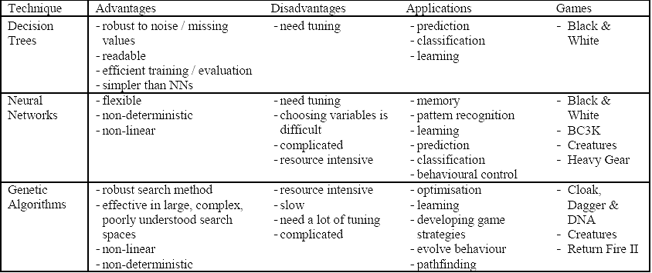
Some Machine Learning Techniques
Notes:
This table presents three popular machine learning techniques:
Most promising is decision trees which has been successfully applied in B&W.
A NN is a simplified emulation of the connections of the human brain, which can be used learning purposes in an artificial environment. Neural Networks is relatively unexplored technique in computer games, especially because they are complicated to understand and are very resource intensive. However, they are flexible and can be used for many purposes such as learning, classification and pattern recognition. Despite drawback, NN has been applied in games (even B&W). Has anyone here played one of these games? How was the AI?
Genetic Algorithms or EA are search algorithms that are based on the principle of biological evolution. EA are extremely useful in covering large search spaces, such as computer games, and can be used to develop new game strategies. This is exactly what I did with my experiments.
There are more machine learning techniques this table doesn’t list such as reinforcement learning.

Slide 7
Learning: The Big Picture
Two forms of learning:
  Supervised: the input and output of the learning component can be perceived (for example: experienced player giving friendly teacher)
  Unsupervised: there is no hint about the correct answers of the learning component (for example to find clusters of data)

Slide 8
Classification
(According to the language representation)
Symbolic
  Version Spaces
  Induction of Decision Trees
  Explanation-Based Learning
  …
Sub-symbolic
  Reinforcement Learning
  Connectionist
  Evolutionary

Slide 9
Induction of Decision Trees

Slide 10
Example
Ex’ple | Bar | Fri | Hun | Pat | Alt | Type | wait
x1 | no | no | yes | some | yes | French | yes
x4 | no | yes | yes | full | yes | Thai | yes
x5 | no | yes | no | full | yes | French | no
x6 | yes | no | yes | some | no | Italian | yes
x7 | yes | no | no | none | no | Burger | no
x8 | no | no | yes | some | no | Thai | yes
x9 | yes | yes | no | full | no | Burger | no
x10 | yes | yes | yes | full | yes | Italian | no
x11 | no | No | no | none | no | Thai | no

Slide 11
Example of a Decision Tree
Patrons?
none
Full
some
no
yes
waitEstimate?
0-10
>60
30-60
10-30
no
Alternate?
Hungry?
yes
no
yes
No
Yes
Reservation?
Fri/Sat?
yes
Alternate?
no
yes
no
yes
no
yes
Bar?
Yes
No
Yes
yes
Raining?
no
yes
no
yes
No
Yes
no
yes

Slide 12
Induction
Databases: what are the data that matches this pattern?
Induction: what is the pattern that matches these data?
Data
Ex’ple | Bar | Fri | Hun | Pat | Type | Res | wait
x1 | no | no | yes | some | french | yes | yes
x4 | no | yes | yes | full | thai | no | yes
x5 | no | yes | no | full | french | yes | no
x6
x7
x8
x9
x10
x11
database
pattern
induction

Slide 13
Induction of Decision Trees
Objective: find a concise decision tree that agrees with the examples
The guiding principle we are going to use is the Ockham’s razor principle: the most likely hypothesis is the simplest one that is consistent with the examples
Problem: finding the smallest decision tree is NP-complete
However, with simple heuristics we can find a small decision tree (approximations)

Slide 14
Decision Trees in Gaming
http://www.youtube.com/watch?v=HMdOyUp5Rvk
Black & White, developed by Lionhead Studios, and released in 2001
Used to predict a player’s reaction to a certain creature’s action
In this model, a greater feedback value means the creature should attack
  This is done by inducing a decision tree

Slide 15
Decision Trees in Black & White
should your creature attack a town?
Example | Attributes |  |  | Target
 | Allegiance | Defense | Tribe | Feedback
D1 | Friendly | Weak | Celtic | -1.0
D2 | Enemy | Weak | Celtic | 0.4
D3 | Friendly | Strong | Norse | -1.0
D4 | Enemy | Strong | Norse | -0.2
D5 | Friendly | Weak | Greek | -1.0
D6 | Enemy | Medium | Greek | 0.2
D7 | Enemy | Strong | Greek | -0.4
D8 | Enemy | Medium | Aztec | 0.0
D9 | Friendly | Weak | Aztec | -1.0

Slide 16
Decision Trees in Black & White
Allegiance
Friendly
Enemy
-1.0
Defense
Weak
Strong
Medium
0.4
0.1
-0.3
Note that this decision tree does not even use the tribe attribute

Slide 17
Decision Trees in Black & White
Now suppose we don’t want the entire decision tree, but we just want the 2 highest feedback values
We can create a Boolean expressions, such as
((Allegiance = Enemy) ^ (Defense = Weak)) v ((Allegiance = Enemy) ^ (Defense = Medium))

Slide 18
Reinforcement Learning (Again)

Slide 19
RL application: Dynamic Scripting
Dynamic Scripting (DS) is an online learning technique inspired by RL
Original implementation of DS (Spronck 2004) in the Computer RolePlaying Game NeverWinter Nights ©
Notes:
In Computer RolePlaying Games (CRPGs) the human player is situated in a virtual world represented by a single character or a party of characters. Each character is of a specific type (e.g., a fighter or a wizard) and has certain characteristics (e.g., weak but smart). In most CRPGs, the human player goes on a quest, which involves conversing with the world’s inhabitants, solving puzzles, discovering secrets, and defeating opponents in combat.

Slide 20




Dynamic Scripting
team controlled
team controlled
b
y computer
by human player
generate
scripted
A
human
Rulebase A
script
Script A
control
control
weight updates
Combat
generate
scripted
B
human
Rulebase B
script
Script B
control
control
Notes:
- Online learning technique >> therefore pitted against human player
- Two teams >> one human, one computer
- Computer player is controlled by script, a dynamic script that is generated on the fly
- Dynamic script is generated by extracting rules from rulebase
- Rules in this game include rules such as (1) attacking an enemy, (2) drinking a potion, (3) casting a spell, (4) moving, and (5) passing.
- These rules are grouped in different rulebases.
- Each different game character type has a set of rules it is allowed to choose from (wizard – spells, warrior – attack sword)
- The chance for a rule to be selected depends on the weight value associated with the rule. The larger the weight value, the higher the chance this rule is selected.
When script is assembled, combat between human player and computer player.
Based on the results of the fight, the weights for the rules selected in the script are updated. Rules that had positive contribution to the outcome (eg. dynamic AI won) are being rewarded, which means their weight value will be increased, hence increasing the chance that this rule will be selected in future games. Rules that had negative contribution to the outcome (eg. dynamic AI lost) are being punished, which means their weight value will be decreased, and thereby decreasing the chance that this rule will be selected in future games.
- Through this process of rewarding and punishing behavior, DS will gradually adapt to the human player tactics.

Slide 21
Dynamic Scripting and Requirements
Computationally Cheap - Script generation and weight updates once per encounter
Effective - Rules are manually designed
Robust - Reward/penalty system
Fast Learning – Experiments showed that DS is able to adapt fast to an unchanging tactic
Notes:
Fast: Should not disturb flow of gameplay. It’s obviously fast.
Effective: Should not generate too many bad inferior opponents. It’s effective because rules are not stupid, even if they are not optimal.
Robust: Should be able to deal with randomness. It’s robust, because a penalty does not remove a rule, it just gets selected less often.
Efficient: Should lead to results quickly. Yes experiments showed that it is.

Slide 22
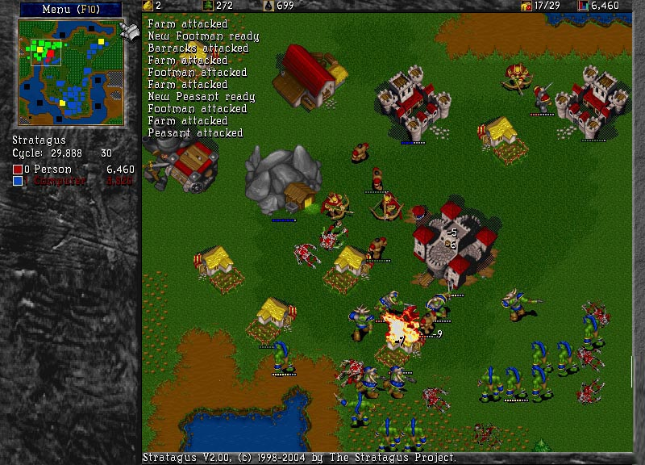
Wargus: A Real-Time Strategy Game
Complex: large state and decision space!

Slide 23
Dynamic Scripting in Wargus
Different rulebases for different game states
State transition on constructing a building that allows new units or new research
Notes:
This concludes my talk on dynamic scripting in NWN. Part of my master thesis, was to implement dynamic scripting in a RTS genre, for which I choose Wargus. Because of the difference between CRPG and RTS, I had to make a few changes to the original DS implementation. First of all, while dynamic scripting for CRPGs employs different rulebases for different opponent types in the game (such as wizzard or warrior), my RTS implementation of dynamic scripting employs different rulebases for the different states of the game. Typically, players in RTS games start a game with only very few game options, and as they gradually move up the technology ladder, new game options will open up to them. In order to let the dynamic AI only select appropriate rules, we have to inform it what is possible at any given state of the game. Therefore, I chose to structure the states based on the building a player possesses. The Buildings a player possess in RTS games usually determine what game options are available to the player. For instance if you want to train an archer in Wargus, you have to own a barrack and lumbermill. If you want to build a catapult, you also need a blacksmith etc. A state transition happen on constructing a building that allows the training of new units or research.

Slide 24
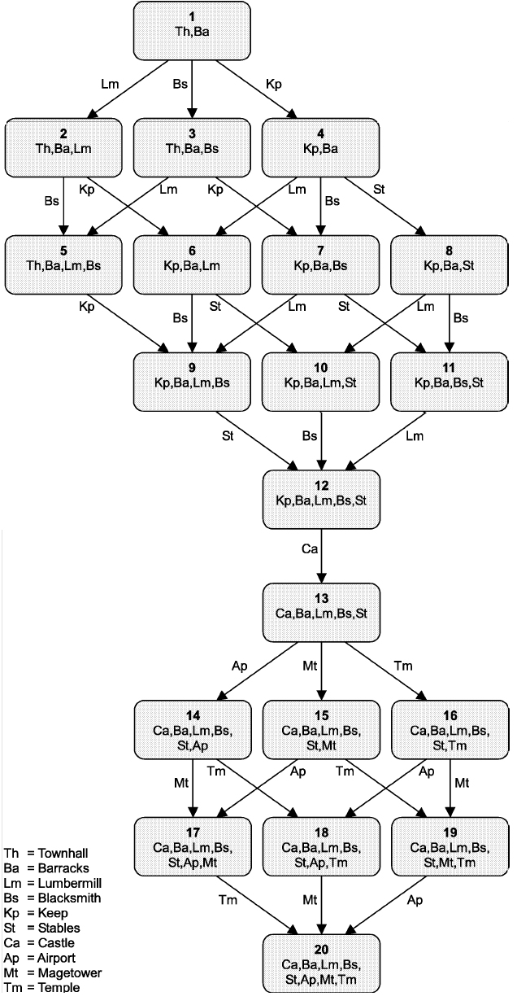
Domain Knowledge in Wargus Abstraction of the state space
States in Wargus are manually predefined and represent game phases that inform the AI on the possible tactics during a game
The possible tactics during a game mainly depend on available units and technology
The availability of units and technology depends on the buildings the player possesses
Therefore, the utility of tactics depends on the available buildings
Notes:
Hector:Slide # 7 is too wordy. Consider reducing the text. Specially the first bullet.
True, but I don’t know whether I can leave something out, all is important. I added animation to hide most text in the beginning.

Slide 25
Domain Knowledge in Wargus
Abstraction of the decision space
A library of tactics for each state
Tactics are action sequences consisting of 1 or more game actions (e.g., building, combat, research etc.)
State 1
Knowledge
base
State n
Knowledge
base
State 20
Knowledge
base
…
…
Construct City Center
Train 4 workers
Defend with 1 Soldier
Construct Keep
Train 30 workers
Defend with 1 Knight
Construct Castle
Train 30 workers
Construct Blacksmith
Research better Weapons
Attack with 2 Soldiers
Attack with 10 Knights
Research magic spell
Defend with 2 Mages
Attack with 10 Knights
Research magic spell
Defend with 2 Mages
Construct Guard tower

Slide 26

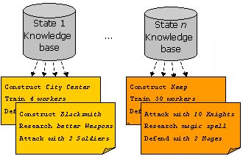
Domain Knowledge in Wargus
State abstraction
complex
Dynamic Scripting learns to win efficiently against static opponents! (Ponsen et al. 2004)
Decision abstraction
Notes:
Hector: What I am suggesting is to have a theme for Slide # 9 that is clearly related to the
problem stated in Slide # 10
Hector, I don’t think I know what you are referring to here. The relation between slide 9 and 10 is: we tested DS with these two sources of domain knowledge in Wargus and found that it learned efficiently against medium-skilled opponents (slide 9). Experiments also showed that (problem statement - slide 10) certain opponents that we considered as though (hard-skilled), were not beaten by DS. That’s why for future research we explored whether improving the domain knowledge could potentially increase the efficiency of DS.

Slide 27
Rules in Rulebases
12 Build rules
9 Research rules
4 Economy rules
25 Combat rules
AiNeed(AiBarracks)
AiResearch(AiUpgradeArmor1)
AiNeed(AiWorker)
AiForce(1, {AiSoldier, 9})
AiWaitForce(1)
AiAttackWithForce(1)

Slide 28
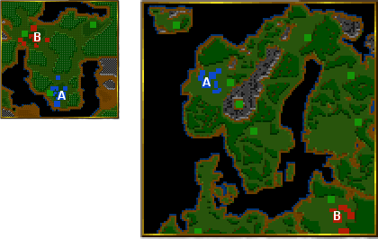
Tactics
Two `balanced’ tactics
  Small Balanced Land Attack (SBLA)
  Large Balanced Land Attack (LBLA)
Two `rush’ tactics
  Soldier Rush (SR)
  Knight Rush (KR)

Slide 29
Dynamic Scripting Test
Dynamic player (using dynamic scripting) plays 100 consecutive games against static player
Randomisation Turning Point (RTP): First game that dynamic player outperforms static player with 90% probability according to a randomisation test (Cohen, 1995)
Notes:
We pitted the dynamic AI against the 4 unchanging tactics and played a max of 100 consecutive games. We aborted a test as soon as we statistically can claim that the dynamic player is outperforming the opponent player. The first game in which the dynamic player outperforms the static player is called the RTP. If a RTP has been reached, we may say that the dynamic player successfully learned to beat its opponent. A low value for the RTP indicates good efficiency of dynamic scripting.

Slide 30
Dynamic Scripting RTP Results
Tactic | Tests | Low | High | Avg. | Med. | >100 | Won
SBLA | 31 | 18 | 99 | 50 | 39 | 0 | 59.3
LBLA | 21 | 19 | 79 | 49 | 47 | 0 | 60.2
SR | 10 |  |  |  |  | 10 | 1.2
KR | 10 |  |  |  |  | 10 | 2.3
Dynamic Scripting WORKS! It adapts efficiently against SBLA and LBLA
Dynamic Scripting is unable to adapt to the optimized tactics SR and KR
Notes:
From left to right, the table displays (1) the tactic used by the static player, (2) the number of tests, (3) the lowest RTP found, (4) the highest RTP found, (5) the average RTP, (6) the median RTP, (7) the number of tests that did not find an RTP within 100 games (therefore where the dynamic AI did NOT learn to adapt to static player), and (8) the average number of games won out of 100.
Conclusion 2: Terrible results. Part 2 of my thesis was to try and improve the performance against the two rush tactics. We choose to do that by improving the domain knowledge used by dynamic scripting.

Slide 31
Evolutionary Computation

Slide 32
Problem Statement
Dynamic Scripting was unable to cope with some tougher static opponents (Ponsen et al. 2004)
Can we increase the efficiency of Dynamic Scripting (i.e., speed up learning and win more games) by improving the domain knowledge?
Our proposed solution: revision of tactic library:
  Semi-Automatic domain knowledge revision
  Automatic domain knowledge revision

Slide 33
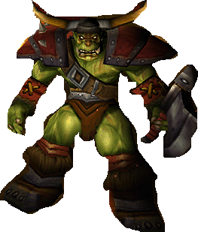
Semi-Automatic Improvement of Domain-Knowledge
manually designed tactic library
Training script 1
Knowledge
Base
manually improved tactic library
Adaptive
Game AI
Performance Evaluation
Compete against static scripts
Training script 2
Dynamic Scripting
Generate Script
….
Training script n
Counter Strategy 1
Counter Strategy 2
….
Counter Strategy n
Knowledge Base Revision
Manually Extract Tactics from Evolved Counter Strategies
Evolutionary Algorithm
Evolve Domain Knowledge

Slide 34
Evaluation Semi-Automatic Approach
Benefits
Evolved tactics can be used to improve domain knowledge used by adaptive AI (Ponsen et al. 2004)
Dynamic scripting converged to solution (i.e., learns to win) two times faster against medium-skilled opponents
Overall 40% more games are won
Limitations
Time consuming
Domain knowledge not optimal (due to human factor)
  Strong tactics not recognized in evolved scripts
  Inferior tactics added to knowledge base
Notes:
Domain knowledge not optimal >> Dynamic Scripting didn’t learn a winning strategy against several strong opponents
To overcome the last 2 problematic points we also evaluated an automatic approach.

Slide 35
Automatic Knowledge Acquisition for Dynamic Scripting (AKADS)
Knowledge
Base
Adaptive
Game AI
Training script 1
automatically generated tactic library
Training script 2
….
Training script n
Dynamic Scripting
Generate Script
Counter Strategy 1
Counter Strategy 2
….
Counter Strategy n
Knowledge Base Revision
Automatically Extract Tactics from Evolved Counter Strategies
Evolutionary Algorithm
Evolve Domain Knowledge

Slide 36
Evolutionary Approaches
Idea: Biological analogy on how populations of species evolve over generations
Step 1: start with a population (each member is a candidate solution)
…
Step 2: Create the next generation by considering evolutionary operations on the population from the previous generation (e.g., mutation) and a fitness function (only the more fit get to contribute to the next generation)
…
Continue the process until a certain condition is reached

Slide 37
The Genetic Algorithm
t ← 0
Initialize the population P(t)
While the termination condition is not met do
{
evaluate fitness of each member of P(t)
select members of P(t) based on fitness
produce the offspring of pairs of selected members using genetic operators
replace, based on fitness, candidates of P(t) based on this offspring
t ← t + 1
}
Crossover
Mutation
Inversion
exchange
Non-selected members are not necessarily eliminated

Slide 38
Example: CNF-satisfaction
A conjunctive normal form (CNF) is a Boolean expression consisting of one or more disjunctive formulas connected by an AND symbol (∧). A disjunctive formula is a collection of one or more (positive and negative) literals connected by an OR symbol (∨).
Example:
(a) ∧ (¬ a ∨ ¬b ∨ c ∨ d) ∧ (¬c ∨ ¬d) ∧ (¬d)
Problem (CNF-satisfaction): Give an algorithm that receives as input a CNF form and returns Boolean assignments for each literal in form such that form is true
Example (above):
a ← true, b ← false, c ← true, d ← false

Slide 39
CNF as a Genetic Algorithm
A potential solution is a true/false assignment to the 4 variables a, b, c, and d in the formula: 1010 means that a and c are true and b and d are false
In particular, a solution for (a) ∧ (¬ a ∨ ¬b ∨ c ∨ d) ∧ (¬c ∨ ¬d) ∧ (¬d) is 1001
Nice: all 4 genetic operations applied on any potential solutions will result in a potential solutions (in other problems or other representations of this problem this may not be the case)
Fitness: for 0101 and 1001: which is a more suitable solution?
Fitness value?
1001
2
3
# of disjunctions in the formula that are made true

Slide 40
Evolving Domain Knowledge
Input: training scripts
  Manually designed scripts
  Dynamic or evolutionary scripts
Output: chromosomes representing candidate solutions (i.e., winning counter-strategies)

Slide 41
Chromosome

Slide 42
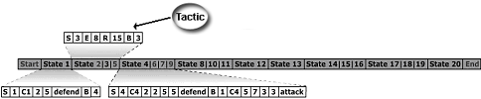
Automatically Extracting Tactics
Use states to distinguish tactics in chromosome!
All genes grouped in a specific state constitutes a tactic that will be inserted into the corresponding knowledge base

Slide 43
Genetic Operators
State Crossover
Gene Replace Mutation
Gene Biased Mutation
Randomization
Notes:
May leave this one out.

Slide 44
Evaluation of Automatic Approach
Benefits
Less time consuming compared to other approaches (knowledge base automatically generated)
Qualitatively better domain knowledge compared to semi-automatic improved knowledge base:
  Overall 15% more games are won
  Converged to solution (i.e., learns to win) two times faster against medium-skilled opponents
  Dynamic Scripting learned to cope with strong opponents
Limitations
Danger of knowledge base over fitting
Notes:
David: p18 is insufficient: Detailed slides are missing on the formal hypothesis being investigated, the empirical methodology, the analysis method, and the results.
Hector: Do you want to say something about the experimental setup?
David, Hector: I can add more details on the experiments, but that would require at least 3 more slides. The presentation as it is already takes 25 minutes. Also, wouldn’t discussing the exp. Setup be a bit too technical (explaining RTP, experimental run, DS learning parameters etc.) ? I prefer not to discuss that in too much detail, but I can give it a shot here anyway.
formal hypothesis: can we improve performance of DS by automatically generating a KB compared to a manually designed KB?
the empirical methodology: test DS against a set of static opponents and measure RTP points and number of games won.
Analysis method: compare RTP and win/loss data of DS with semi-automatic generated KB with automatic generated KB.
Results: these are discussed here, but only in text and not in a table.
Hector: can you be more precise on the results ("more": 20%?, 30%?)
Done.

Slide 45
Final Remarks
Machine learning has been successfully applied in a number of games
  We have seen some: decision trees, neural networks
Still a number of ML techniques haven’t even been tried out
We illustrated a simple approach using Evolutionary Computation and Reinforcement Learning
  Lots of potential: balancing units in an RTS game, balancing classes in an RPG game, detecting hacks in an MMO…
Notes:
David: There's no final summary slide that would contain a "takeaway message".
That was the purpose of this slide. Is this not appropriate or sufficient?

