Slide 1
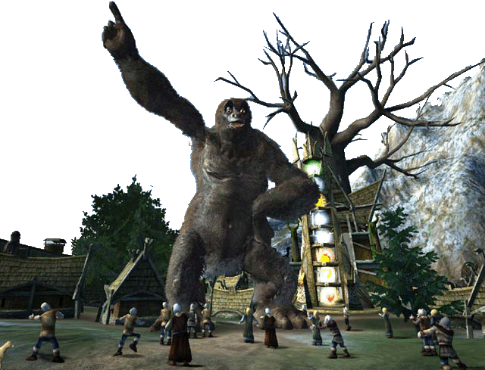
Machine Learning in Computer Games
Automated GenerationTactics for Strategy Games
Original: Marc Ponsen
Update: H. Munoz-Avila
Notes:
Far Cry. (2:30)

Slide 2
Game AI: The Last Frontier
“Progress in graphics and sound has slowed in recent years… Now, more than ever, good game play is at the forefront and AI is one of the most critical components (Rabin 2004).”
“… Interactive computer games provide a rich environment for incremental research on human-level AI… Populating games with realistic, human-level characters will lead to fun, challenging games with great game play (Laird 2000).”
Notes:
Here are two quotes illustrating the importance of game AI in modern games. The first quote is by Rabin, the author of the AI Programming Wisdom book. He more or less represents the game industries perspective. (Say quote)
Game AI is not only a hot topic amongst game developers, also academic people are more and more looking into games. This a quote from a famous AI researcher John Laird. He wrote a famous paper called: Human-level AI's Killer Application, wherein he makes the case that computer games are the ideal test bed for incremental AI research.

Slide 3
Previous class: Large Decision Space
Variables
Civilization-wide variables
N: Number of civilizations encountered
D: Number of diplomatic states (that you can have with an opponent)
G: Number of government types available to you
R: Number of research advances that can be pursued
I: Number of partitions of income into entertainment, money, & research
U: #Units
L: Number of locations a unit can move to in a turn
C: #Cities
Z: Number of citizens per city
S: Citizen status (i.e., laborer, entertainer, doctor)
B: Number of choices for city production
Decision complexity per turn (for a typical game state)
O(D^{N}GRI*L^{U}*(S^{Z}B)^{C}) ; this ignores both other variables and domain knowledge
This becomes large with the number of units and cities
Example: N=3; D=5; G=3; R=4; I=10; U=25; L=4; C=8; Z=10; S=3; B=10
Size of decision space (i.e., possible next states): 2.5*10⁶⁵ (in one turn!)
Comparison: Decision space of chess per turn is well below 140 (e.g., 20 at first move)
(David W. Aha, NRL)

Slide 4
So what can AI do?
Some tasks are solved: pathfinding
Other tasks can be solved well with standard techniques: FSM
Tackle tasks of the problem that can be hard to solve otherwise
Example: Automated Generation of tactics
Which AI techniques?

Slide 5
Requirements: must be General; Independent of details
Must work on any map
Must work on any opponent
Must work with different kinds teammates

Slide 6
Example Task: Strategic Decision Making with Planning (Alternative 1)
UT task: Domination
Declarative language for expressing conditions
Strategy: secure most locations
Solution to 1: call external function (implemented with FSMs)
UT action: move Bot1 to location B
Solution to 2: use Java Bots to represent actions (FSMs)
2. Dealing with contingencies while Bots are executing actions
Planning requires less engineering requirements than FSMs but can still require lots of human effort

Slide 7
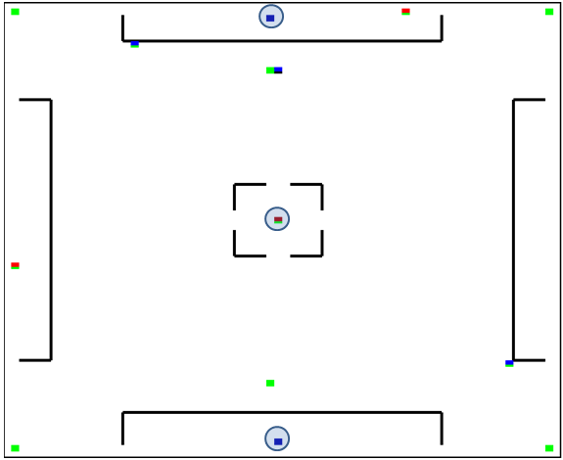
Alternative 2: Heuristic evaluation
Divide the map into areas (determining the actual partition can be done with FSMs)
For each area assign a heuristic value
Send bots to region with highest heuristic value

Slide 8
Alternative 2: Heuristic evaluation
GOOD (0.9 score)
F(area) =
w1*friendlyDeaths(zone) +
w2*ownership(zone)+
…
BAD (0.2 score)
Heuristic evaluation has proved very useful (game trees, planning, A*,…)
OK (e.g., 0.6 score)

Slide 9
Alternative 3: Learning
The process of learning in games generally implies the adaptation of behavior for opponent players in order to improve performance
Self-correction
Automatically fixing exploits
Creativity
Responding intelligently to new situations
Scalability
Better entertainment for strong players
Better entertainment for weak players
Notes:
Why do we need learning in games?
Learning could be applied to automatically fix weaknesses in the game AI. Designing strong AI for computer games is a very challenging task considering the tremendous complexity of modern computer games. It is feasible that an AI developer overlooked certain aspects of the game, and left the AI with weaknesses or exploits. Human players generally discover these exploits really easy. Through learning, the AI can automatically fix these exploits so that the human player is forced to continuously search for new tactics to beat the AI.
This can be considered as reactive learning, but we learning could also be used proactively. Rather than responding to human playing styles, through learning the AI could also develop a notion of creativity, make it respond seamlessly intelligent in new situations.
Definition not always true (maybe for academic people). You do not want to always improve the AIs performance. In some situation you might even want to dumb down the AI for scalability purposes > Improve performance against strong players, Decrease performance against weak players. The third point is strictly from a game developers point of view. Game developers want to create an entertaining AI, one that puts up a good challenge. Academic people on the other hand are mostly trying to develop the best AI they can.

Slide 10
Offline vs. Online Learning
Online – during gameplay
Adapt to player tactics
Avoid repetition of mistakes
Requirements: computationally cheap, effective, robust, fast learning (Spronck 2004)
Offline - before the game is released
Devise new tactics
Discover exploits
Notes:
Two different types of learning in games: online and offline:
Online learning takes place during gameplay against human players. The main applications for online learning are to adapt to player tactics and playing styles and avoid the repetition of mistakes. However, online learning has rarely been applied in commercial games because most game companies are not comfortable with shipping their games with an online learning technique included in the game. What if the NPC learns something stupid? What if the learning takes too long or is too computational expensive? Therefore we set a couple of requirements for online learning:
Computationally cheap: Should not disturb flow of gameplay.
Effective: Should not generate too many bad inferior opponents.
Robust: Should be able to deal with randomness incorporated in games. For instance you don’t want permanently unlearn a specific behavior because it performed badly at some point. The reason for the bad performance could be subscribed to chance.
Fast learning: Should lead to results quickly. Don’t want to bore the players with slow learning AI.
Offline learning can be applied before a games is being released. Typically, offline learning is used to explore new game tactics or to find exploits.

Slide 11
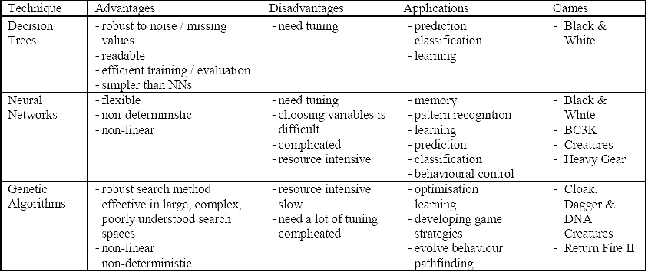
Some Machine Learning Techniques
Notes:
This table presents three popular machine learning techniques:
Most promising is decision trees which has been successfully applied in B&W.
A NN is a simplified emulation of the connections of the human brain, which can be used learning purposes in an artificial environment. Neural Networks is relatively unexplored technique in computer games, especially because they are complicated to understand and are very resource intensive. However, they are flexible and can be used for many purposes such as learning, classification and pattern recognition. Despite drawback, NN has been applied in games (even B&W). Has anyone here played one of these games? How was the AI?
Genetic Algorithms or EA are search algorithms that are based on the principle of biological evolution. EA are extremely useful in covering large search spaces, such as computer games, and can be used to develop new game strategies. This is exactly what I did with my experiments.
There are more machine learning techniques this table doesn’t list such as reinforcement learning.

Slide 12
Alternative 3.1: Learning Decision Tree of Tactics
Assumes you have many game traces (visualized as a table)
Assumes game designer has identified classes or categories of desired behaviors (e.g., “defend locations”)
Induces a tree that indicates under which conditions a particular behavior is desirable
Decision Tree
induction
If owning locations 1 and 2, and 3 then defend locations 1, 2, and 3

Slide 13
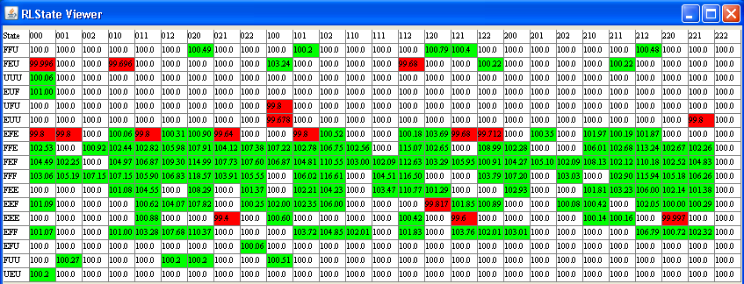
Alternative 3.2: Reinforcement Learning
ACTIONS
STATES
“good” action
“bad” action
Best action identified so far
For state “EFE” (Enemy controls 2 DOM points)

Slide 14
OK But that DOM game is kind of simple…
Bots can be be at any location
Maps are 70*70 (M*M)
Capture occurs only after 5 ticks of getting to a dom location (D)
B Bots have health points [0..10]
Horde Bonus :
For each teammate within 4 squares: add 3 to damage dealt
For each teammate within 8 squares: add 2 to damage dealt
For each teammate within 12 squares: add 1 to damage dealt
spawn point (S) is owned by the team controlling its nearest domination point
Number of states O(M² * 6 * D * 11 * B * S)
AI uses abstracted the states to O(D* B)

Slide 15
RL application: Dynamic Scripting for Wargus
Dynamic Scripting (DS) is an online learning technique inspired by RL
Original implementation of DS (Spronck 2004) in the Computer RolePlaying Game NeverWinter Nights ©
Notes:
In Computer RolePlaying Games (CRPGs) the human player is situated in a virtual world represented by a single character or a party of characters. Each character is of a specific type (e.g., a fighter or a wizard) and has certain characteristics (e.g., weak but smart). In most CRPGs, the human player goes on a quest, which involves conversing with the world’s inhabitants, solving puzzles, discovering secrets, and defeating opponents in combat.

Slide 16
Dynamic Scripting
team controlled
team controlled
b
y computer
by human player
generate
scripted
A
human
Rulebase A
script
Script A
control
control
weight updates
Combat
generate
scripted
B
human
Rulebase B
script
Script B
control
control
Notes:
- Online learning technique >> therefore pitted against human player
- Two teams >> one human, one computer
- Computer player is controlled by script, a dynamic script that is generated on the fly
- Dynamic script is generated by extracting rules from rulebase
- Rules in this game include rules such as (1) attacking an enemy, (2) drinking a potion, (3) casting a spell, (4) moving, and (5) passing.
- These rules are grouped in different rulebases.
- Each different game character type has a set of rules it is allowed to choose from (wizard – spells, warrior – attack sword)
- The chance for a rule to be selected depends on the weight value associated with the rule. The larger the weight value, the higher the chance this rule is selected.
When script is assembled, combat between human player and computer player.
Based on the results of the fight, the weights for the rules selected in the script are updated. Rules that had positive contribution to the outcome (eg. dynamic AI won) are being rewarded, which means their weight value will be increased, hence increasing the chance that this rule will be selected in future games. Rules that had negative contribution to the outcome (eg. dynamic AI lost) are being punished, which means their weight value will be decreased, and thereby decreasing the chance that this rule will be selected in future games.
- Through this process of rewarding and punishing behavior, DS will gradually adapt to the human player tactics.

Slide 17
Dynamic Scripting and Requirements
Computationally Cheap - Script generation and weight updates once per encounter
Effective - Rules are manually designed
Robust - Reward/penalty system
Fast Learning – Experiments showed that DS is able to adapt fast to an unchanging tactic
Notes:
Fast: Should not disturb flow of gameplay. It’s obviously fast.
Effective: Should not generate too many bad inferior opponents. It’s effective because rules are not stupid, even if they are not optimal.
Robust: Should be able to deal with randomness. It’s robust, because a penalty does not remove a rule, it just gets selected less often.
Efficient: Should lead to results quickly. Yes experiments showed that it is.

Slide 18
Wargus: A Real-Time Strategy Game
Complex: large state and decision space!
(Not as large as Civilization but larger than DOM)

Slide 19
Dynamic Scripting in Wargus
Different rulebases for different game states
State transition on constructing a building that allows new units or new research
AiNeed(AiBarracks)
AiResearch(AiUpgradeArmor1)
AiNeed(AiWorker)
AiForce(1, {AiSoldier, 9})
AiWaitForce(1)
AiAttackWithForce(1)
Notes:
This concludes my talk on dynamic scripting in NWN. Part of my master thesis, was to implement dynamic scripting in a RTS genre, for which I choose Wargus. Because of the difference between CRPG and RTS, I had to make a few changes to the original DS implementation. First of all, while dynamic scripting for CRPGs employs different rulebases for different opponent types in the game (such as wizzard or warrior), my RTS implementation of dynamic scripting employs different rulebases for the different states of the game. Typically, players in RTS games start a game with only very few game options, and as they gradually move up the technology ladder, new game options will open up to them. In order to let the dynamic AI only select appropriate rules, we have to inform it what is possible at any given state of the game. Therefore, I chose to structure the states based on the building a player possesses. The Buildings a player possess in RTS games usually determine what game options are available to the player. For instance if you want to train an archer in Wargus, you have to own a barrack and lumbermill. If you want to build a catapult, you also need a blacksmith etc. A state transition happen on constructing a building that allows the training of new units or research.

Slide 20
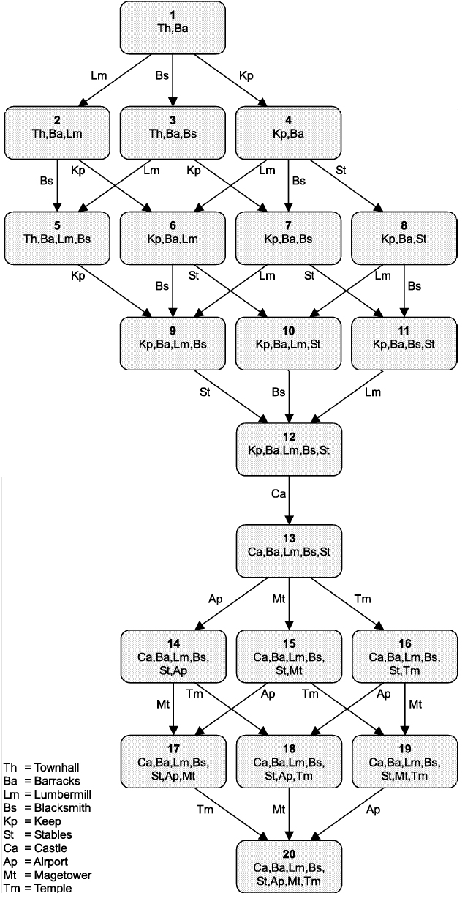
Domain Knowledge in Wargus Abstraction of the state space
Abstraction: States in Wargus are manually predefined and represent game phases that inform the AI on the possible tactics during a game
The possible tactics during a game mainly depend on available units and technology
The availability of units and technology depends on the buildings the player possesses
Therefore, the utility of tactics depends on the available buildings
Notes:
Hector:Slide # 7 is too wordy. Consider reducing the text. Specially the first bullet.
True, but I don’t know whether I can leave something out, all is important. I added animation to hide most text in the beginning.

Slide 21
Domain Knowledge in Wargus Abstraction of the decision space
A library of tactics for each state
Tactics are action sequences consisting of 1 or more game actions (e.g., building, combat, research etc.)
State 1
Knowledge
base
State n
Knowledge
base
State 20
Knowledge
base
…
…
Construct City Center
Train 4 workers
Defend with 1 Soldier
Construct Keep
Train 30 workers
Defend with 1 Knight
Construct Castle
Train 30 workers
Construct Blacksmith
Research better Weapons
Attack with 2 Soldiers
Attack with 10 Knights
Research magic spell
Defend with 2 Mages
Attack with 10 Knights
Research magic spell
Defend with 2 Mages
Construct Guard tower

Slide 22
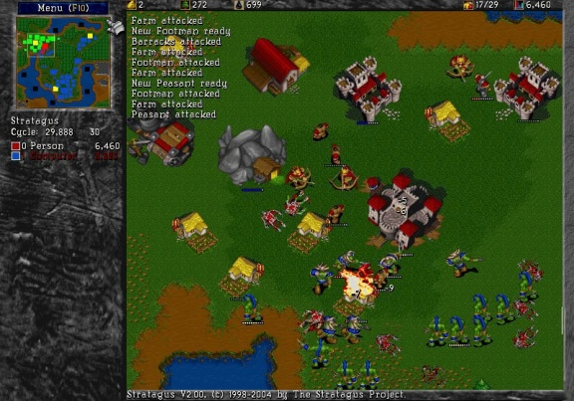
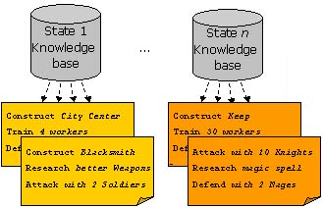
Domain Knowledge in Wargus
State abstraction
complex
Dynamic Scripting learns to win efficiently against static opponents! (Ponsen et al. 2004)
Decision abstraction
Notes:
Hector: What I am suggesting is to have a theme for Slide # 9 that is clearly related to the problem stated in Slide # 10
Hector, I don’t think I know what you are referring to here. The relation between slide 9 and 10 is: we tested DS with these two sources of domain knowledge in Wargus and found that it learned efficiently against medium-skilled opponents (slide 9). Experiments also showed that (problem statement - slide 10) certain opponents that we considered as though (hard-skilled), were not beaten by DS. That’s why for future research we explored whether improving the domain knowledge could potentially increase the efficiency of DS.

Slide 23
Rules in Rulebases
AiNeed(AiBarracks)
AiResearch(AiUpgradeArmor1)
AiNeed(AiWorker)
AiForce(1, {AiSoldier, 9})
AiWaitForce(1)
AiAttackWithForce(1)
12 Build rules
9 Research rules
4 Economy rules
25 Combat rules

Slide 24
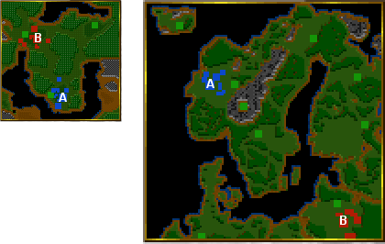
Tactics
Two `balanced’ tactics
Small Balanced Land Attack (SBLA)
Large Balanced Land Attack (LBLA)
Two `rush’ tactics
Soldier Rush (SR)
Knight Rush (KR)

Slide 25
Dynamic Scripting Test
Dynamic player (using dynamic scripting) plays 100 consecutive games against static player
Randomisation Turning Point (RTP): First game that dynamic player outperforms static player with 90% probability according to a randomisation test (Cohen, 1995)
Notes:
We pitted the dynamic AI against the 4 unchanging tactics and played a max of 100 consecutive games. We aborted a test as soon as we statistically can claim that the dynamic player is outperforming the opponent player. The first game in which the dynamic player outperforms the static player is called the RTP. If a RTP has been reached, we may say that the dynamic player successfully learned to beat its opponent. A low value for the RTP indicates good efficiency of dynamic scripting.

Slide 26
Dynamic Scripting RTP Results
Tactic | Tests | Low | High | Avg. | Med. | >100 | Won
SBLA | 31 | 18 | 99 | 50 | 39 | 0 | 59.3
LBLA | 21 | 19 | 79 | 49 | 47 | 0 | 60.2
SR | 10 |  |  |  |  | 10 | 1.2
KR | 10 |  |  |  |  | 10 | 2.3
Dynamic Scripting WORKS! It adapts efficiently against SBLA and LBLA
Dynamic Scripting is unable to adapt to the optimized tactics SR and KR
Notes:
From left to right, the table displays (1) the tactic used by the static player, (2) the number of tests, (3) the lowest RTP found, (4) the highest RTP found, (5) the average RTP, (6) the median RTP, (7) the number of tests that did not find an RTP within 100 games (therefore where the dynamic AI did NOT learn to adapt to static player), and (8) the average number of games won out of 100.
Conclusion 2: Terrible results. Part 2 of my thesis was to try and improve the performance against the two rush tactics. We choose to do that by improving the domain knowledge used by dynamic scripting.

Slide 27
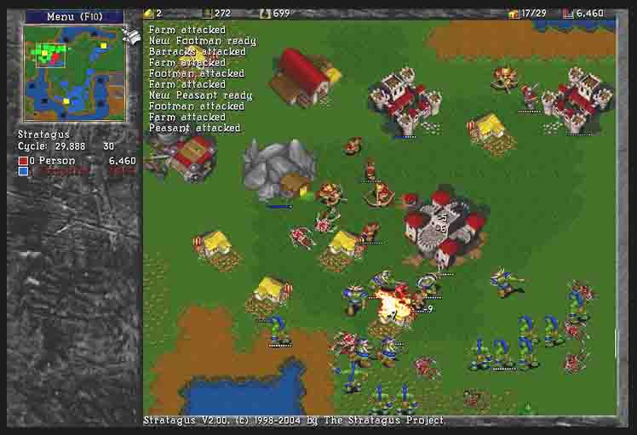
Wargus Demo

Slide 28
Solution 3.3: Evolutionary Computation
Dynamic Scripting was unable to cope with some tougher static opponents (Ponsen et al. 2004)
Can we increase the efficiency of Dynamic Scripting (i.e., speed up learning and win more games) by improving the domain knowledge?
Our proposed solution: revision of tactic library with evolutionary computation:
Semi-Automatic domain knowledge revision
Automatic domain knowledge revision
Now we are talking!

Slide 29
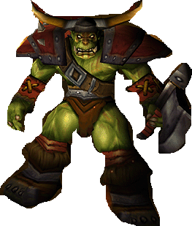
Semi-Automatic Improvement of Domain-Knowledge
Knowledge
Base
Training script 1
manually designed tactic library
manually improved tactic library
Adaptive
Game AI
Performance Evaluation
Compete against static scripts
Training script 2
Dynamic Scripting
Generate Script
….
Training script n
Counter Strategy 1
Counter Strategy 2
….
Counter Strategy n
Knowledge Base Revision
Manually Extract Tactics from Evolved Counter Strategies
Evolutionary Algorithm
Evolve Domain Knowledge

Slide 30
Evaluation Semi-Automatic Approach
Benefits
Evolved tactics can be used to improve domain knowledge used by adaptive AI (Ponsen et al. 2004)
Dynamic scripting converged to solution (i.e., learns to win) two times faster against medium-skilled opponents
Overall 40% more games are won
Limitations
Time consuming
Domain knowledge not optimal (due to human factor)
Strong tactics not recognized in evolved scripts
Inferior tactics added to knowledge base
Notes:
Domain knowledge not optimal >> Dynamic Scripting didn’t learn a winning strategy against several strong opponents
To overcome the last 2 problematic points we also evaluated an automatic approach.

Slide 31
Automatic Knowledge Acquisition for Dynamic Scripting (AKADS)
Knowledge
Base
Adaptive
Game AI
Training script 1
automatically generated tactic library
Training script 2
….
Training script n
Dynamic Scripting
Generate Script
Counter Strategy 1
Counter Strategy 2
….
Counter Strategy n
Knowledge Base Revision
Automatically Extract Tactics from Evolved Counter Strategies
Evolutionary Algorithm
Evolve Domain Knowledge

Slide 32
Evolutionary Computation
Idea: Biological analogy on how populations of species evolve over generations
Step 1: start with a population (each member is a candidate solution)
…
Step 2: Create the next generation by considering evolutionary operations on the population from the previous generation (e.g., mutation) and a fitness function (only the more fit get to contribute to the next generation)
…
Continue the process until a certain condition is reached

Slide 33
Evolving Domain Knowledge
Input: training scripts
Manually designed scripts
Dynamic or evolutionary scripts
Output: chromosomes representing candidate solutions (i.e., winning counter-strategies)

Slide 34
Chromosome
Full game
script
command

Slide 35
Automatically Extracting Tactics
Use states to distinguish tactics in chromosome!
All genes grouped in a specific state constitutes a tactic that will be inserted into the corresponding knowledge base

Slide 36
Genetic Operators
State Crossover
Gene Replace Mutation
Gene Biased Mutation
Randomization
Notes:
May leave this one out.

Slide 37
Evaluation of Automatic Approach
Benefits
Less time consuming compared to other approaches (knowledge base automatically generated)
Qualitatively better domain knowledge compared to semi-automatic improved knowledge base:
Overall 15% more games are won
Converged to solution (i.e., learns to win) two times faster against medium-skilled opponents
Dynamic Scripting learned to cope with strong opponents
Limitations
Danger of knowledge base over fitting
Notes:
David: p18 is insufficient: Detailed slides are missing on the formal hypothesis being investigated, the empirical methodology, the analysis method, and the results.
Hector: Do you want to say something about the experimental setup?
David, Hector: I can add more details on the experiments, but that would require at least 3 more slides. The presentation as it is already takes 25 minutes. Also, wouldn’t discussing the exp. Setup be a bit too technical (explaining RTP, experimental run, DS learning parameters etc.) ? I prefer not to discuss that in too much detail, but I can give it a shot here anyway.
formal hypothesis: can we improve performance of DS by automatically generating a KB compared to a manually designed KB?
the empirical methodology: test DS against a set of static opponents and measure RTP points and number of games won.
Analysis method: compare RTP and win/loss data of DS with semi-automatic generated KB with automatic generated KB.
Results: these are discussed here, but only in text and not in a table.
Hector: can you be more precise on the results ("more": 20%?, 30%?)
Done.

Slide 38
Conclusion
Game AI has used only a fraction of the AI techniques
We talked today about strategy games but principles such as state abstraction, learning, heuristic evaluation can be applied to many game genres: racing games, sport games, FPS
We have seen a few examples of fielded applications in games
The potential is there
Notes:
David: There's no final summary slide that would contain a "takeaway message".
That was the purpose of this slide. Is this not appropriate or sufficient?

Slide 39
References
Ponsen, M. and Spronck, P. (2004). “Improving Adaptive Game AI with Evolutionary Learning.” Computer Games: Artificial Intelligence, Design and Education (CGAIDE 2004). pp. 389-396. University of Wolverhampton.
Spronck, P., Sprinkhuizen-Kuyper, I. and Postma. E. 2004. “Online Adaptation of Game Opponent AI with Dynamic Scripting.” International Journal of Intelligent Games and Simulation, Vol. 3, No. 1, University of Wolverhampton and EUROSIS, pp. 45–53.
Ponsen, M., Munoz-Avila, H., Spronk, P., Aha, D. (2007) Knowledge Acquisition for Adaptive Game AI. To appear in: Science of Computer Programming. Special Issue on Computer Games. Elsevier.
Ponsen, M., Munoz-Avila, H., Spronk, P., Aha, D. (2006) Automatically generating game tactics with evolutionary learning. To appear in: AI Magazine. AAAI Press.
Ponsen, M., Munoz-Avila, H., Spronck, P., and Aha, D. Automatically Acquiring Domain Knowledge For Adaptive Game AI Using Evolutionary Learning . Proceedings of the Seventeenth Innovative Applications of Artificial Intelligence Conference (IAAI05-05). AAAI Press.

