Slide 1
RECAP
CSE 348 AI Game Programming
Héctor Muñoz-Avila

Slide 2

Course Goal
A
C
C
B
B
C
B
A
A
B
A
C
B
C
A
B
C
B
A
C
A
B
A
C
B
A
C
A
A
C
B
C
B
C
B
A
A
AI
research
B
C
“AI”
as game practitioners implemented it
(me)
Our goal was to understand the connections and the misconceptions from both sides
projects
(you)
keywords

Slide 3
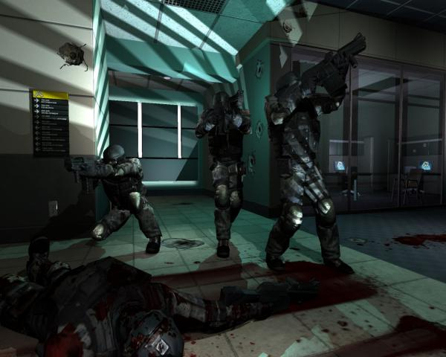
Controlling the AI Opponent: FSMs
FSM: States, Events and Actions
Stack Based FSM’s
Polymorphic FSM
Multi-tier FSM
Goal-based
Patrol
  Preconditions:
  No Monster
  Effects:
  patrolled
Fight
  Preconditions:
  Monster in sight
  Effects:
  No Monster
Attack
E,~D
FSM:
~E
Robocode
Monster In Sight
Wander
~E,~S,~D
D
E
Chase
S,~E,~D
E
S
Patrol
Fight
E
~S
D
~E
Spawn
D
Planning Operators
D
S
No Monster
A resulting plan:
Soldier
Monster in sight
No Monster
Rifleman
Machine Gunner
Officer
Fight
Patrol
patrolled
American
German
American
German
American
German
British
Soviet
British
Soviet
British
Soviet
Scripting

Slide 4
Controlling the AI Opponent: Hierarchical Planning
Hierarchical FSM
Hierarchical planning
Attack
UT task: Domination
Wander
~E
Strategy: secure most locations
Pick-up
Powerup
E
~S
Chase
S
Spawn
Turn Right
Start
D
UT action: move Bot1 to location B
~E
Go-through
Door

Slide 5



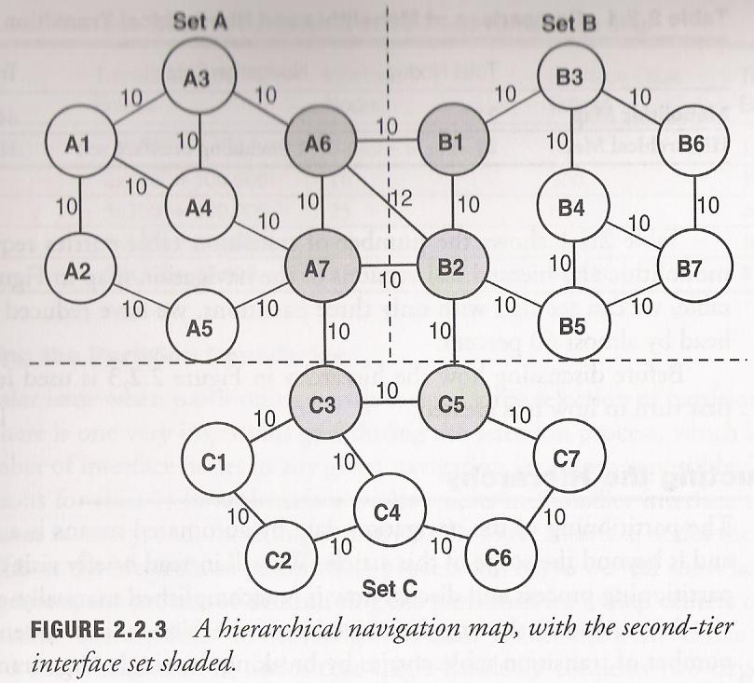
Path-Finding
A*: heuristic search
PACMAN
    Navigation
    Navigation set hierarchy
Depth (Breadth First) | Nodes | Time | Memory
2 | 1100 | 1 sec | 1MiB
4 | 111,100 | 11 sec | 106 MiB
6 | 10⁷ | 19 minutes | 10 GiB
8 | 10⁹ | 31 hours | 1 TiB
10 | 10¹¹ | 129 days | 101 TiB
12 | 10¹³ | 35 years | 10 PiB
14 | 10¹⁵ | 3,523 years | 1 EiB
Interface tables
Reduction memory
Increase performance

Slide 6
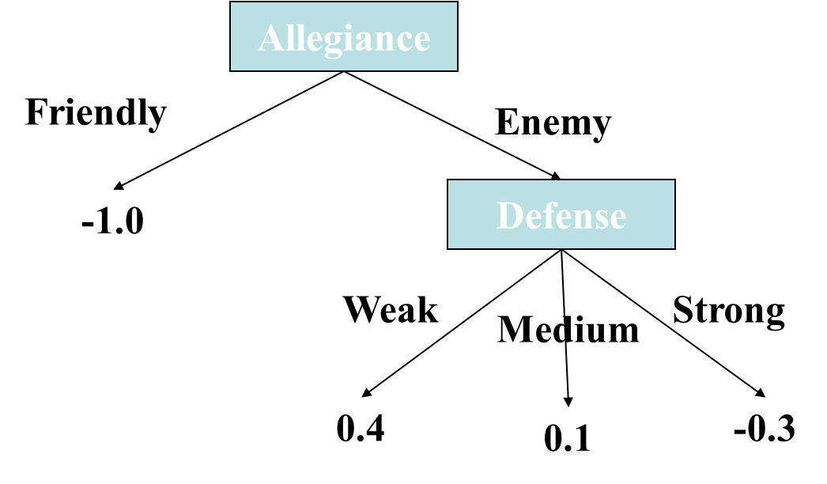




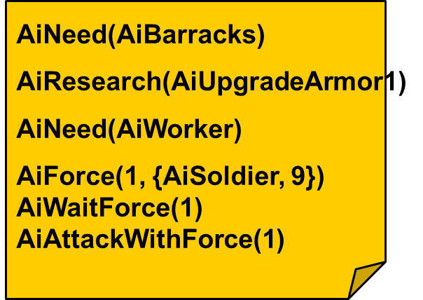
Controlling AI Opponent: Learning
Induction of Decision Trees
Dynamic Scripting
Evolutionary computation
Reinforcement Learning
team controlled
team controlled
Training script 1
b
y computer
by human player
Training script 2
A
….
Training script n
Combat
B
Counter Strategy 1
Counter Strategy 2
….
Counter Strategy n
Knowledge Base Revision
Manually Extract Tactics from Evolved Counter Strategies
Evolutionary Algorithm
Evolve Domain Knowledge

Slide 7
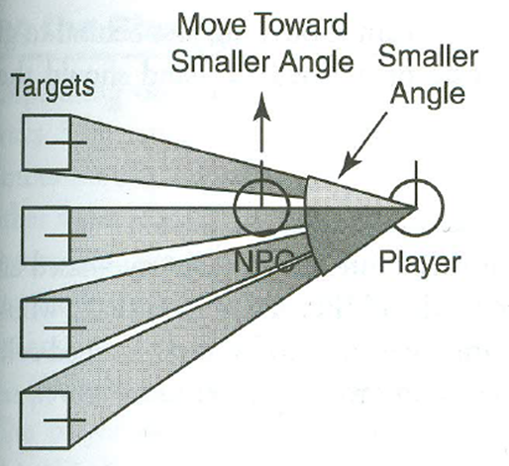
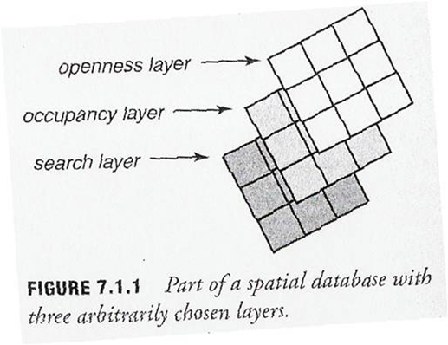
Game Genres: FPS
Squad Tactics
Individual Behavior
Heuristics for LOS issues
Supporting player
decentralized vs centralized
Influence maps
Genetic programming for adapting to opponents
Divided into four major components: animation, movement, combat, and behavior
Spatial Analysis: line of fire
Tactical positioning: cover
(Jon Hardy, Michael Caffrey, Shamus Field)
(Matt Mitchell, David Pennenga,
John Formica)

Slide 8
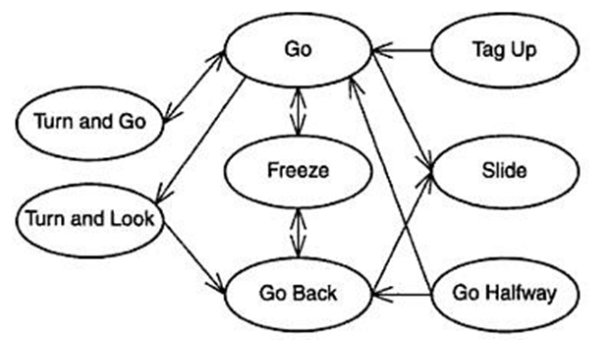
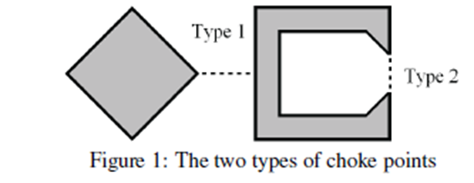
Game Genres
Wargus
Sport Games
Event-driven (using FSMs)
Issues: cheating, Rubber band AI
Difficulty level: +stats for NPCs
Racing games:
  Splines
  Obstacle avoidance – simple math
  Using ML for driving control
  Sport commentary
RTS
Managers
  Civilization
  Build
  Unit
  Resource
  Research
  Combat
Difficulty levels
Goals and priority lists
Terrain analysis
(Alex Dulmovits, Luis Villegas)
(Daniel Phillips, Dan Ruthrauff)

Slide 9
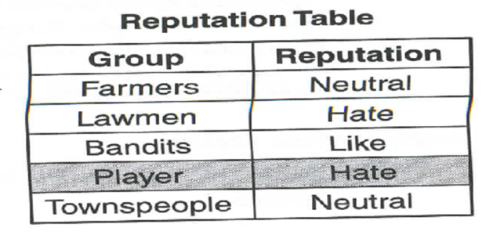
Game Genres
Role Playing Games
Rich history but prevalent elements: exploration, combat (stat based), leveling
Scripting vs Goal based
Level of detail
Reputation system: area based
Side quests
Story line
(Josh Westbrook, Ethan Harman)

Slide 10
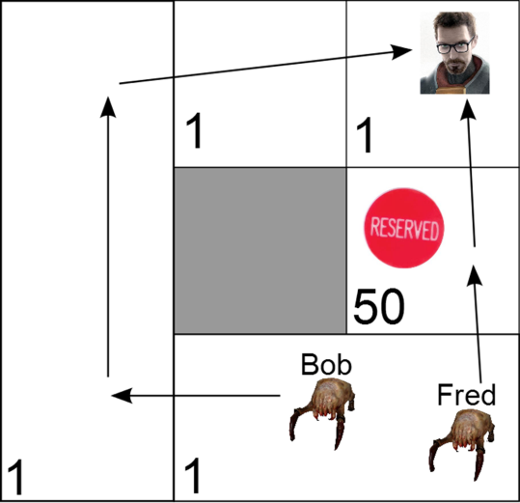
Other Crucial Topics
NPC Behavior
  Requirements: believable
  Scripted vs, autonomous
  Human traits: Dependency
  Path reservation
  Reputation system
  Ideal NPC: act, moves, responds “naturally”
(Daniel Phang & Sui Ying Teoh)

Slide 11
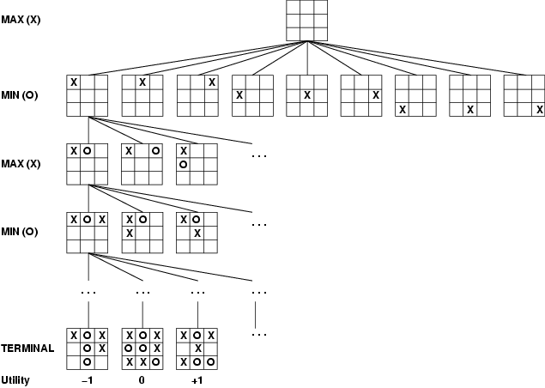
Other Game AI Topics
Game Trees
Programming Projects
  Finite State Machines
  RTS
  Space simulation
  Pathfinding
  Simulate some of the real game-developing conditions:
    Working with someone else’s code
    tight deadlines
    need lots of trial and error to tune the AI
  Used to determine game difficulty
With appropriate evaluation functions avoid needing to construct the whole tree
EF(state) = w₁f₁(state) + w₂f₂(state) + … + w_{n}f_{n}(state)

Slide 12
2012 Hall of Fame
Project # 1. Robocode.
Tournament winner and Innovation winner: Phang, Daniel W., Teoh, Sui Ying).
Project # 2. Pathfinding.
  Tournament winner: Mitchell, Matthew M., Pennenga, David J., Formica, John M.
Project # 3. Space Simmulation
  Tournament winner: Mitchell, Matthew M., Pennenga, David J., Formica, John M.
Project # 4: Wargus
  Tournament winners:
  Mitchell, Matthew M., Pennenga, David J., Formica, John M.
    Use farms to create choke points
    Advance resource collection
    Set patrols as resource gathering units move forward
    Griphons and Mages

Slide 13
Acknowledgements
All of you:
  Presentations were very good
  Projects worked well (despite difficulties)
  James Ahlum: Pathfinding
  Jon Schiavo: Space simulation
  Yisheng Tang: Robocode and Wargus

Slide 14
Final Summary
Programming
  Finite State Machines
  RTS
  Space simulation
  Pathfinding
Genres
  First-person shooter
  Real-time strategy
  Racing games
  Team sports
  Role-playing games
A
C
C
B
B
C
B
A
A
B
A
C
B
C
A
B
C
B
A
C
A
B
A
C
B
A
C
A
A
C
B
C
B
C
B
Path finding
  Look-up tables
  Waypoints
A
A
AI
research
B
C
A*
AI Planning
  HTN Planning
Heuristic evaluation
Machine learning
  Decision Trees
  Reinforcement learning
    Dynamic scripting
  Evolutionary comp.
Game trees
“AI”
as game practitioners implemented it
Other crucial topics
  NPC behavior
    Individual
    Team

