Slide 1
Robocode
CSE 348 - AI Game Programming

Slide 2
Installation
http://robocode.sourceforge.net/

Slide 3
First robot!
A simple robot can be written in just a few minutes - but perfecting a robot can take months or more
You have two weeks!

Slide 4
Work in Eclipse
First add jars from “C:\robocode\libs\”
Add VM arguments:
-Xmx512M -Dsun.io.useCanonCaches=false -Ddebug=true
-Xmx512M: tells the Java VM that Robocode can use up to maximum 512 MB RAM
-Dsun.io.useCanonCaches=false: to prevent SecurityExceptions to occur when robots try to access a file
-Ddebug=true: tells Robocode that it should not give you skipped turns just because you paused robot in debugger

Slide 5
Work in Eclipse 2
Add a robot project from another IDE into Robocode
Select Preferences from the Options menu, select the Development Options tab
Useful shortcut
Ctrl+space : invoke the content assistant
Ctrl+shift+G : find references in workspace
Ctrl+shift+T : open type
Ctrl+T : Open hierarchy
Drop to frame : re-enter the currently stack frame
Skip All Breakpoint

Slide 6
Frames and ticks
tick = turn
The gun turns at 20 degrees per tick.
The radar turns 45 degrees per tick.
You can control the frame rate. If too fast, you will miss some frames of animation. This won't affect the robots' behavior
During one turn, you may perform one action as a Robot, or multiple (independent) actions as an AdvancedRobot

Slide 7
Rules.java
http://robocode.sourceforge.net/docs/robocode/robocode/Rules.html

Slide 8
Basic
Body
Gun
Radar

Slide 9
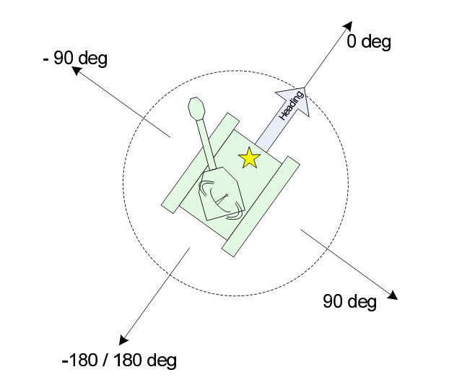
Basic
0
1.5*Pi 0.5*Pi
Pi
Coords. are (x,y), with bottom left as (0,0)
robocode.Robot.getX()
robocode.Robot.getY()
Heading: degrees, straight up = 0, pos. clockwise (0 <= heading <= 360)
Note that the heading in Robocode is like a compass, where 0 means North, PI / 2 means East, PI means South, and 3 * PI / 2 means West.
Bearing: relative angle from your heading, pos. clockwise (-180 <= bearing <= 180)
Hitting a wall or another bot ends turn

Slide 10
Move
Maximum speed of 8.0 units/tick
Accelerate at 1 unit/tick, decelerate at 2 units/tick.
For example, if you are moving at an speed of 8.0 and reverse your direction your velocities will be [6.0, 4.0, 2.0, 0.0, 1.0, 2.0, 3.0, 4.0, 5.0, 6.0, 7.0, 8.0].
The faster you go, the slower you turn.
See: robocode.Rules.getTurnRate(double)
Turn rate in degree: 10 - 0.75 * abs(velocity)

Slide 11
Energy
You lose energy when:
hit a wall
max(abs(velocity) * 0.5 - 1, 0) damage.
hit an robot
0.6 damage
hit by an bullet
4 * bullet power + 2 * max(bullet power - 1 , 0)
you fire your gun
equal to the power of the bullet fired
You get energy when:
Your bullet hit other robot.
collect back 3 * bullet power energy
moving forward hits an opponent robot (ramming)
1.2 energy points

Slide 12
Energy (Disabled)
You can't kill yourself, so when your energy drops to zero because you hit a wall or you fire, your bot gets disabled.
Another case in which you can get disabled is throwing an exception, which may disable your bot, even if you catch the exception.

Slide 13
Bullet physics
Bullet power: 3.0~0.1
Bullet speed:11.0 ~19.7
velocity = 20 - (3 * power).
bullet velocity is not affected by robot velocity
Heat & cools down
heat: 1 + (firepower / 5)
cools down: 0.1 per turn(default)
you can fire a 3.0 power bullet every 16 ticks

Slide 14
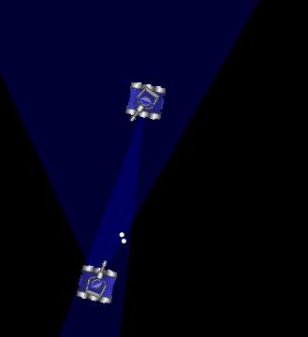
Radar

Slide 15
Radar
http://robowiki.net/wiki/Radar
Radar is mounted on gun
setAdjustRadarForGunTurn(true);
setAdjustRadarForRobotTurn(true);
The radar scans robots up to 1200 units away.
The closest bot is detected first, while the furthest bot is detected last.
By default, the onScannedRobot() method is the last one to be triggered each tick.

Slide 16
Events
ScannedRobotEvent－When the radar scanned another robot
HitByBulletEvent － When your robot is hitted by bullet
HitRobotEvent －When your robot hit another robot
HitWallEvent －when your robot hit the wall

Slide 17
Robot, AdvancedRobot & TeamRobot
AdvancedRobot is a more advanced type of robot than Robot that allows non-blocking calls, custom events, and writes to the filesystem.
TeamRobot gives robot the tools to distinguish friend from enemy, as well as communicate with their teammates.

Slide 18
Advices
Friendly Fire!
Please Use AdvancedRobot
Artificial Intelligence
Be a Team

Slide 19
Further reading
http://en.wikipedia.org/wiki/Robocode

Slide 20
Hope you enjoy Robocode!

