Slide 1
Announcements
Special lecture on game development for mobile devices
  e.g., cellphones
Online conversation with a Lehigh alumni who is a mobile games developer
  But only if the class is interested
  Homework for next class:
    Email to the instructor two well-thought questions to ask
    For each question explain briefly why it is an interesting question

Slide 2
The Design Process
Assigned readings:
  Preface, Chapters 1 & 2, Lord Rings
Disclaimer: I use these notes as a guide rather than a comprehensive coverage of the topic. They are a substitute neither for attending the lectures nor for reading the assigned material
Dr. Héctor Muñoz-Avila

Slide 3
Two Notes
In class we will cover part of the assigned chapters and some topics not in the book
  You are responsible for the assigned chapters + topics covered in class
The book take on game design can be controversial at times
  We will disagree with the book from time to time
  We can be critical based on your own experience
    After all you are “gamers”
However, the book presents a way of thinking about the process of designing games
  describes a theory for aesthetics of game design and a conceptual framework for this topic
When is a game “cool”?

Slide 4
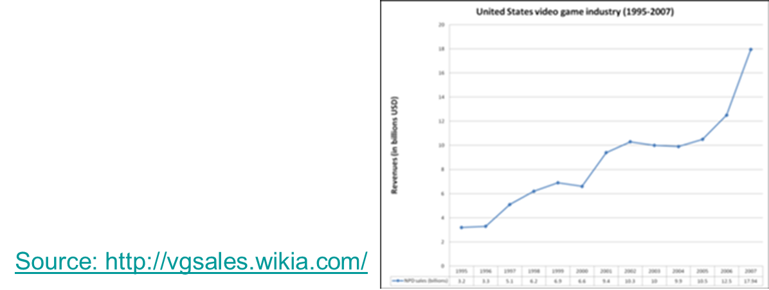
Game Design: preliminaries (1)
Games: have been there for a long time
  Think: Chess (2BC?)
But only with advent of computer technology more attention has been given to game design
  For no small reason because of revenue!
Current state of the art:
  “build a cathedral with a tooth brush”
Two aspects of complexity:
  Internal structure of the game
  Player experience
    The “forgotten” aspect
      Game can be boring

Slide 6
Game Design: preliminaries (2)
A general conceptual framework is need. Or does it?
Do you see any benefits of such framework?
  Sure: we can gain insight and understanding
  There is a sense of “boundless potential”:
    Which contrast to the reality of what it is on the market
  What kind of potential? (examples)
    High-level cognition and rapid response at the same time
    Open ended, collaborative
But where are games that explore these possibilities?

Slide 7
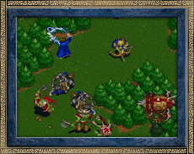
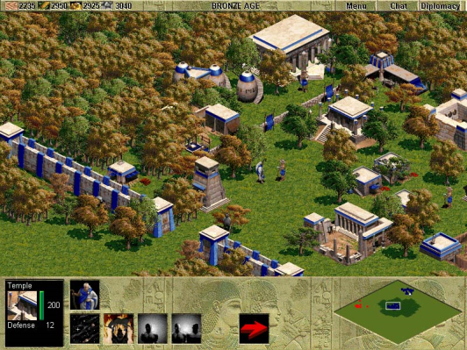
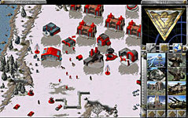

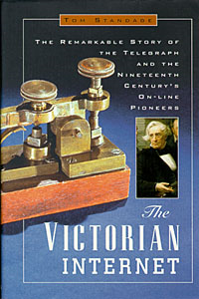

Game Design: Preliminaries (3)
A lot of creativity is put into many aspects of game design
  But a lot of repetition too
Big gap between what can be done and what it is usually done
  Analogy between interactive systems today and mechanical systems in Victorian time
  When you think outside of the box:

Slide 8
The Pong Game
Pong is a very simple game inspired in Ping-Pong
Since its inception in 1972 was a big hit and continues today
Why people like to play Pong?
  Simple to play
  Social
  Every game is unique
    - Controversial issue: control versus openness

Slide 9
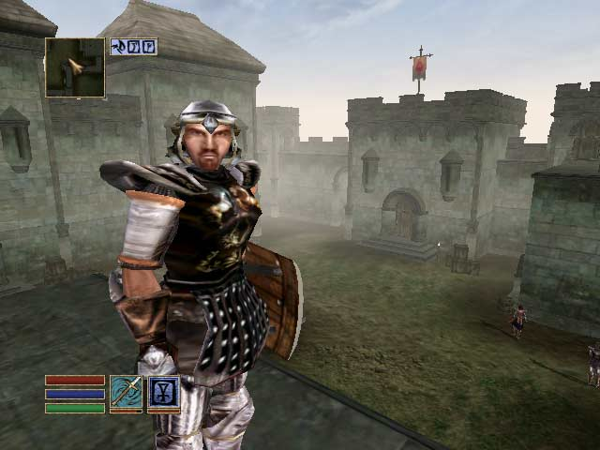
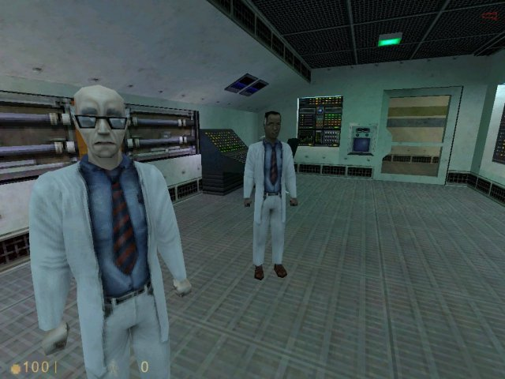
Side Track: Control versus Openness
Half-Life
Morrowind
Lets discuss advantages and potential drawbacks

Slide 10
Game Design
Game designer focuses on:
  Game play
  Internal structures (e.g., rules)
  Expected player experience:
    How games evoke emotional-intellectual responses from players
Game design is not game development
  Although at points difference is unclear
Lessons we learned from game design can be applied to interactive systems more broadly
  Example: Intelligent Tutoring Systems

Slide 11

What is a Game?
Two definitions:
  Games are everything
  Games are an interactive storytelling medium
Here we try to give multiple points of understanding
  A different example: Design of a kettle
War games, economy games, …
    Size
    Weight
    Shape
    Cost
    Material
    Color
    Intended use!

Slide 12
Game Design Schemas and Fundamentals
Schema: a way of framing and designing knowledge
Primary schemas for game design:
  Rules: logic of the game (Chess)
  Play: experience with the game (F.E.A.R)
  Culture: context of the game (Monopoly)
Factors of game design fundamentals include:
  Interactivity (of the game, but also social interaction)
  Player choice, action and outcome
    Even in a highly-scripted game like Half-life players have choices, which?
  Rule-making and rule-breaking

Slide 13
Iterative Design
Designing by experiencing things made
Iterative design is a play based design process
  Playtesting and prototyping
  Prototype defines fundamental rules and core mechanics of game
Why is iterative design so important?
prototype-test common in non electronic games
  less so in digital games → results in many problems
  Because it is not possible to fully anticipate play apriori
  Think the Trespasser example

Slide 14

Prototyping
Doesn’t have to be fully automatic
Doesn’t have to include final graphics/arts
But it is more than an slideshow!
  This is why we are not going to design a game “on paper”
Typically, commercial games are pre-defined by a large spec-document…
  … which becomes obsolete when game is developed
  Play of a game always surprise its creators
  Let your self be surprised and be flexible!
There are companies well-known for testing and re-testing

Slide 15

Lord of the Rings Board Game
Note: predates the movies
Author: Reiner Knizia
Team play: 4-5 players
Main board and four scenario boards
Player: who am I? what I try to achieve? main choices? how to win?
sets of action and resource cards.
The outcome of action determines how close you move to the shadow and Sauron on the Main board.
You must keep the ring bearer from being captured by Sauron
Role-playing game (RPG)

Slide 16
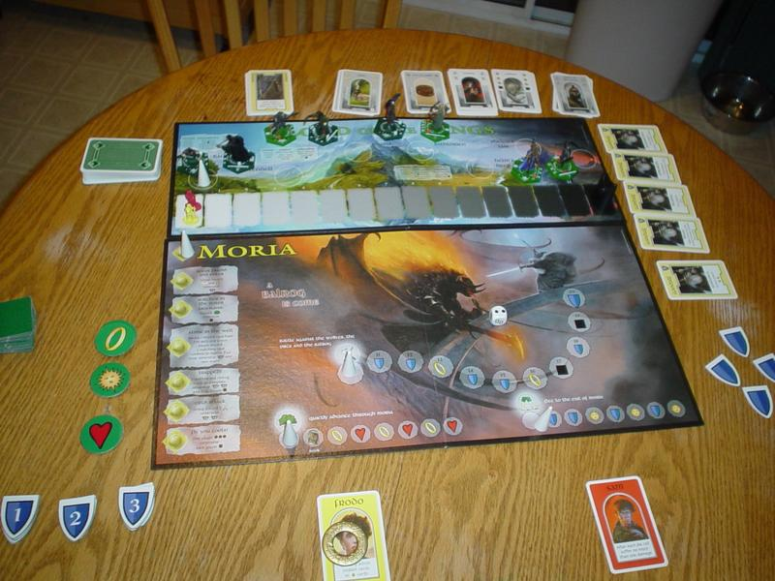

Slide 17





Lord of the Rings Board Game
Designer studied storyline in detail
Neat idea: not forcing collaborative play but stimulating it
  Examples in other games?
Game must be replayable multiple times
Another idea: designer want to entice players to do side-quests
  Examples in other games?
Shields give bonus when completing scenarios and quests
Problem: they want Gandalf but that may create game imbalance
  Solution: Gandalf deck with cards that can be bought with shields

