Slide 1
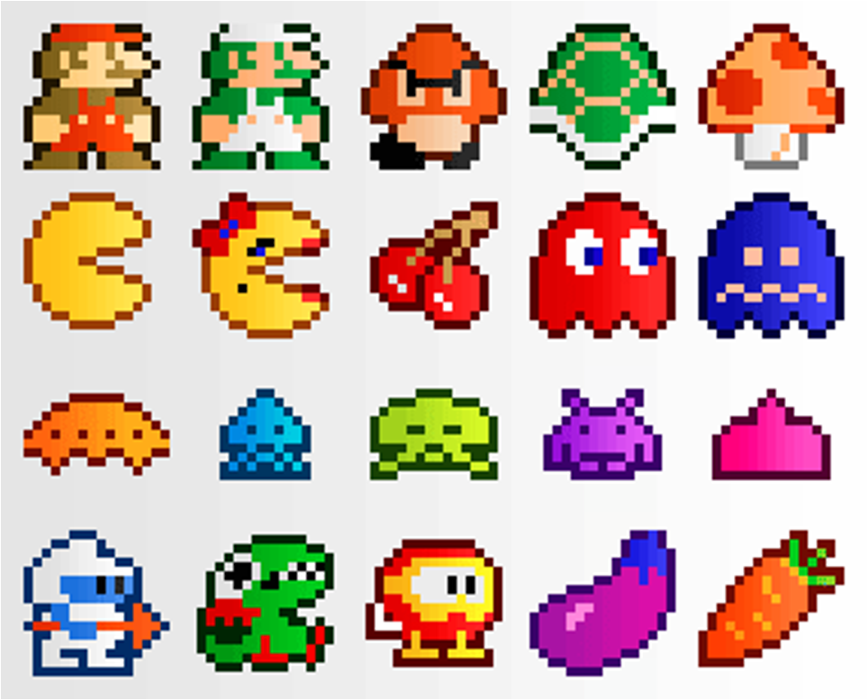
Game Development
Daniel Phang (dwp313@lehigh.edu) September 6, 2013
CSE 42

Slide 2
A bit about me
Currently doing an M.S. in computer science
Focus on AI, game programming
Graduated in computer engineering last year
Mobile app experience
Interactive app for children (research)
Android game using libGDX (in progress)
Game experience
Mostly Dota 1 & 2, WC3
Scripted and created WC3 maps

Slide 3
Overview
You’re all studying game design
But more from a theoretical view
I’ll be talking about game development
From a practical view
With a focus on mobile games
Can anyone tell me the difference?

Slide 4
Overview
Game design: focus on gameplay elements such as level design, mechanics, balancing
Game development: the process of making a game from start to finish. This includes planning, designing, programming, testing, publishing etc.

Slide 5
Why Game Development?
Impress your friends… and yourself.
Learn a useful skill
Awesome feeling when people love your game

Slide 6
Why Game Development?
Income!
Mobile app markets are very rapidly growing
Companies love creative designers and developers!

Slide 7
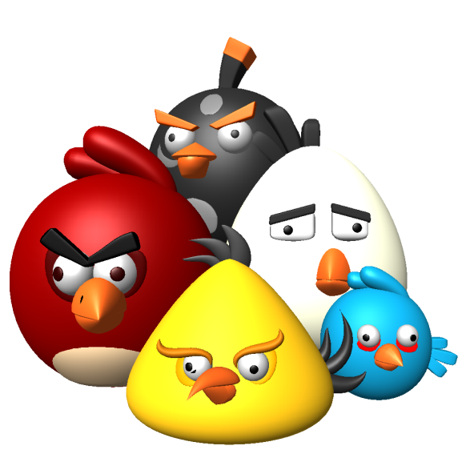
Planning/Designing a Game
It’s mostly an art
People love gameplay, eyecandy and visuals
User experience is important
Good games aren’t just about complex mechanics and gameplay
..but you should still learn good design (that’s why you’re here, right?)

Slide 8
Planning/Designing a Game
For mobile games:
Design for the mobile market
Users tend to like casual yet addicting games
Why is Angry Birds so successful?
Use mobile-specific user controls
Touchscreen, accelerometer, gyroscope
While fun, game genres that need virtual buttons are harder to play on phones

Slide 9
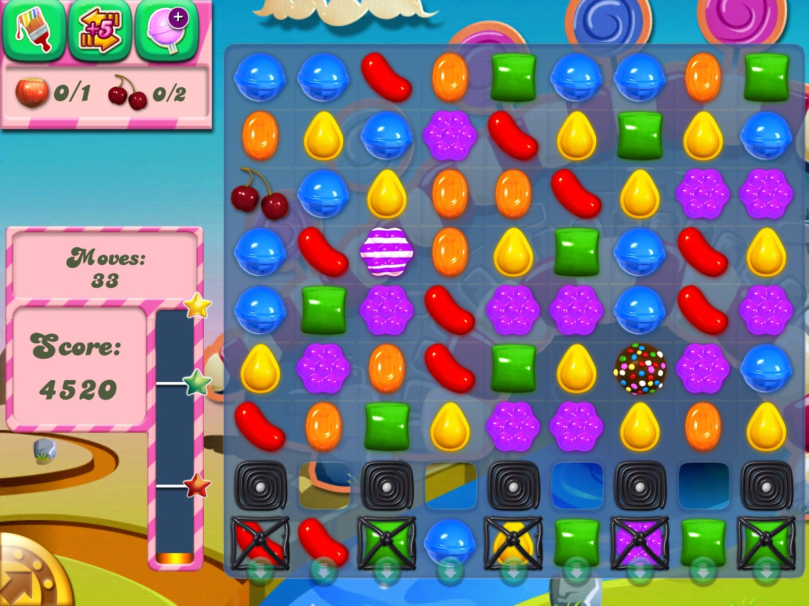
Good Design
All of you should know this game, because almost everyday there is that one friend who sends you a life request.

Slide 10
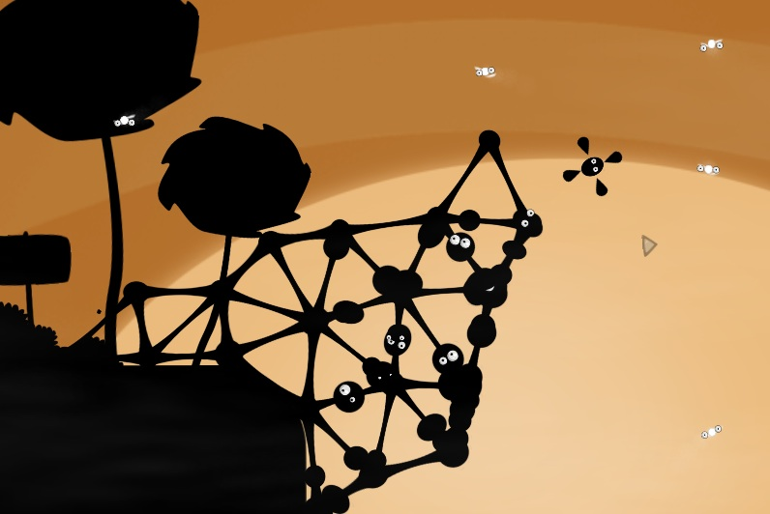
World of Goo
Intuitive
Creative visual effects
Candy Crush Saga
Addicting
New twist on old game

Slide 11
(Intentionally) Bad Design
http://www.ign.com/videos/2013/04/24/iphone-garbage-super-monster-bros-by-adventure-time-pocket-free-games

Slide 12
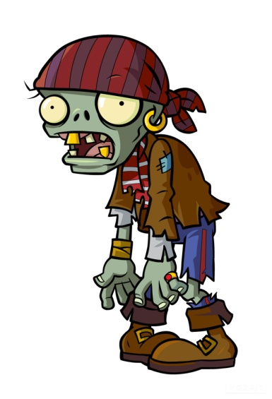
Implementing the Ideas
The harder part is actually implementing it
Fortunately, you don’t need to be good at programming!
You just need to be slightly creative
Many drag-and-drop tools available
+
=

Slide 13
GUI Tools
Very easy to learn
Intuitive, drag-and-drop interface
Built-in event scripting (remember your FSMs?), sometimes using its own language
Usually free to use and publish to some platforms
Desktop exporting is free
Licenses for Android/iOS publishing
To be fair, they both have lots of wavy lines and circles.

Slide 14
GUI Tools
Construct 2
HTML5-based
Only for Windows
Chrome Store, Facebook, Web, Windows 8 Metro
Game previews, powerful event system
JavaScript support

Slide 15
GUI Tools
GameSalad
Windows/Mac download, better for Macs
Free web/mac/iOS publishing
Slightly fewer updates & features than in Construct 2

Slide 16
Advanced Tools
If you want a challenge…
Create a game in a programming language!
Free, open-source, cross-platform frameworks available

Slide 17
Advanced Tools
Not for the faint of heart…
…but very rewarding
Very cool to show off in interviews, unlike that calculator program you made
Improve your programming skills!

Slide 18
Advanced Tools
LibGDX
Java language
Windows/Linux/Mac/iOS/Android/HTML5
Only iOS exporting needs a license

Slide 19
Advanced Tools
Monogame
C# programming
Windows/Linux/Mac/iOS/Android/Windows Phone 8
Android/iOS exporting needs a license

Slide 20
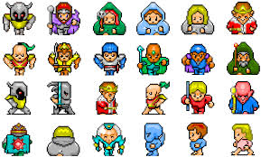
Help! I’m not artistic.
Many online resources available
Free art/sound/music
http://opengameart.org/
http://hasgraphics.com/free-sprites/
http://www.drpetter.se/project_sfxr.html
http://ccmixter.org/
http://www.newgrounds.com/audio/ (might have to ask authors first)

Slide 21
When it’s finally over…
Hard work, but rewarding
You’ll experience and learn good design
You’ll be frustrated when first implementing your game, but you’ll learn so much
You’ll learn what people like/dislike in mobile apps

Slide 22
A Few Tips
Find people with a wide range of talents! Artists, designers, musicians, programmers are all needed
Put your own style into your games
Experiment with new game mechanics
Don’t be afraid to start simple! Not all games have to be Blizzard-level to be fun
Have fun, and keep practicing!

Slide 23
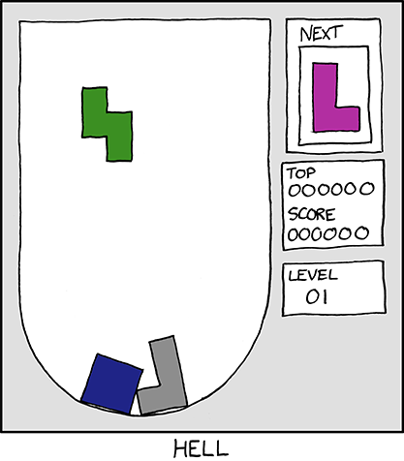
Lastly…
Please don’t do this, ever. I will hate you.
Hover text:
"There's also a Katamari level where everything is just slightly bigger than you, and a Mario level with a star just out of reach."

Slide 24
Thank you!
Questions?

